Slide 1
Visuals for USSO
1820s-1860s

Slide 2
Movements

Slide 3
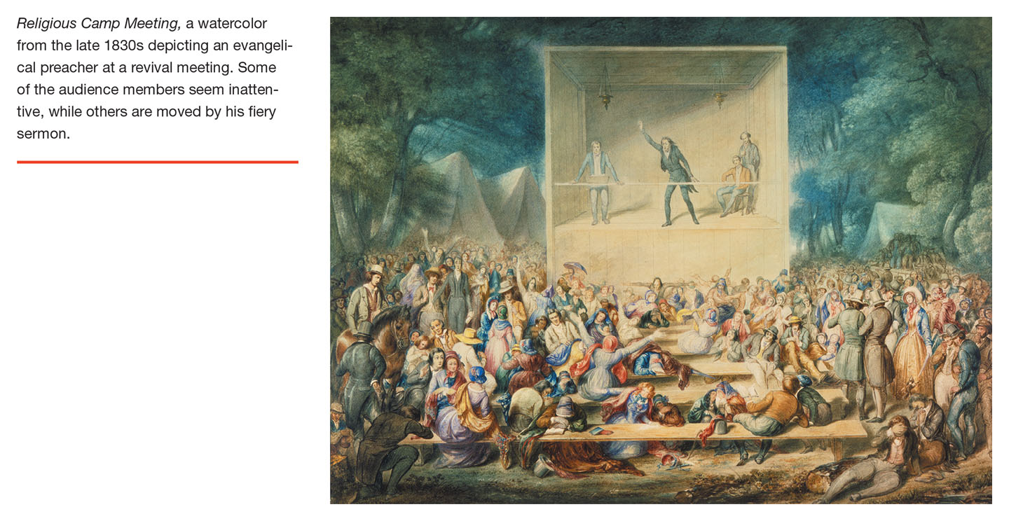
Post-1815 is a time of many movements – social, religious, cultural

Slide 4
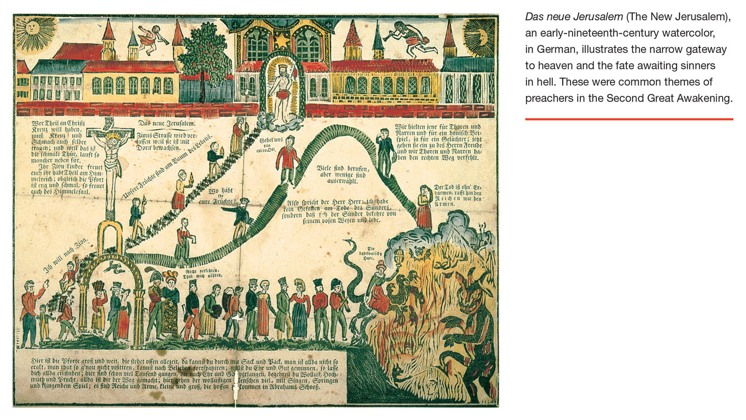
“Second Great Awakening” of Early 1800s

Slide 5
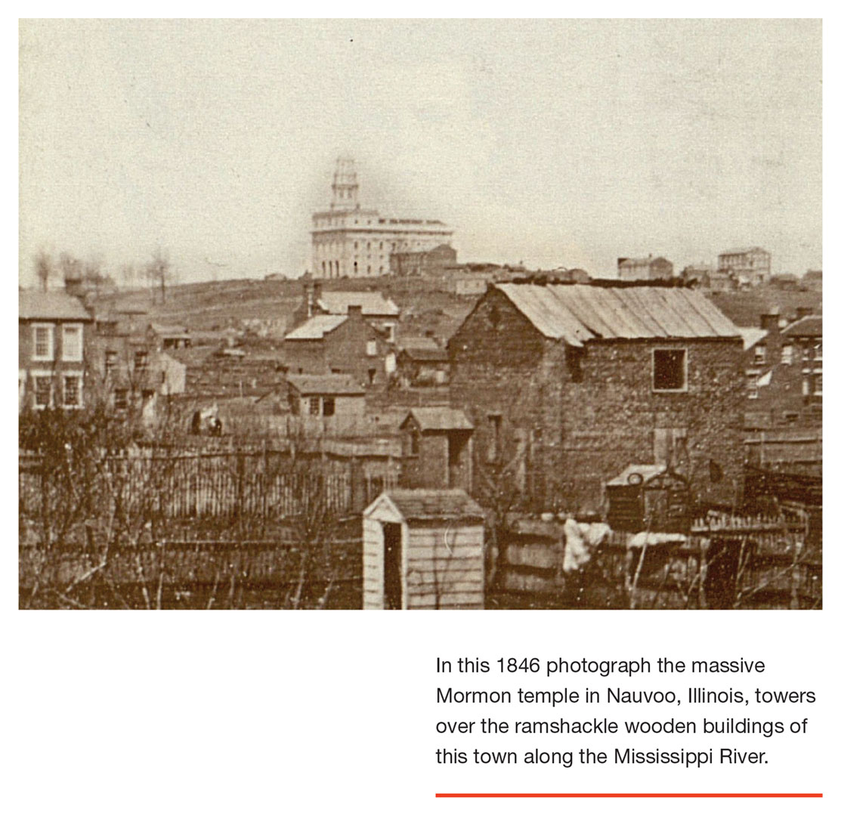
Church of Latter-Day Saints (Mormons) founded by Joseph Smith wanders as utopian-religious community from upstate New York through various locations where they tend to be unpopular – Joseph Smith is lynched in St. Louis - until they settle in Utah, where they displace the native population and almost establish an independent .state before joining the United States.

Slide 6
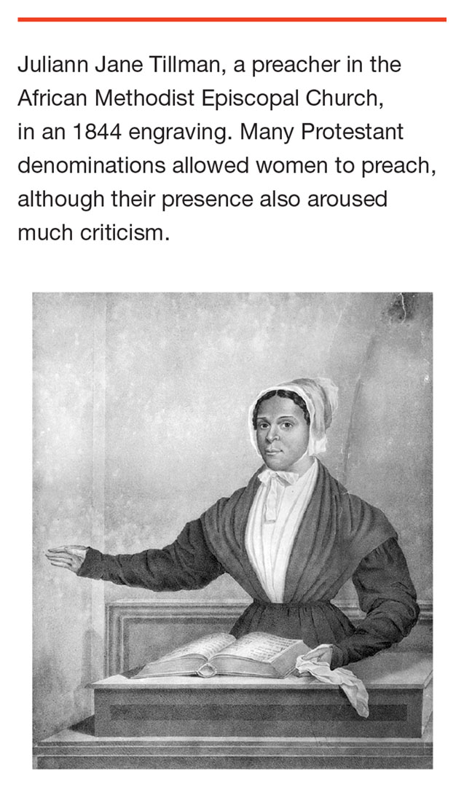
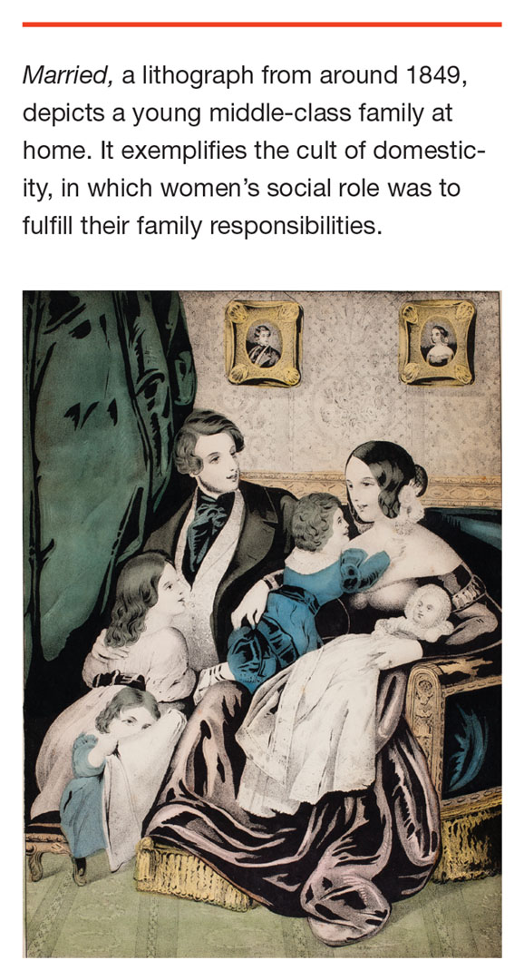
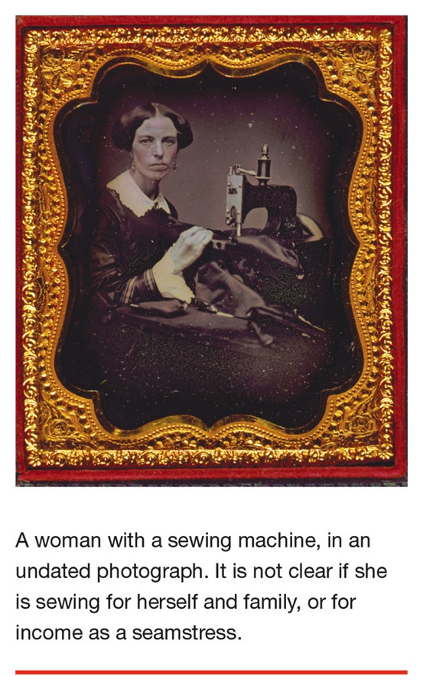

Slide 7
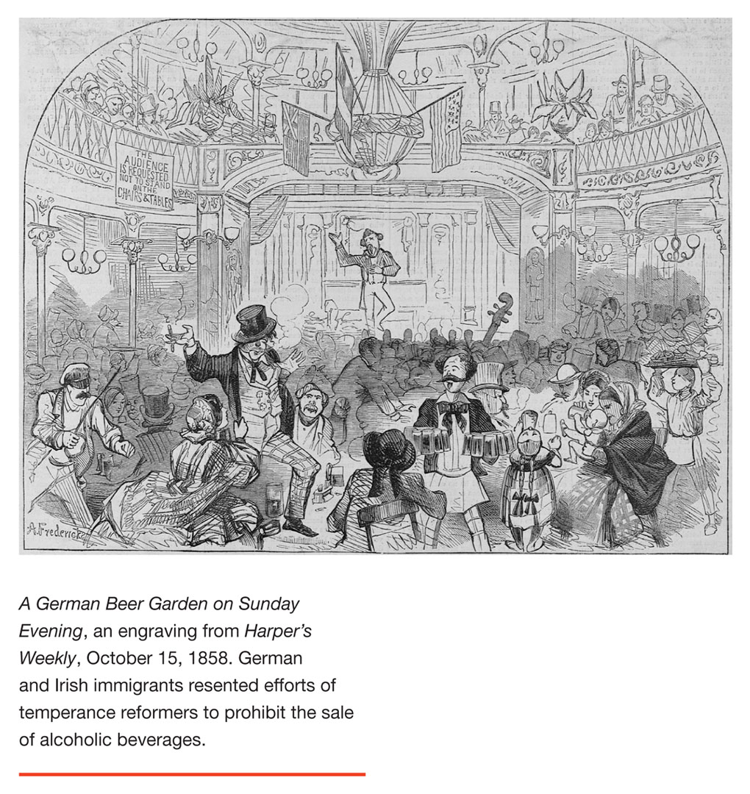
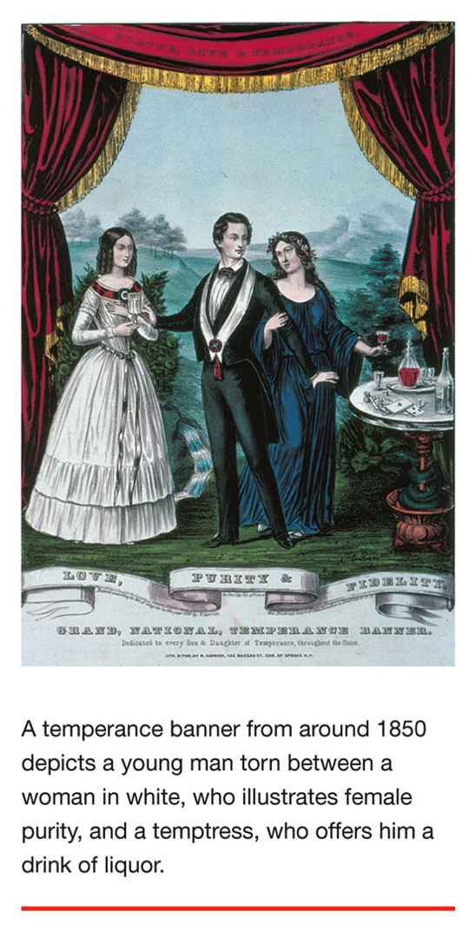
Temperance Movement

Slide 8
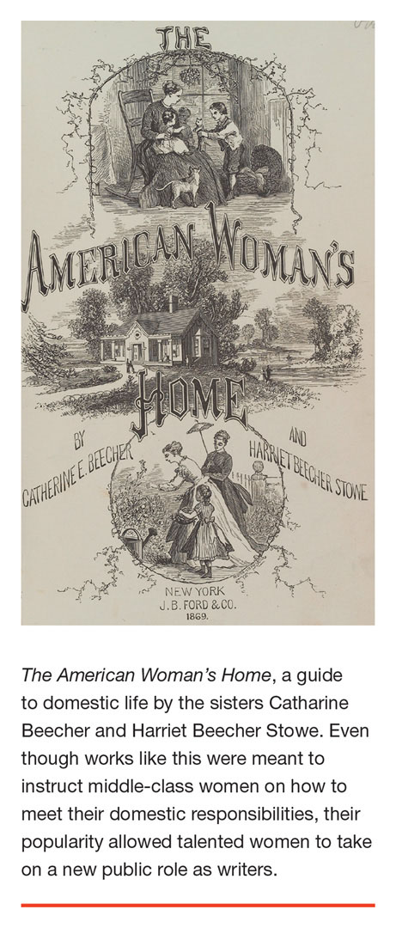
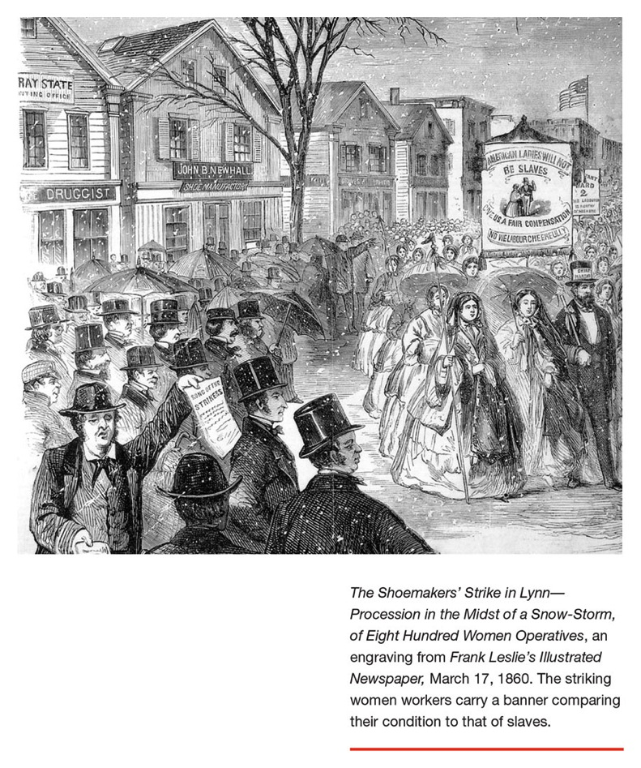
Women are the first industrial workers
& the first “modern” labor movement in U.S.

Slide 9
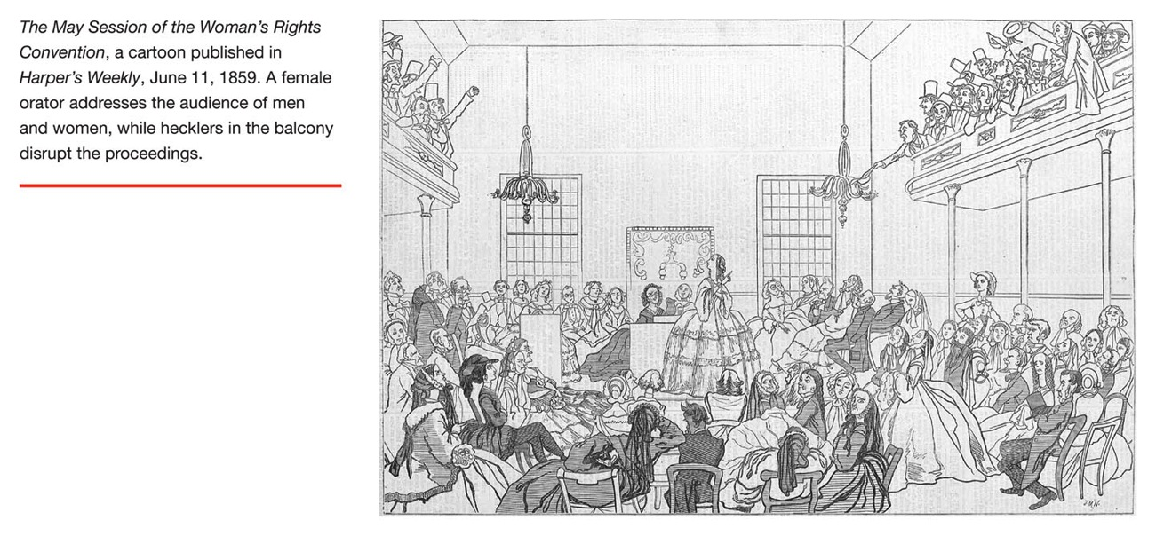
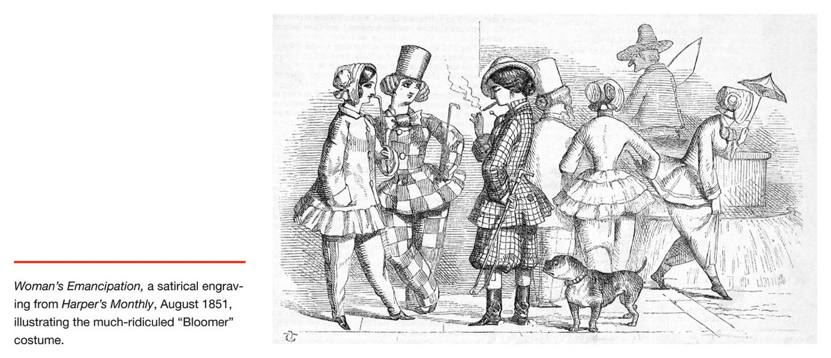

Slide 10
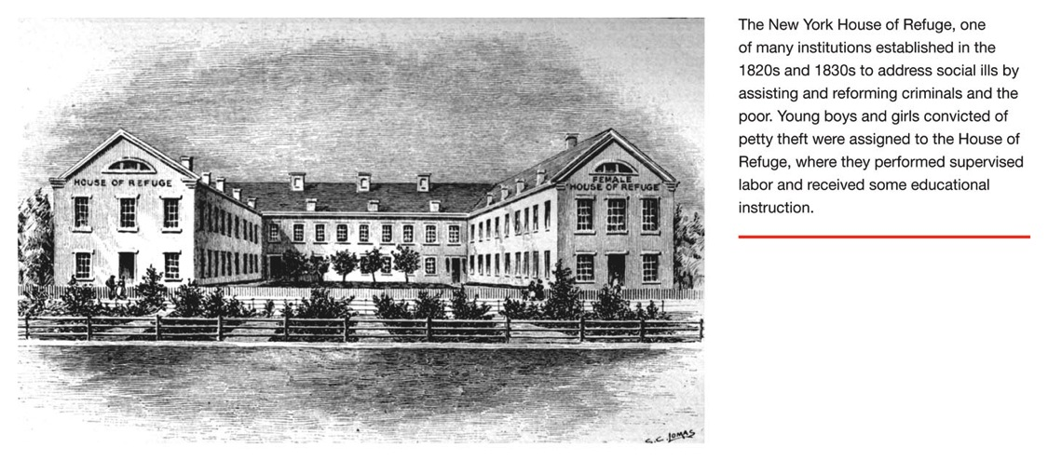
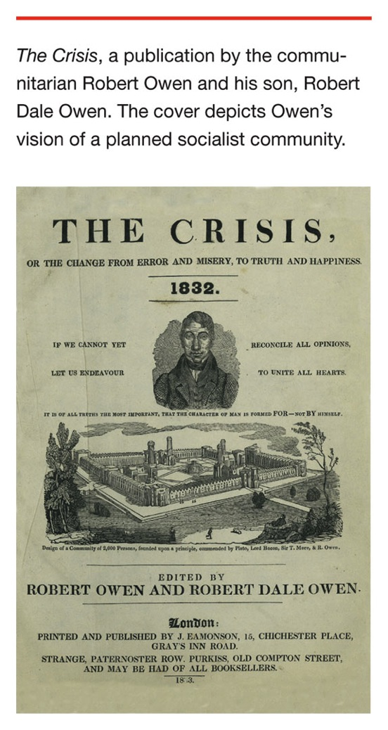
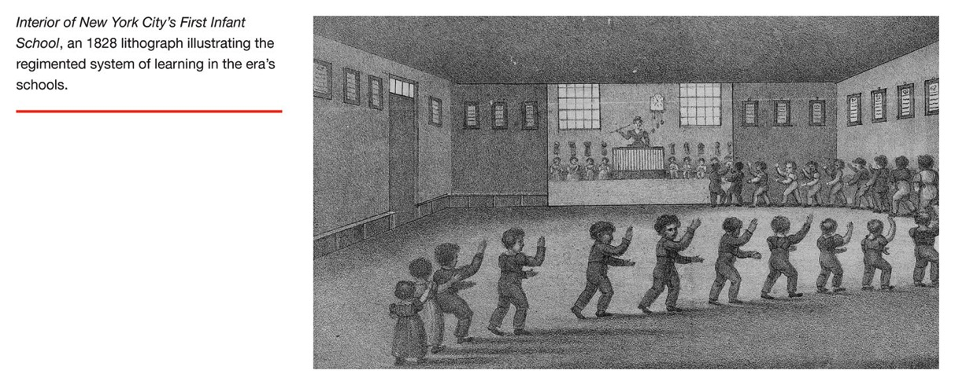
Penitentiaries, poor houses, asylums…
Utopian communities
Public schools…

Slide 11
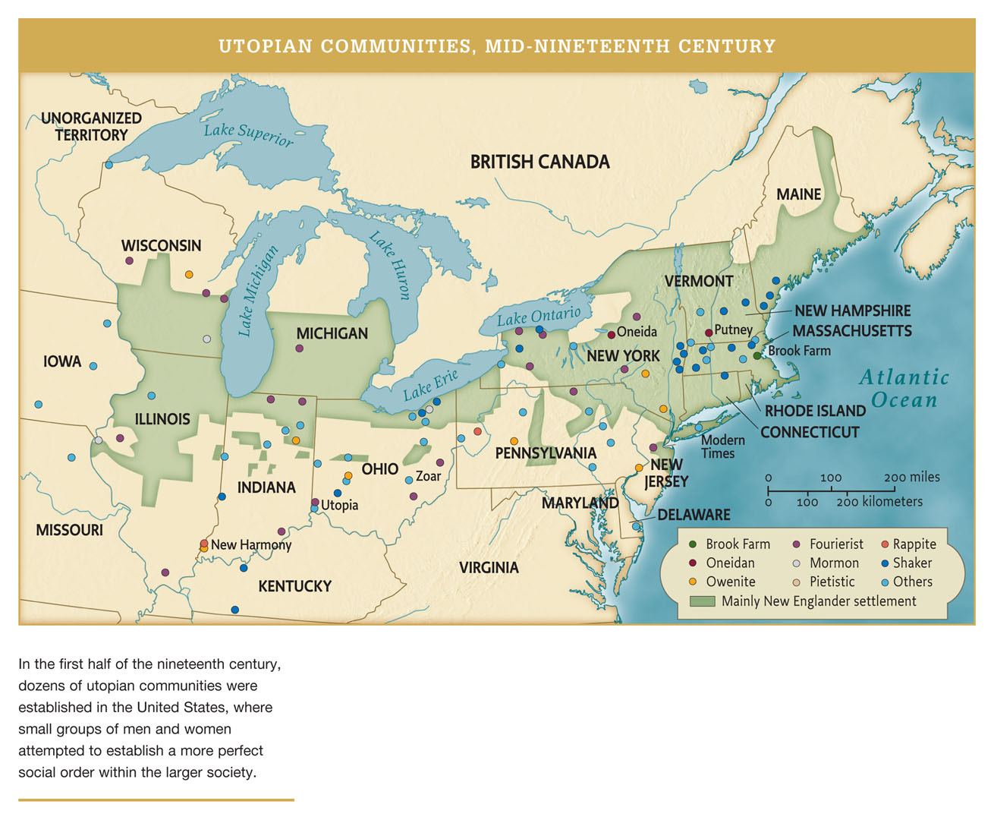

Slide 12
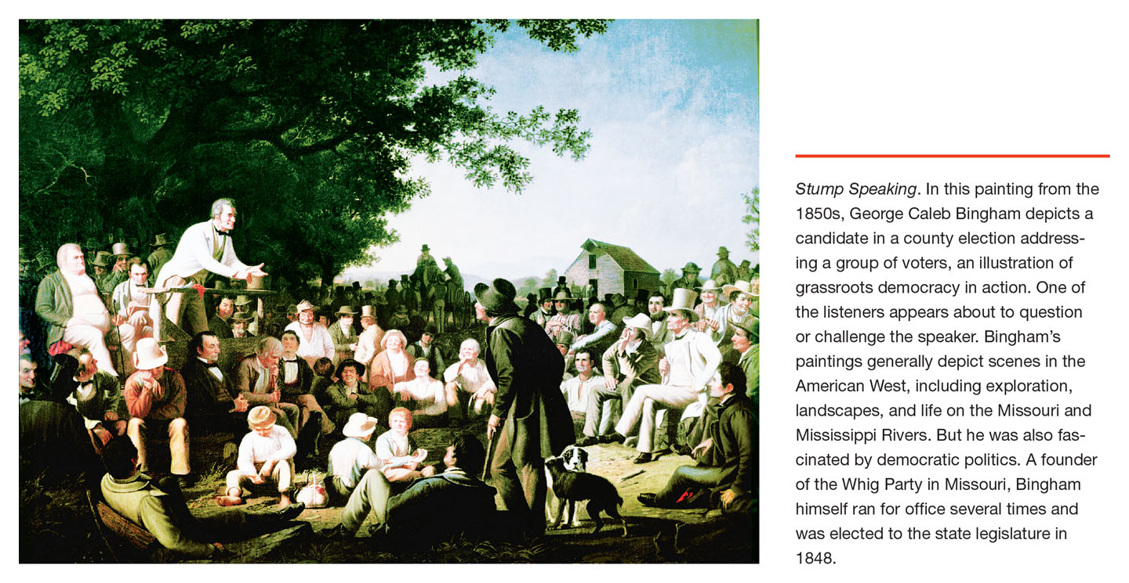

Slide 13
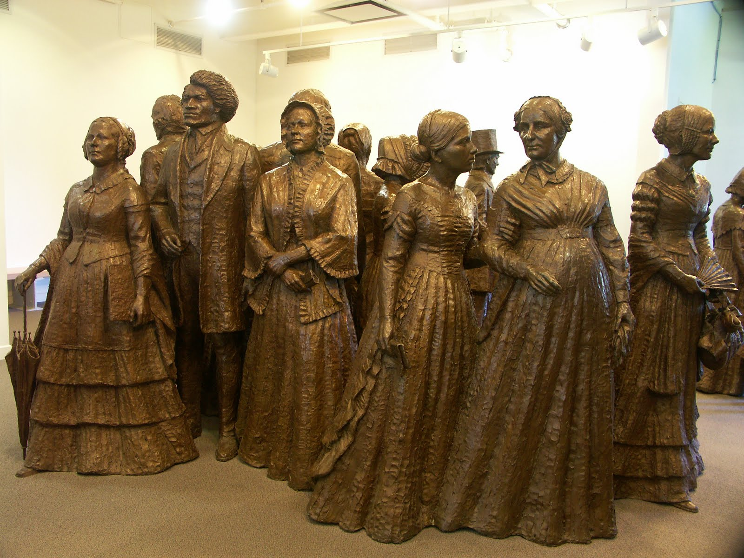

Slide 15
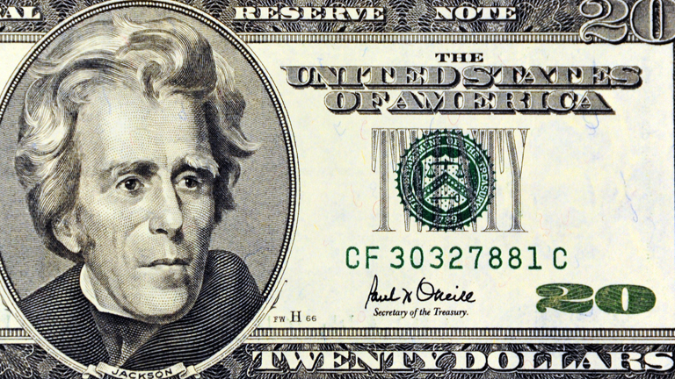
Jackson presidency (1828-36) is associated with democratic revolution – massive political participation among white men – also expansion of slavery and harsh times for Indians.

Slide 16
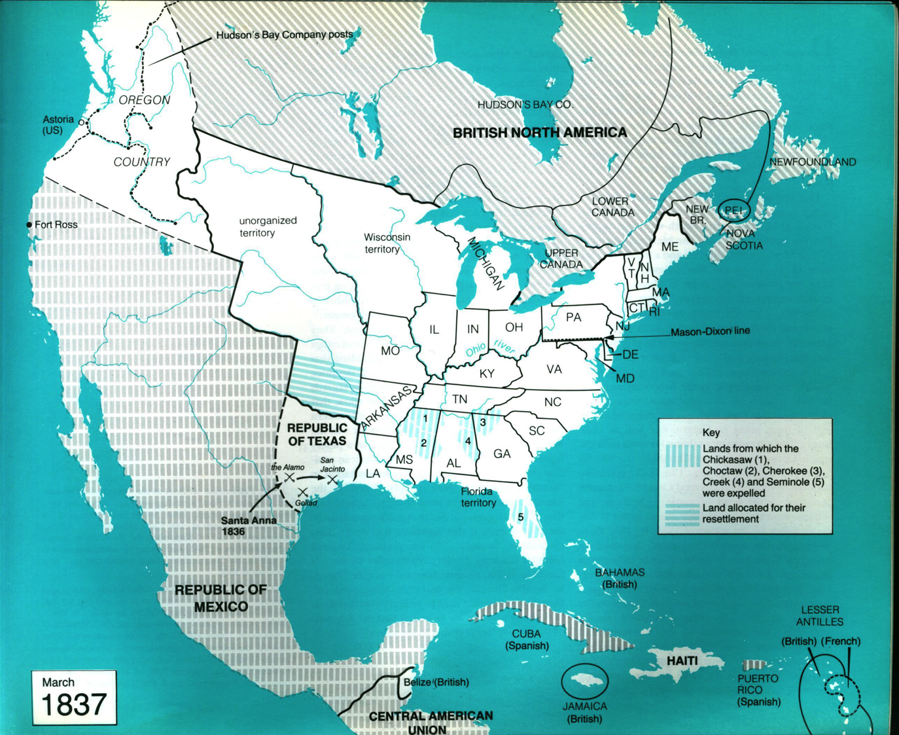
Under Jackson presidency (1828-1836), Indian Removal acts (1830-31) forced relocation of Cherokee and other tribes to Oklahoma (“Trail of Tears”)
Many more states chartered…
White settlers in Texas (some with slaves) declare independent Republic, win battles with Mexico, agitate for union with U.S.

Slide 17
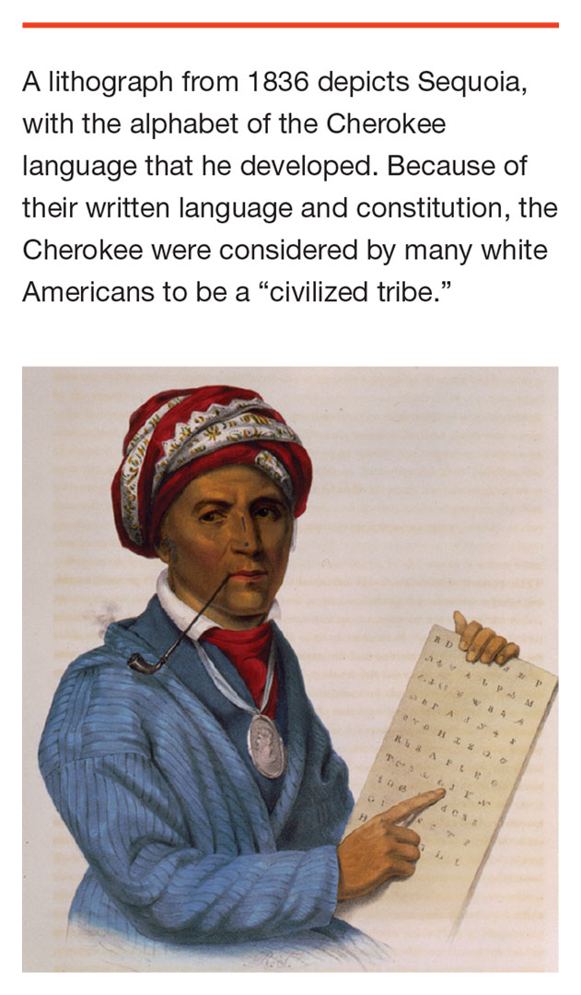
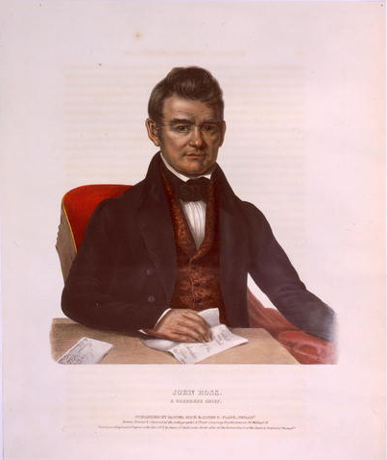
John Ross, Cherokee leader, argues against Indian Removal before Supreme Court, but court rules that it lacks jurisdiction.

Slide 18
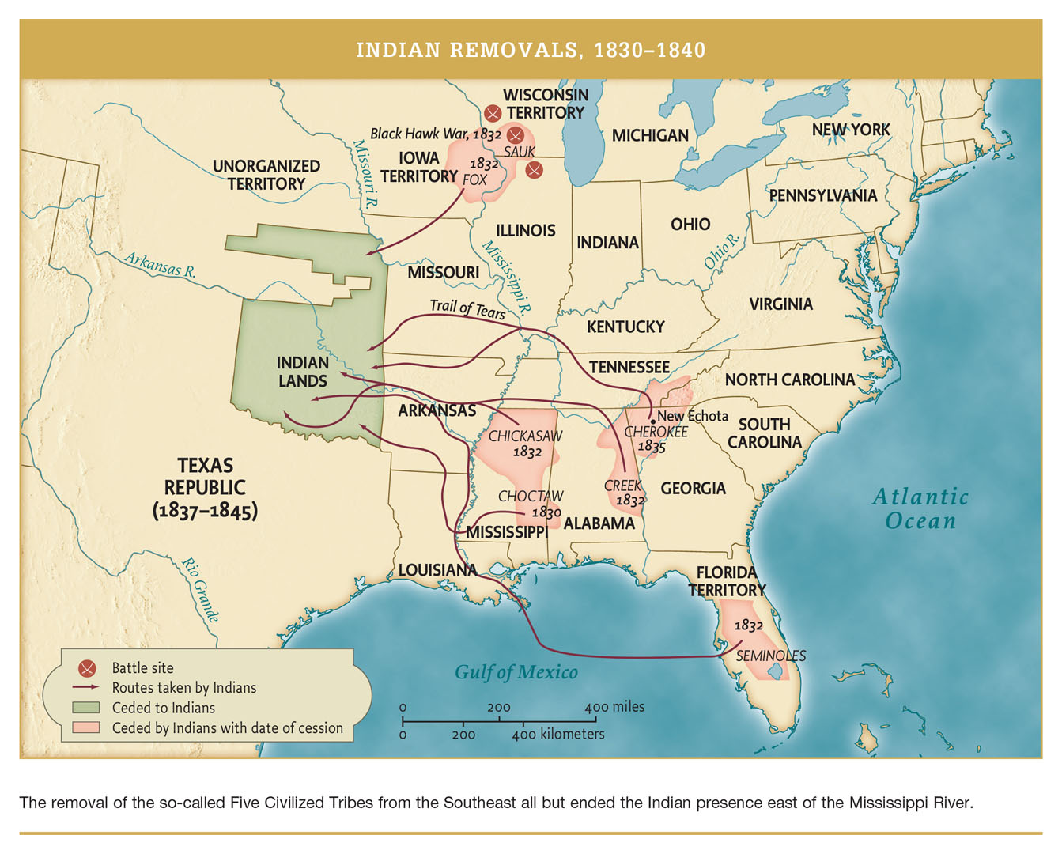

Slide 19
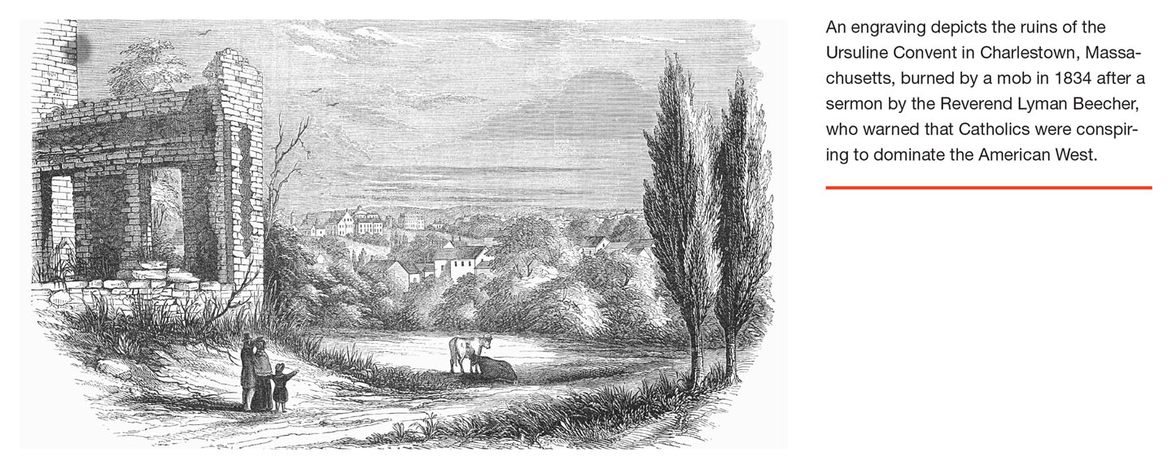
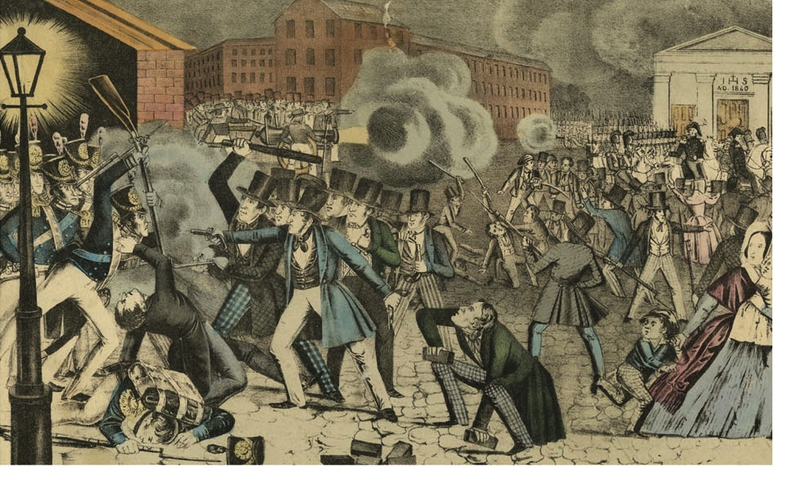
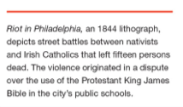
American “Nativism” against Catholics and Irish-German immigration…

Slide 20
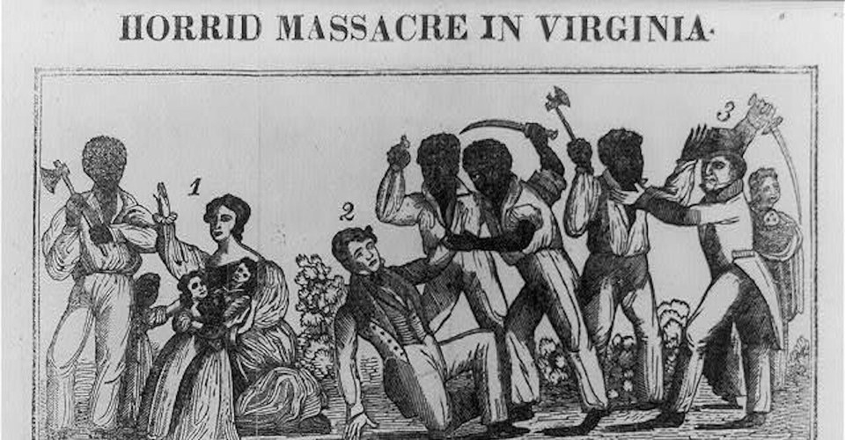
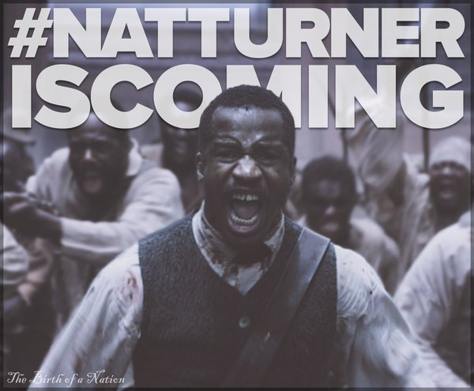
1831: Black preacher Nat Turner leads bloody slave revolt in Virginia – becomes big trauma for slave society.
Theaters Everywhere October 2016

Slide 21
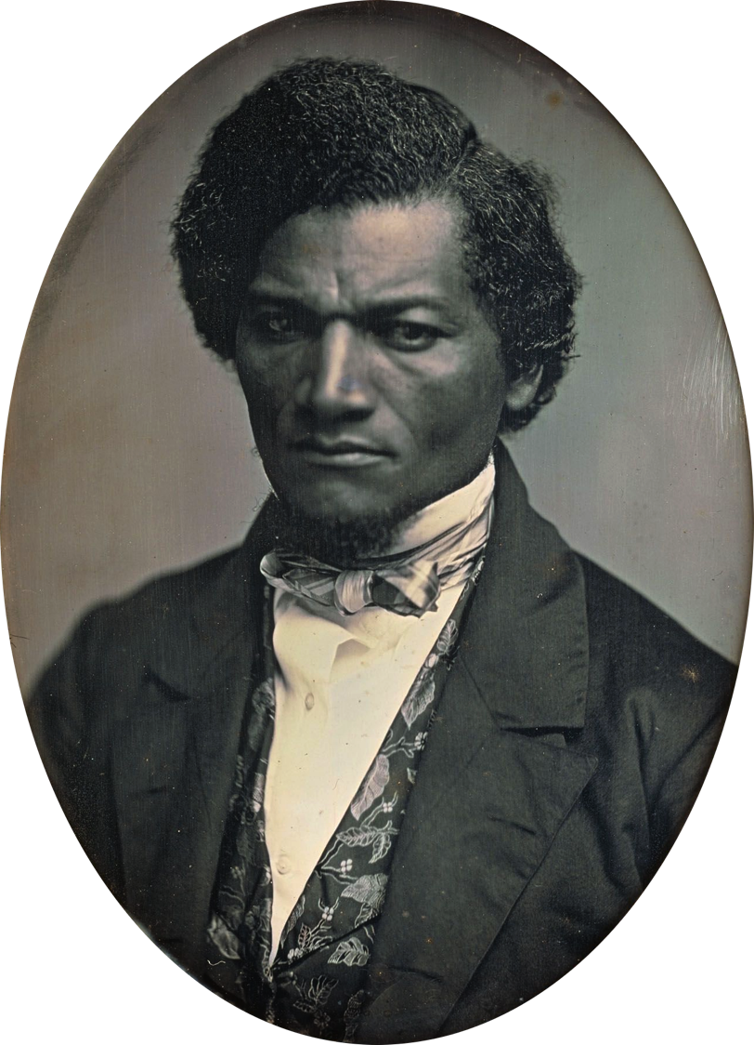
Frederick Douglass escapes slavery in 1838,
becomes an abolitionist leader…
I have often been asked, how I felt when first I found myself on free soil. And my readers may share the same curiosity. There is scarcely anything in my experience about which I could not give a more satisfactory answer. A new world had opened upon me. If life is more than breath, and the 'quick round of blood,' I lived more in one day than in a year of my slave life. It was a time of joyous excitement which words can but tamely describe. In a letter written to a friend soon after reaching New York, I said: 'I felt as one might feel upon escape from a den of hungry lions.' Anguish and grief, like darkness and rain, may be depicted; but gladness and joy, like the rainbow, defy the skill of pen or pencil.

Slide 22
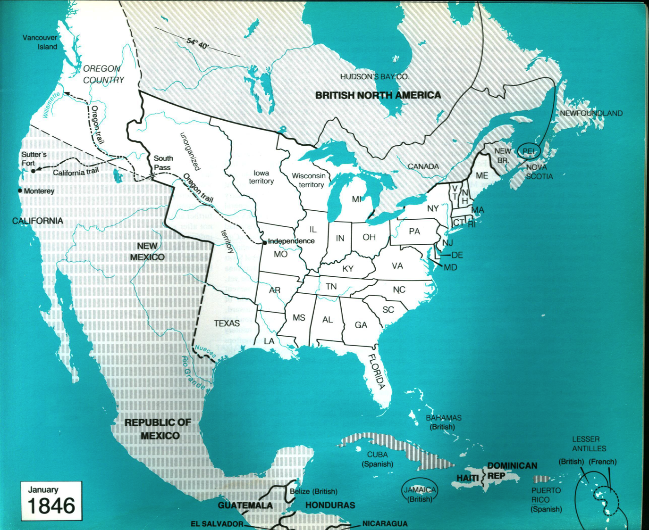
Era of
“Manifest Destiny”
1840s – Settlers moving into Oregon and California over “Oregon Trail.”
1844 – Polk elected on promise to expand country to west coast and claim Oregon and Canada up to 54-40 latitude.
Texas Republic is incorporated as a state (with slavery).
U.S. soon involved in war with Mexico…

Slide 23
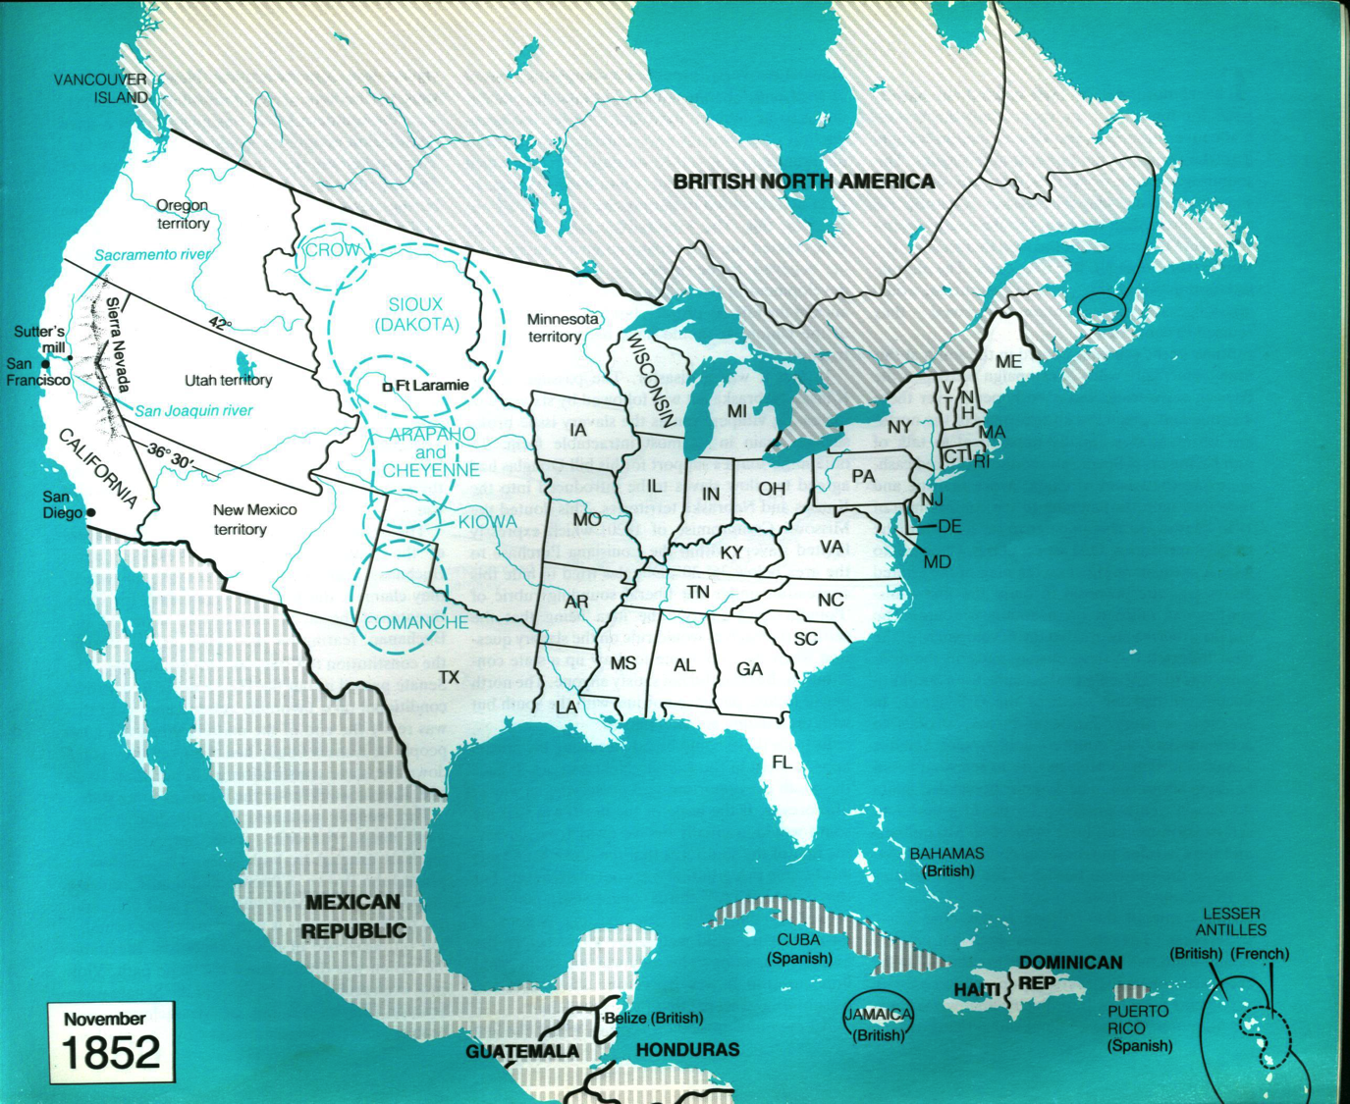
Westward Expansion
1848: Treaty with Mexico and settlement with British establish (almost) present-day United States borders. The West is open. The Plains Indians are the last independent tribes.
Gold in California: Thousands flood into territory in 1849. Its incorporation as a free state is seen by South as violating the 1820 Missouri compromise and sets off sequence of events that will lead to Civil War.
Question: Where will the railroad route be?

Slide 24
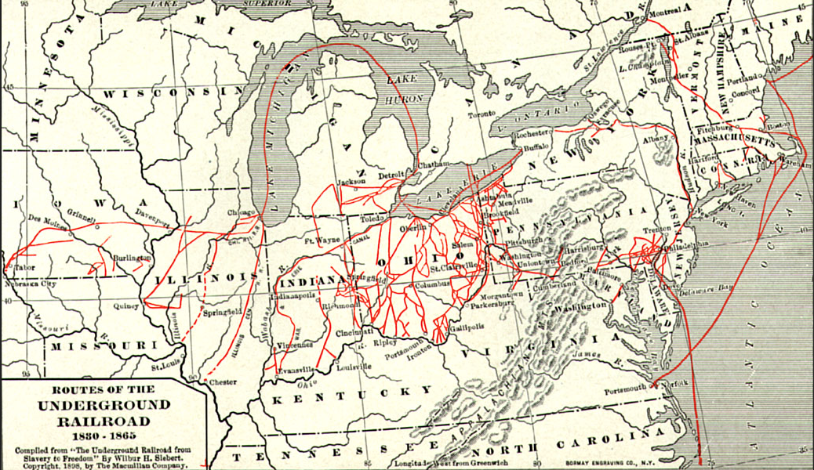
A Different Kind of Railroad

Slide 25
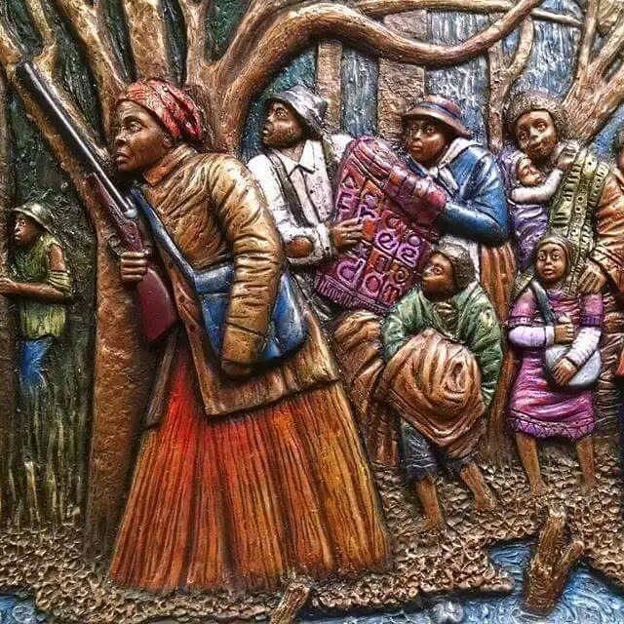
"If you hear the dogs, keep going. If you see the torches in the woods, keep going. If there's shouting after you, keep going. Don't ever stop. Keep going. If you want a taste of freedom, keep going."
~Harriet Tubman

Slide 26
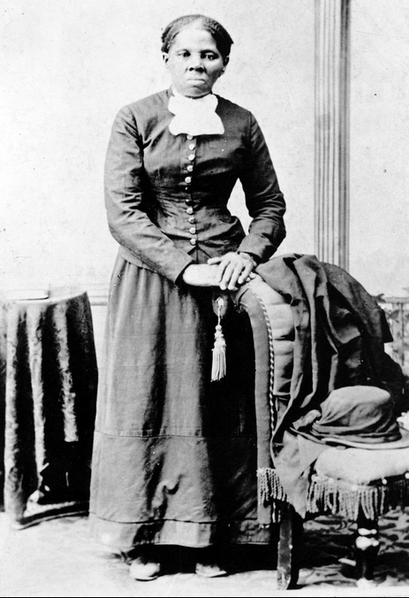
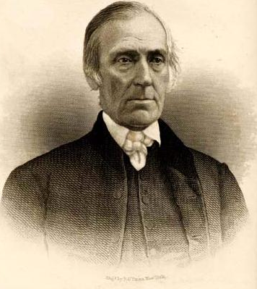
← Harriet Tubman
Levi Coffin

Slide 27
Abolitionism
Free blacks are always heavily supportive of abolishing slavery (more openly in the North than the South). But the early 1800s abolitionist movement tends to be white-led and many among it support the idea of “colonization” or “back to Africa” for the freed slaves. This is how Liberia came to be founded as a settlement for freed slaves from the US in 1822 – the capital, Monrovia, was named after President Monroe. Liberian-Americans became the elite within a mostly indigenous society, until the civil wars of the 1980s. In 1807, when the slave trade was banned within the British empire, Sierra Leone similarly was founded as an “anti-slavery” outpost of the British Empire, but still a colony. “Anti-slavery” would end the international slave trade but also serve as the pretext for a European take-over of Africa.
From a low point in the 1830s, the abolitionist movement becomes increasingly militant and more of its members call for immediate freedom of the slaves, without conditions, even as full citizens of the United States (there are varieties of abolitionists). Abolitionists are among those organizing the Underground Railroad that helps thousands of slaves to escape from the South to Canada. More and more slaves find refuge in the North. Gangs from the South often venture North to locate and kidnap escaped slaves – or unlucky free blacks.
Many, like Douglass, participate in abolitionist agitation. While a white majority in the North was not for abolition (or willing to fight a war for it), support among white Northerners for an end to slavery was undoubtedly high and growing. And a big majority in the North did oppose the expansion of slavery into new states, which the South constantly pushed for. This explains the eventual emergence of the Republican Party in the 1850s, not as an abolitionist party (which was “too controversial” for winning elections) but as a party opposed to the expansion of slavery.

Slide 28
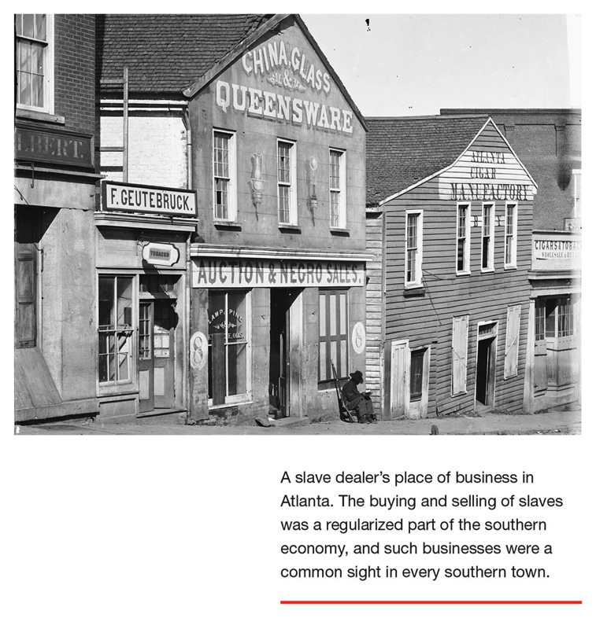
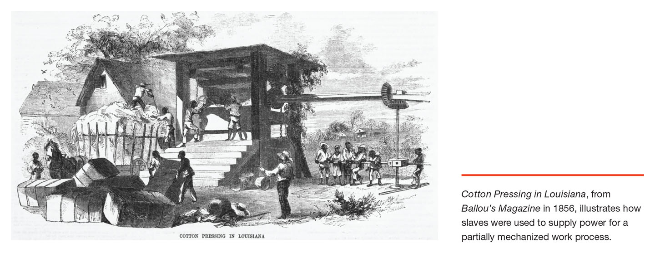
The cotton gin had come into use early in the 1800s. It intensified slave labor and allowed much higher production. It allowed the Southern economy to be based on vast cotton plantations with slave labor. The domestic slave trade turned to breeding slaves so as to supply new labor. This made up for the end of the international slave trade. The cotton was sold to textile factories in the North and to the far larger textile industry of Britain. Industrial revolution and this form of large-scale slave economy were linked through the market. Both were equally “modern” and developed together.

Slide 29
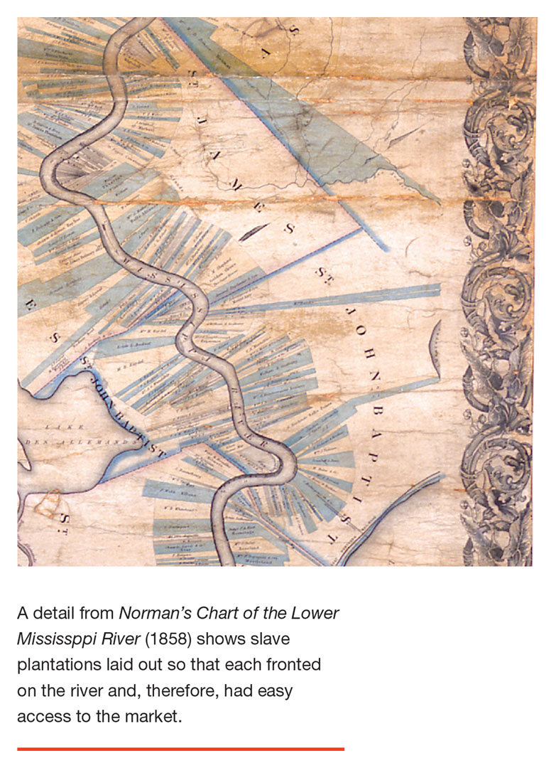
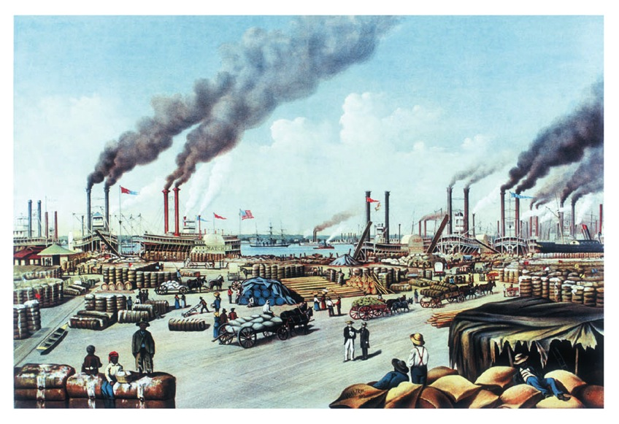
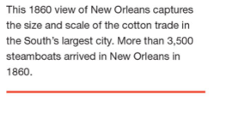

Slide 30
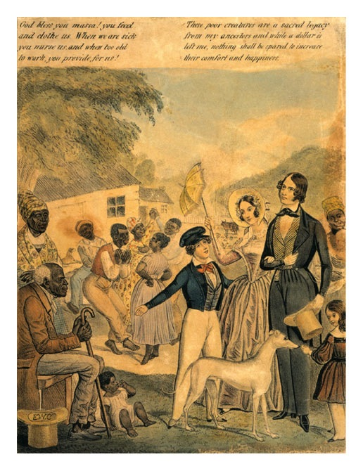
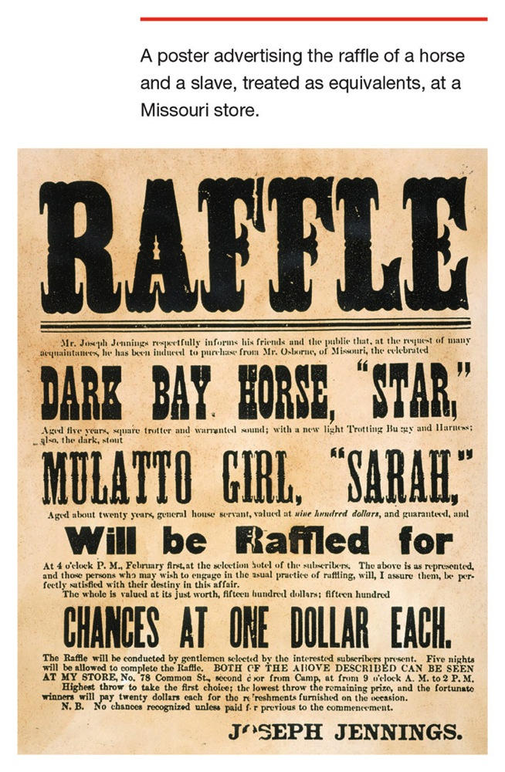
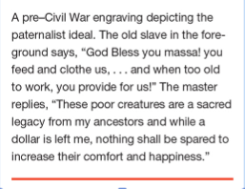
“Paternalism” as ideology of the slave-master…

Slide 31
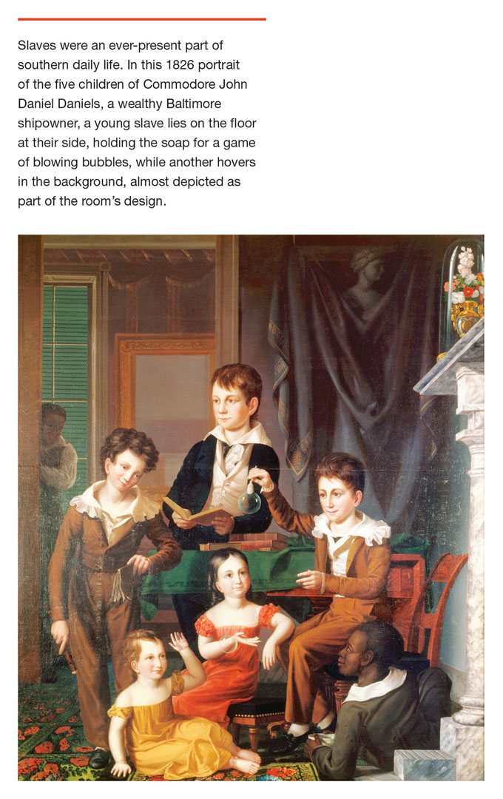
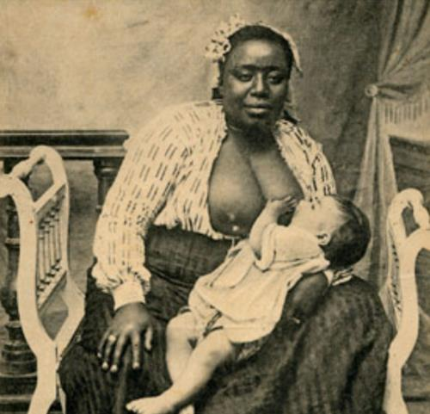

Slide 32
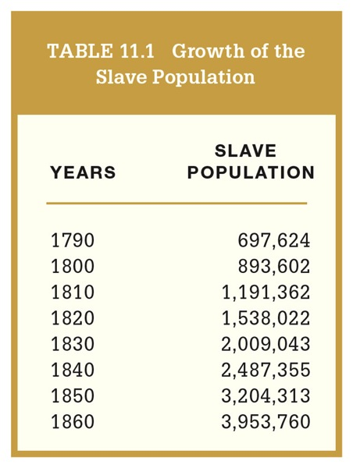
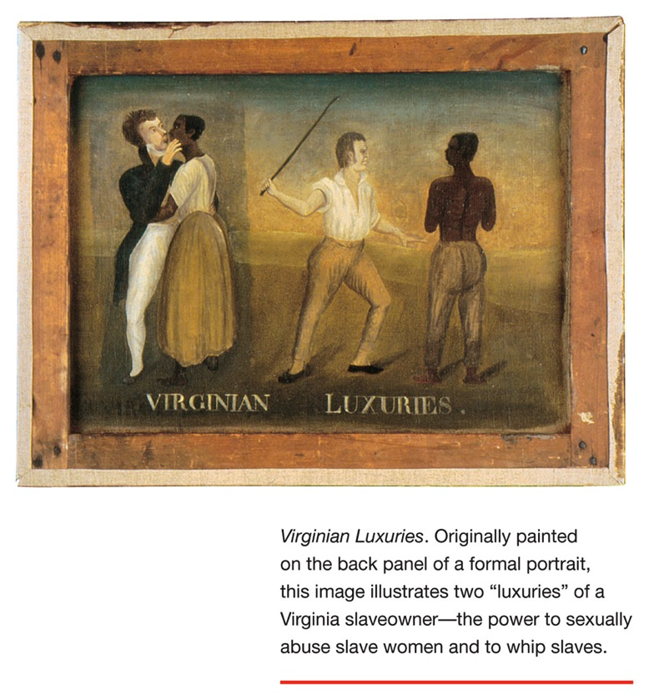
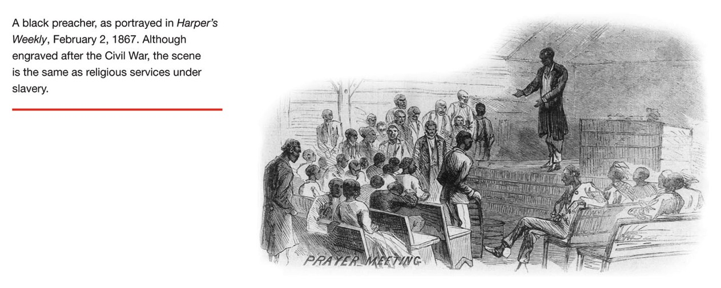

Slide 33
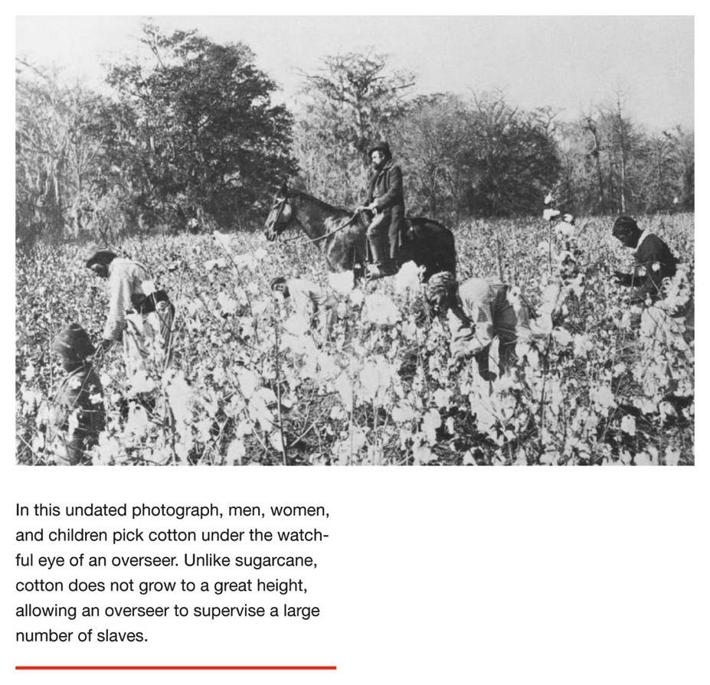
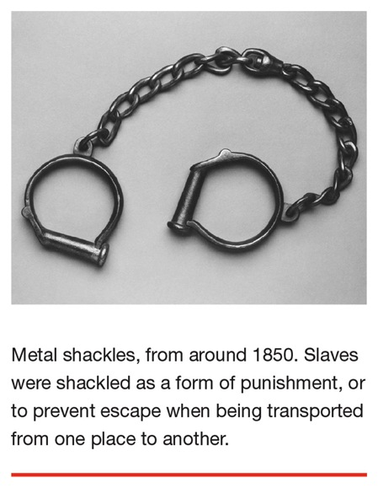


Slide 34




Slide 35

The impossibility of keeping slave South and
free-labor North as separate entities…

Slide 36




Slide 37


After having lived in the North with his master, Dred Scott sues in court for freedom, with support from abolitionists. The case reaches the Supreme Court.
Southern-dominated Supreme Court in 1857 rules that no people of African descent are U.S. citizens. They have no rights of citizens.
What does this mean for free blacks?
Slaveholders may bring slaves into free states?
This and the Kansas crisis give impetus to abolitionists and Republicans in North.

Slide 38



One of several “filibusters,” William Walker organized a private invasion of Nicaragua in 1855. He made himself president, and legalized slavery. He was chased out but tried again in Honduras – where he was captured and executed. Plans circulated among southern planters for invasions of Cuba and Mexico to create new slave states.

Slide 39



Slide 40



Slide 41
“Bleeding Kansas”
The Kansas-Nebraska act set up a conflict over whether Kansas would be incorporated as a free or slave state. Slave-owners arrived as settlers with their slaves in tow. Activists and militias entered Kansas from both North and South, and came into conflict. Southern interests rigged the election of a legislature that declared Kansas a slave state. This erupted into open hostilities with hundreds killed. When a fair vote was held, the Kansas settlers voted to charter as a free-labor state by an overwhelming margin.
This conflict prefigured the coming Civil War.
One of the abolition fighters in Kansas had been John Brown, and he decided to bring the fight to the Old South – Virginia itself.

Slide 42


John Brown, as portrayed by John Steuart Curry

Slide 43


October 1859:
John Brown and his sons lead raid on Harper’s Ferry, a river port in Virginia, attempting to free slaves and start an uprising. They are defeated after a day’s battle and executed.

Slide 44

Eve of the
Civil War

Slide 45


Rise of the Republicans and victory of Lincoln as parties split in 1860. This sets off sequence of secessions by Southern states…

Slide 46



Slide 47

Railway network shows relative state of industrial and infrastructural development in South and North.
North in 1860: 22 million people.
South: 11 million, 4 million of them slaves.

