Slide 1
Visuals used in lectures on 1750s-1820s
(not a replacement for class or reading)
USSO 10100

Slide 2
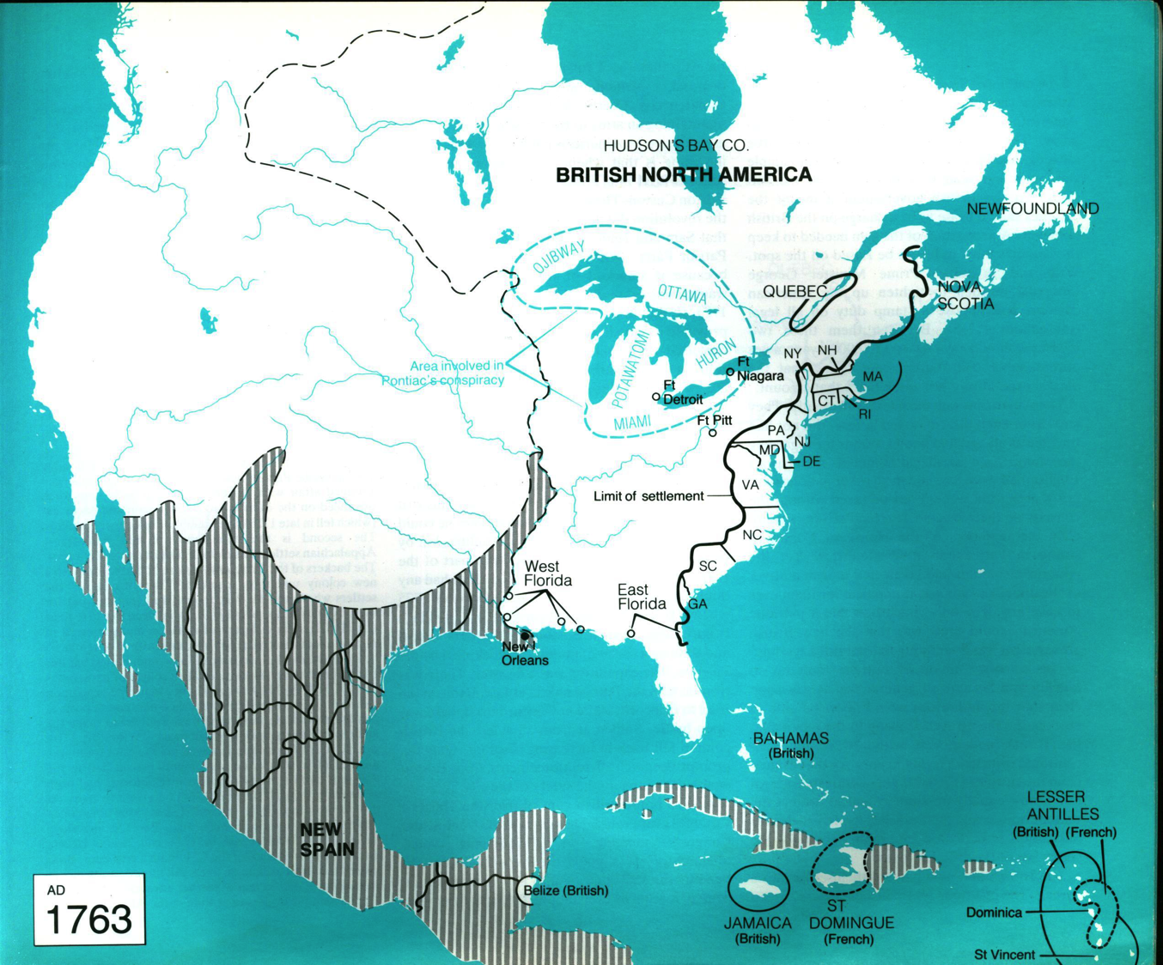
At end of the “French and Indian War” British take over Canada and suppress large Indian uprising led by Pontiac. This ends major threats to colonies.
British draw a “line of settlement” and wish to impose taxation on colonists to pay for war costs.

Slide 3
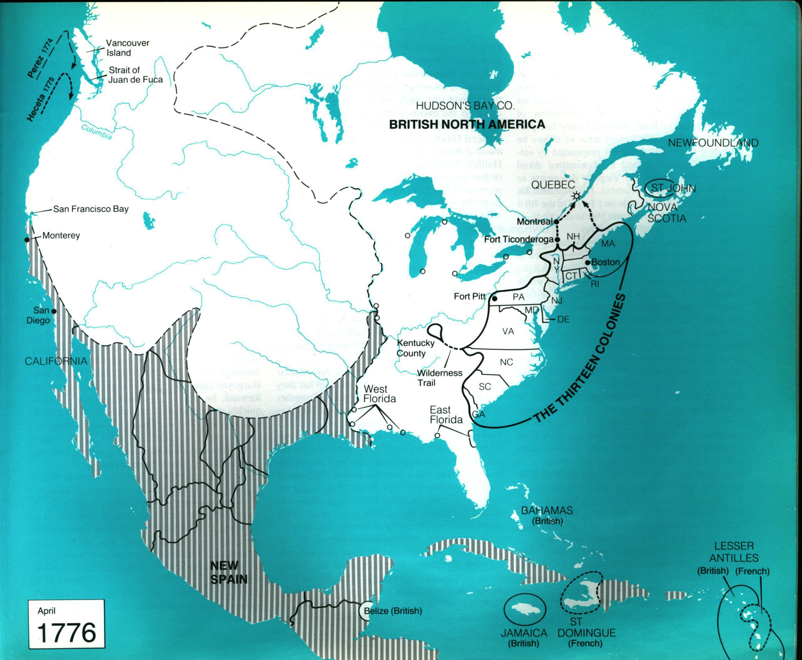
By 1776, colonial societies have undergone revolutionary change. All British taxation efforts fail due to the colonists’ resistance. “Patriot” has come to mean rebellious Americans rather than loyal British subjects. Britain has turned to force, imposing martial law in Massachusetts. Patriot leaders coordinate the colonies through “committees of correspondence” and meet as a Continental Congress in Philadelphia in 1774. Hostilities erupt between British forces and Patriot militias in Massachusetts and eventually throughout the colonies. The situation is ripe for independence…

Slide 4
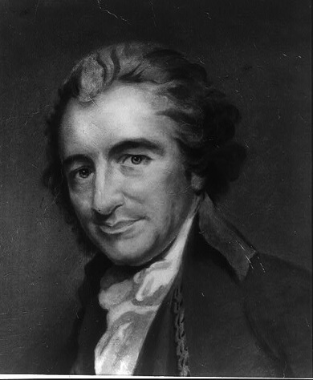
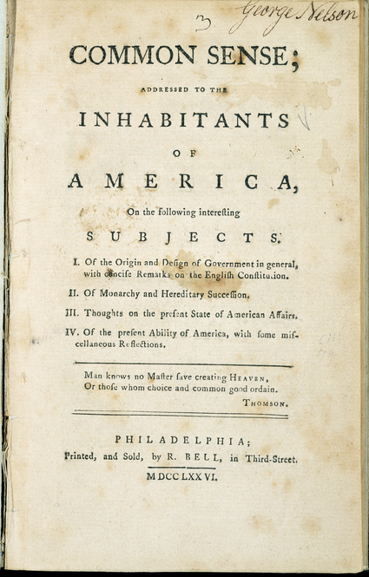
1776: February
Thomas Paine
COMMON SENSE. ON THE ORIGIN AND DESIGN OF GOVERNMENT IN GENERAL, WITH CONCISE REMARKS ON THE ENGLISH CONSTITUTION.
SOME writers have so confounded society with government, as to leave little or no distinction between them; whereas they are not only different, but have different origins. Society is produced by our wants, and government by our wickedness; the former promotes our happiness positively by uniting our affections, the latter negatively by restraining our vices. The one encourages intercourse, the other creates distinctions. The first is a patron, the last a punisher. Society in every state is a blessing, but Government, even in its best state, is but a necessary evil; in its worst state an intolerable one: for when we suffer, or are exposed to the same miseries by a Government, which we might expect in a country without Government, our calamity is heightened by reflecting that we furnish the means by which we suffer.. Govern- ment, like dress, is the badge of lost innocence; the palaces of kings are built upon the ruins of the bowers of paradise. For were the impulses of conscience clear, uniform and irresistibly obeyed, man would need no other law-giver; but that nor being the case, he finds it necessary to surrender up a part of his prop- erty to furnish means for the protection of the rest; and this he is induced to do by the same prudence which in every other case ad- vises him, out of two evils to choose the least.

Slide 5
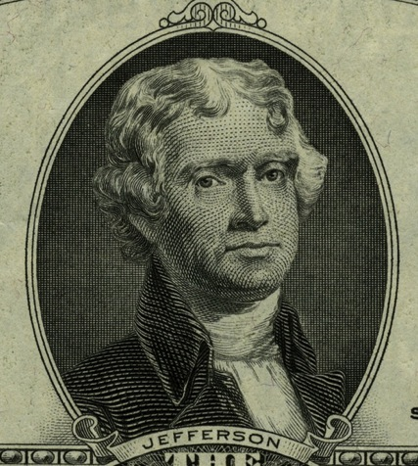
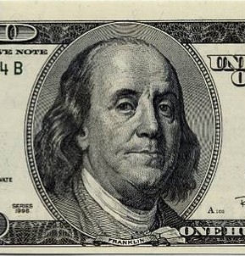
The Declaration of Independence
IN CONGRESS, July 4, 1776.
The unanimous Declaration of the thirteen united States of America,
When in the Course of human events, it becomes necessary for one people to dissolve the political bands which have connected them with another, and to assume among the powers of the earth, the separate and equal station to which the Laws of Nature and of Nature's God entitle them, a decent respect to the opinions of mankind requires that they should declare the causes which impel them to the separation.
We hold these truths to be self-evident, that all men are created equal, that they are endowed by their Creator with certain unalienable Rights, that among these are Life, Liberty and the pursuit of Happiness.--That to secure these rights, Governments are instituted among Men, deriving their just powers from the consent of the governed, --That whenever any Form of Government becomes destructive ofs to them shall seem most likely to effect their Safety and Happiness.
Prudence, indeed, will dictate that Governments long established should not be changed for light and transient causes; and accordingly all experience hath shewn these ends, it is the Right of the People to alter or to abolish it, and to institute new Government, laying its foundation on such principles and organizing its powers in such form, a, that mankind are more disposed to suffer, while evils are sufferable, than to right themselves by abolishing the forms to which they are accustomed. But when a long train of abuses and usurpations, pursuing invariably the same Object evinces a design to reduce them under absolute Despotism, it is their right, it is their duty, to throw off such Government, and to provide new Guards for their future security.--Such has been the patient sufferance of these Colonies; and such is now the necessity which constrains them to alter their former Systems of Government. The history of the present King of Great Britain is a history of repeated injuries and usurpations, all having in direct object the establishment of an absolute Tyranny over these States. To prove this, let Facts be submitted to a candid world.
1776: July

Slide 6
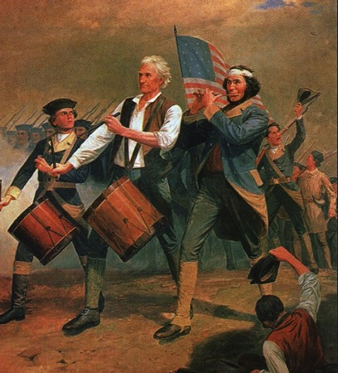
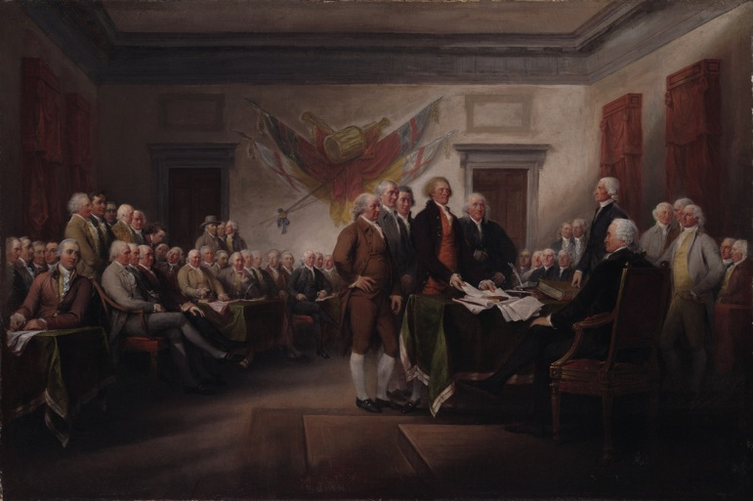
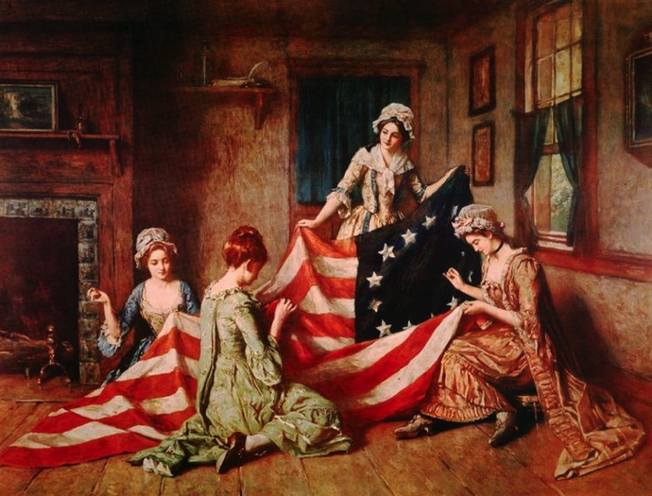
1776 and memory culture through 1800s
(…and a bit of teaching about gender roles?)
“Yankee Doodle” or
“Spirit of ’76” by
Archibald Willard, 1876 →
“Declaration of Independence,”
painter: John Trumbull, 1823
Betsy Ross making flag, one of a long series by painter
Henry Mosler, 1870s

Slide 7
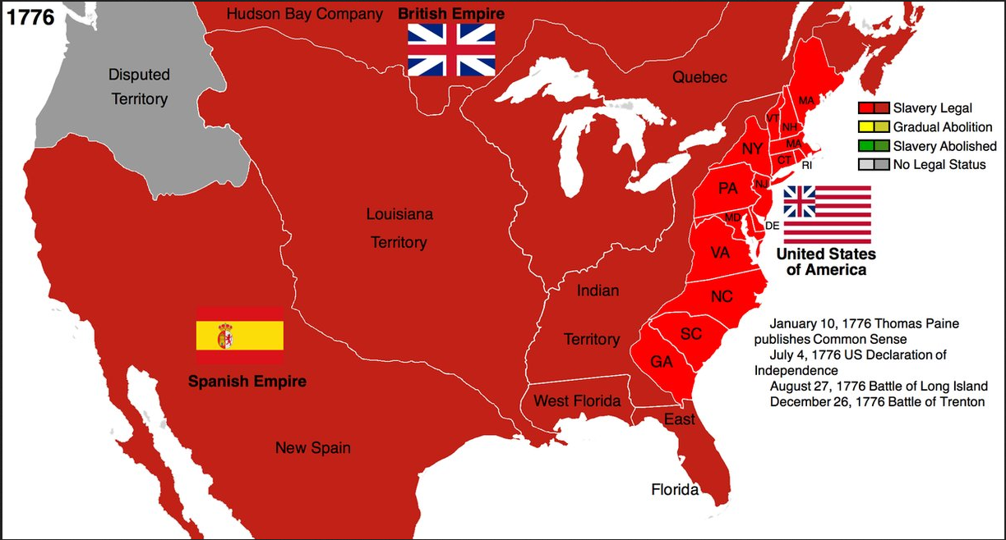

Slide 8
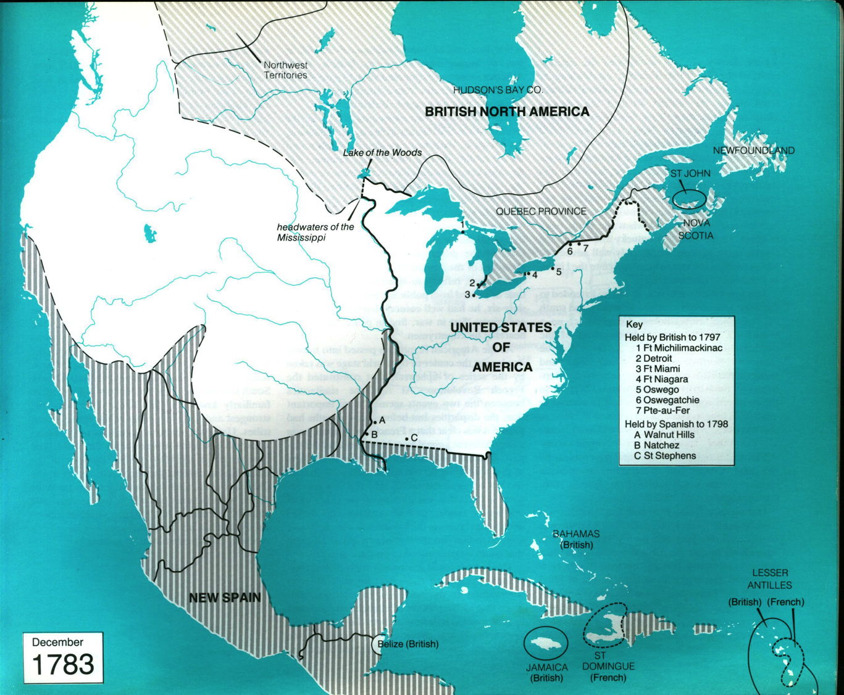
After initial losses and many retreats – and the capture of New York and Philadelphia by the British – the rag-tag Continental Army wins an important battle at Saratoga (1778). This encourages the French crown to go all-in for the Americans. With French support, the Patriots are able to win a decisive victory at Yorktown when the war moves to the South. The Treaty of Paris (1783) establishes the United States up to the Mississippi River. 80,000 Loyalists flee to elsewhere in the British Empire, many to Canada.

Slide 9
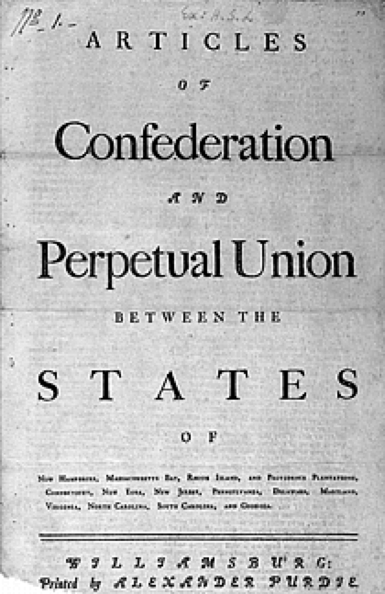
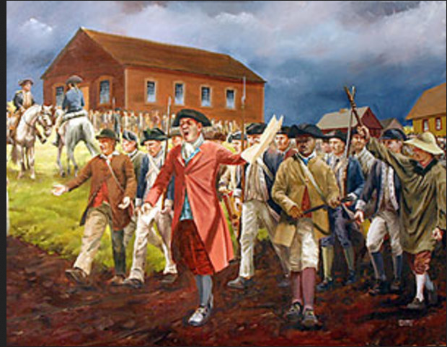
Depiction of “Shay’s Rebellion” in Massachusetts,
1787: Impoverished farmers and war veterans demanding back pay and debt relief seize courthouses and burn debt records. For the Federalists who are convening to discuss constitutional changes, this highlights the weakness of the Articles of Confederation.

Slide 10
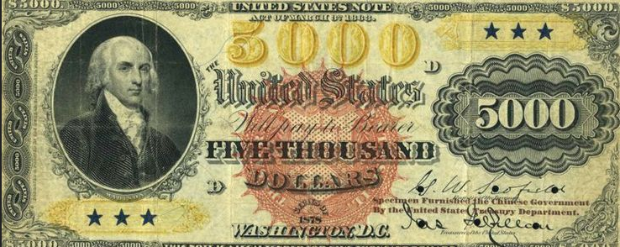
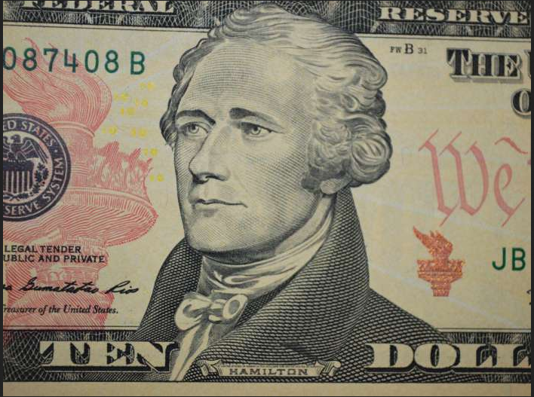
Madison & Hamilton
1787 Federalist leaders &
main authors of constitution
(In 1790s Madison becomes
Jeffersonian/Republican)

Slide 11
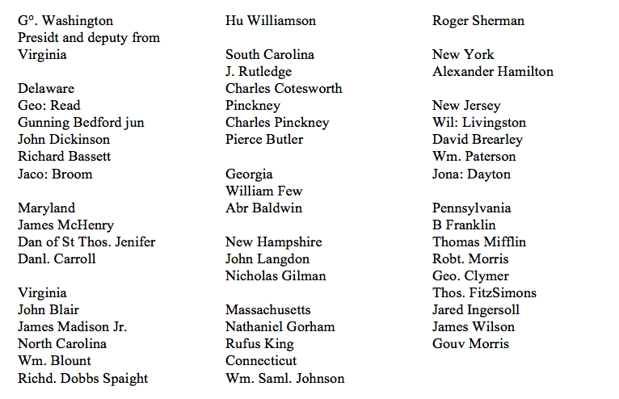

Slide 12
“Early Republic”

Slide 13
Some key points about 1787 constitution and aftermath…
Single market of all states created (no internal tarriffs).
States are limited to present borders (on demand of states that cannot expand westward). A system is established for chartering new states. Congress votes on allowing their entry, once these have enough American settlers. This proves very effective as country.
While the Constitution was based on past state charters, now all of the eventual 50 states (except one) will adopt nearly an identical framework in their own constitutions: a bicameral legislature with strong executive (governor) and court system and many divisions of powers between authorities.
Stronger federal government can raise revenues, but not by income tax. (That will require an amendment in 1913.) Government can pay debt, raise military, declare war (by act of Congress only), build infrastructure, take measures to improve commerce.
States decide on franchise (who can vote). Northern states generally make it easier than Southern (not only for slaves).
Conflicts of interest between big and little states and North and South solved with: bicameral legislature; “3/5 rule” for Census count of slaves and Indians; and decision to build a new capital between north and south in Maryland.
Senators elected by state legislatures (amended to direct popular vote in 1912). They serve six-year terms. Only one-third are elected in each two-year election, so Senate represents states & is more immune to popular pressures.

Slide 14
Some key points about 1787 constitution and aftermath…
Fear of too much democracy is countered by a number of institutions: the Senate, the Electoral College, lifetime appointments for Supreme Court, and even the strong executive independent of Congress.
Strong protections on property rights (except for “eminent domain” in cases where property can be taken, for example to allow building infrastructure) .
Amendment is possible, but difficult: it requires a 2/3 vote of both chambers of Congress and ratification by 2/3 of the states.
Division of powers and checks and balances between branches, such as: President appoints judges but Senate must approve. Congress makes laws but president can veto. Congress may override veto on 2/3 vote of both chambers, or impeach president. Only Congress may declare war but president is commander-in-chief of armed forces.
Supreme Court later successfully asserts power to interpret and overturn laws based on Constitution.
Provisions are made to end international slave trade within 20 years. After ratification, northern states abolish slavery in series through early 1800s. (The trade is banned within the British empire in 1807 and slavery itself is abolished in 1838.)
The southern states seek to expand slavery, however. The international trade is replaced by active breeding of new generations of the enslaved into slavery. (Historians call this the “Second Middle Passage” of Africans into America.) The domestic slave trade becomes an enormous business on its own. The South maintains a majority or strong balance with the north in the Senate and on the Supreme Court, and usually holds the Presidency.

Slide 15
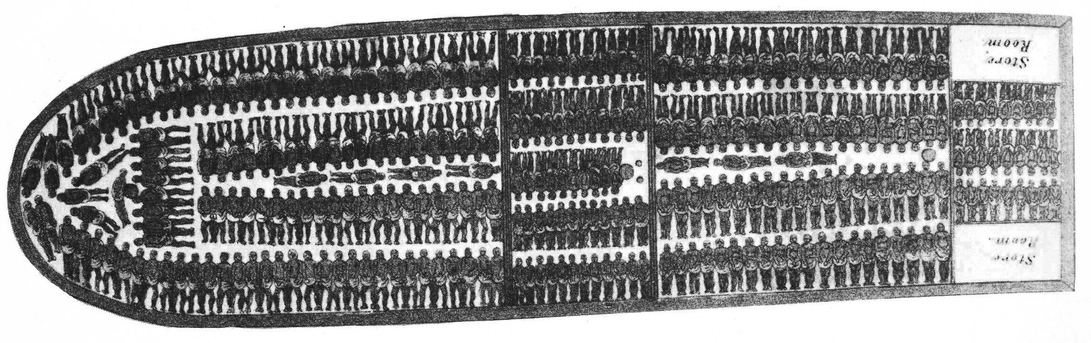
Ending the international slave trade is no small thing…
(Plan of cargo hold on slave ship)

Slide 16
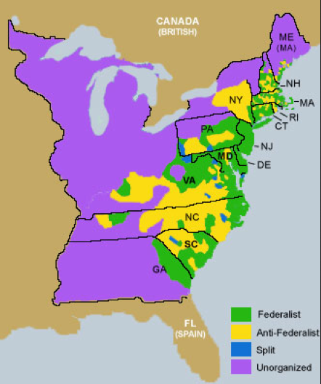
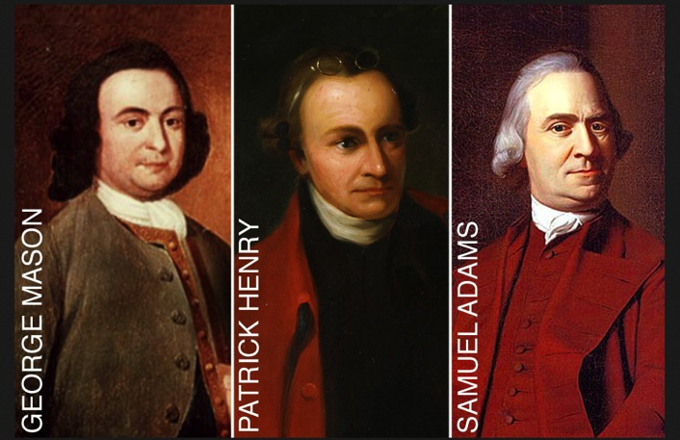
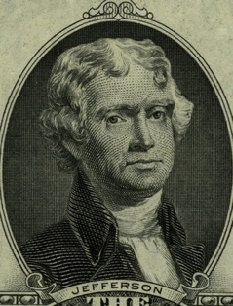
Ratification: Rural vs. Urban
Anti-Federalists oppose ratification of Constitution
A coalition of various groups:
- advocates of more democracy
- farmers independent of the market
- slaveholders and others who fear federal government
might limit slavery.
They coalesce around the complaint that the Constitution does not have a Bill of Rights. The Federalists fight this briefly and then give in, clearing the way to ratification of the Constitution and of the first 10 Amendments by the states.
Patriot Leaders among the Anti-Federalists
Jefferson?!
(on the fence)

Slide 17
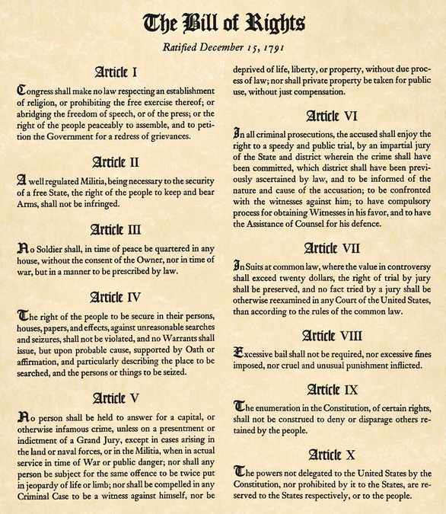
1791
1 – Freedom of speech, press, assembly, petition and religion. No establishment of state religion.
2 – Right to bear arms (original intent: protection of state and local militias against federal interference).
3 – Government may not quarter soldiers in your house without permission or basis in law.
4 – No searches or seizures without a lawful warrant specifying the place to be searched.
5 – You can’t be forced to testify against yourself or deprived of life, liberty or property without due process.
6 - Your accusers must show themselves. You have a right to trial by a jury of your peers, and a right to defense, counsel, and calling your own witnesses.
7 – Right to trial in lawsuits.
8 – No cruel or unusual punishments.
9 – Just because we say some rights are protected here it does not mean that you have no other rights!
10 – Powers not specified as federal in the constitution are reserved to the States, “or to the people.”

Slide 18
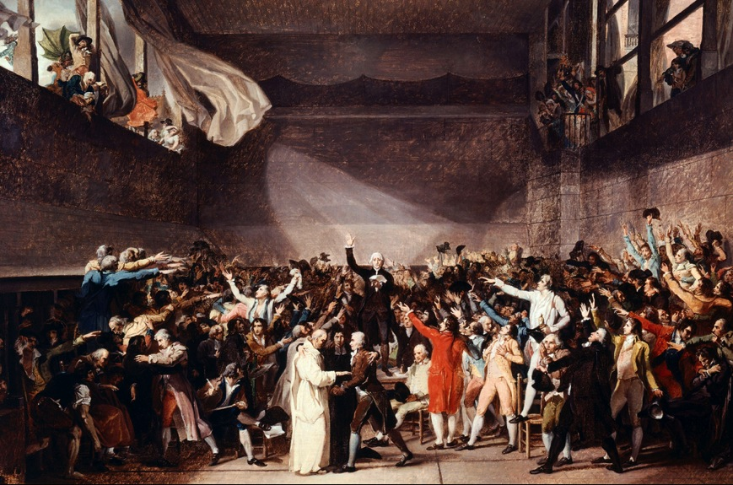
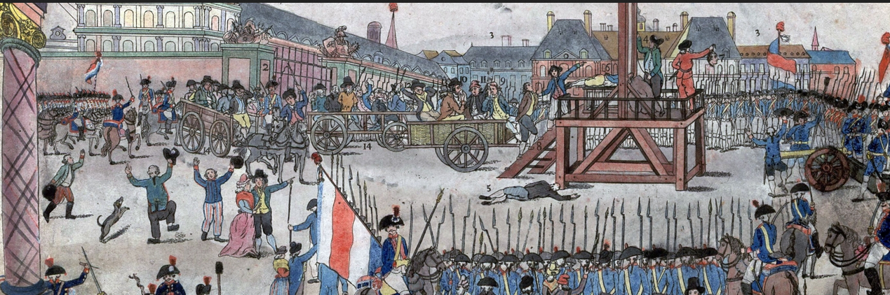
Meanwhile, in France…
- Revolution from 1789 forward
- Year of the “Terror” 1793-94
- Napoleon as Emperor, 1798 forward
- French occupations and reforms
across Europe, wars until 1815.
- British navy imposes blockade on
Continental Europe, blocking trade…
French vs. British question in America

Slide 19
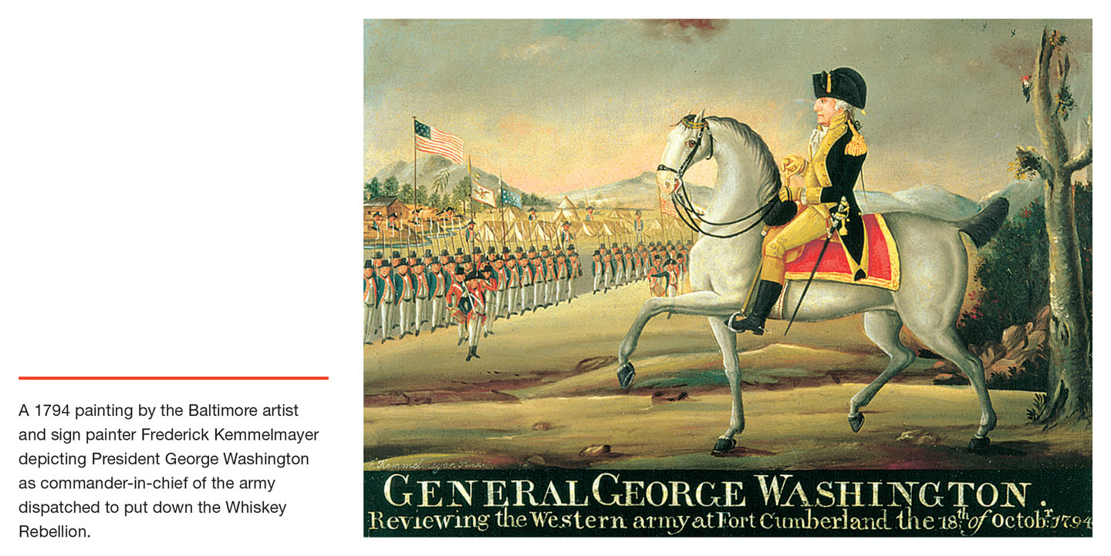
1794 – President as literal commander-in-chief leads army to suppress Pennsylvania rebellion against whiskey tax.

Slide 20
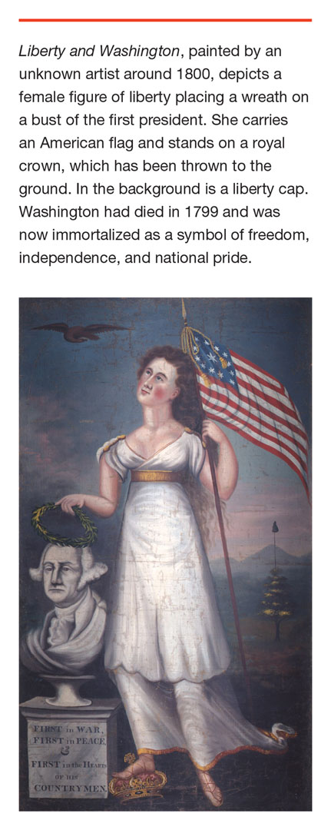
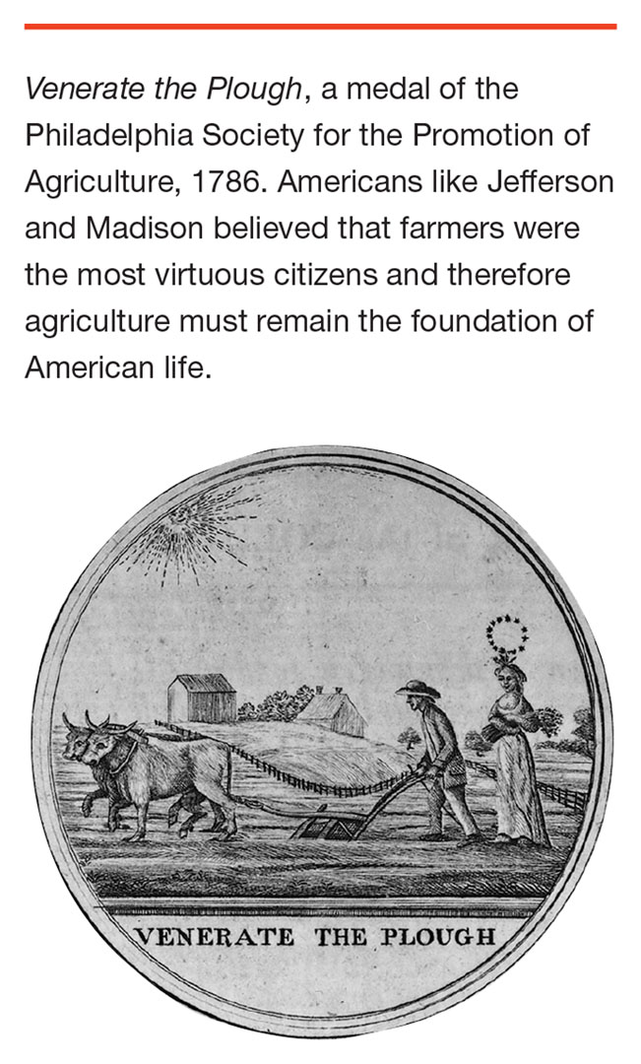
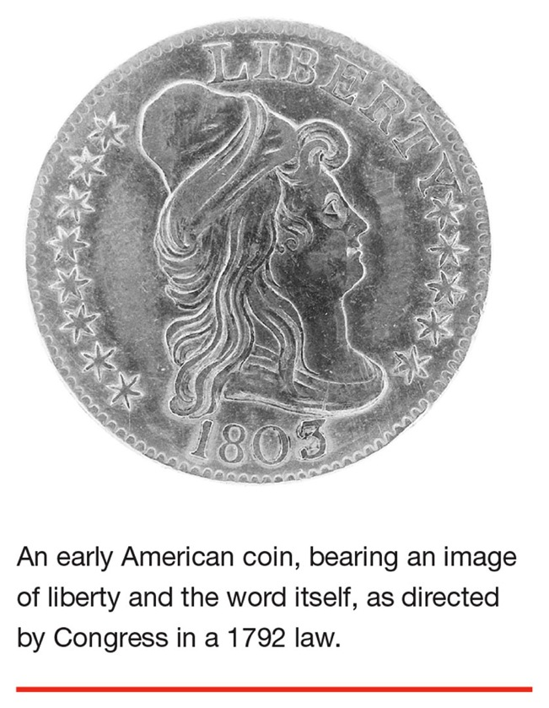
Images of
Liberty & Virtue

Slide 21
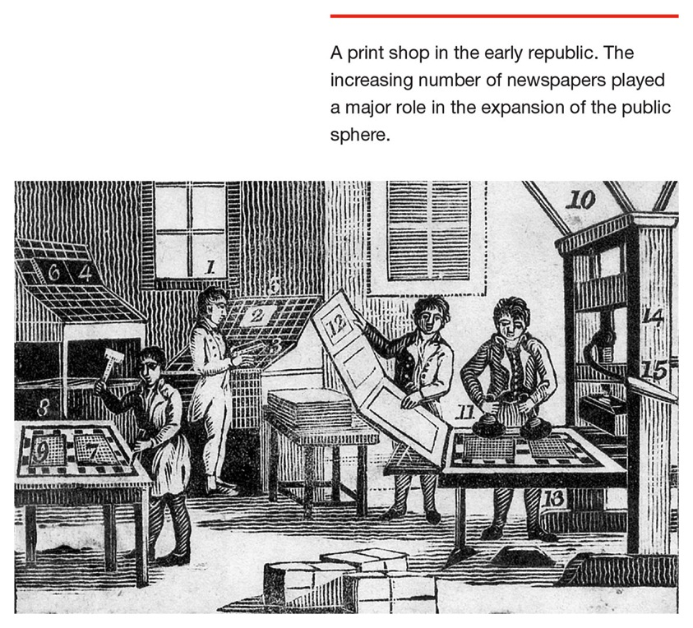
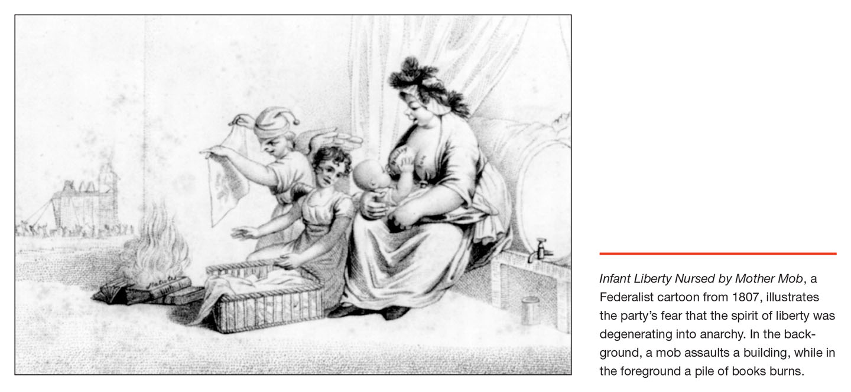
Or is it Liberty vs. Virtue?
(“Virtue” is the preferred slogan of the Federalists, “Liberty” that of the anti-Federalists who populate the new Republican party. (This will later become the Democrats, and another Republican Party will be founded in the 1850s on a platform to limit slavery.)

Slide 22
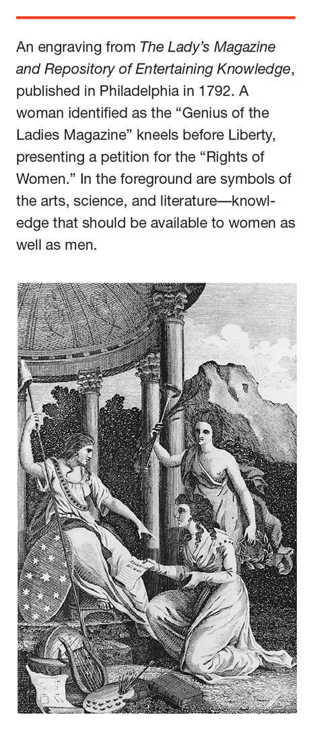
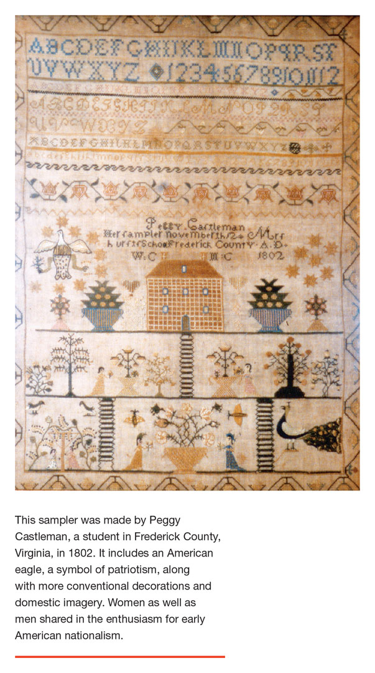
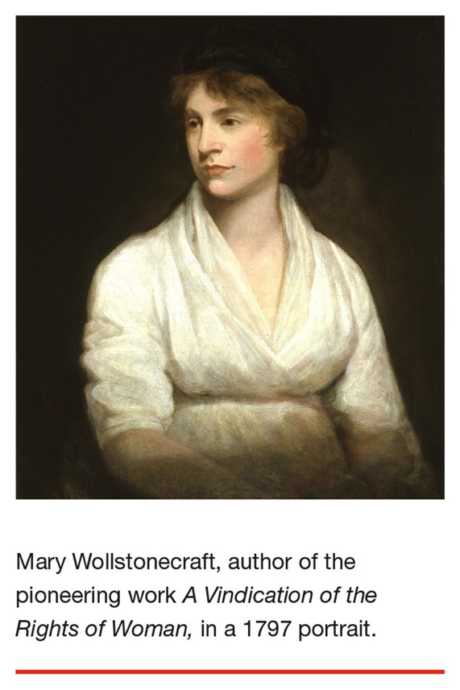
Liberty & Women

Slide 23
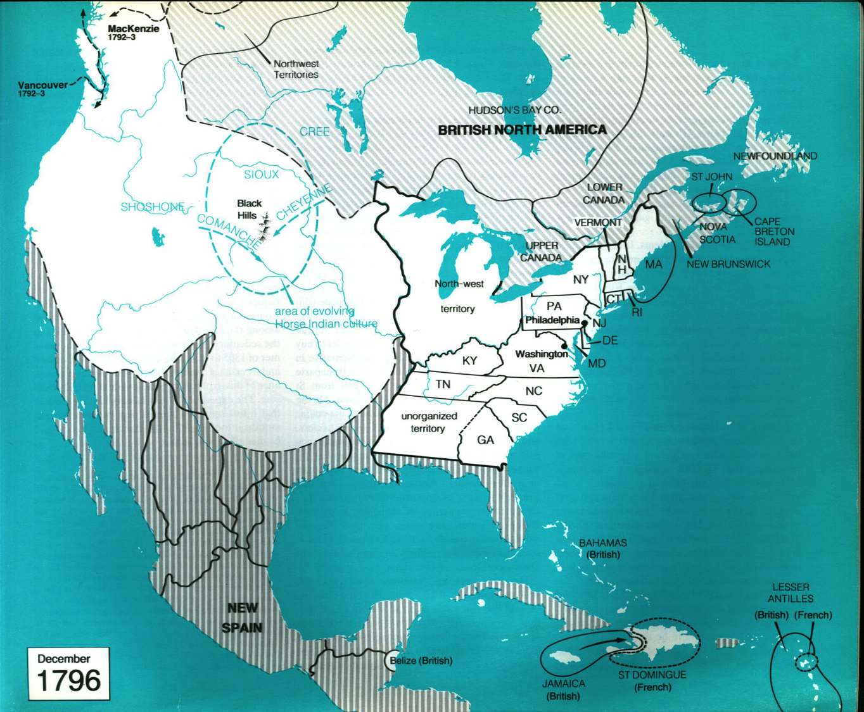
First charters
of new states:
Kentucky
Tennessee…
Northwest
Ordinance gives
land grants to settlers in Ohio Valley and Great Lakes territory.
Slave revolution
in St. Domingue
(Haiti) unsettles
Southern planters.
Washington DC is built and becomes capital in 1800.

Slide 24
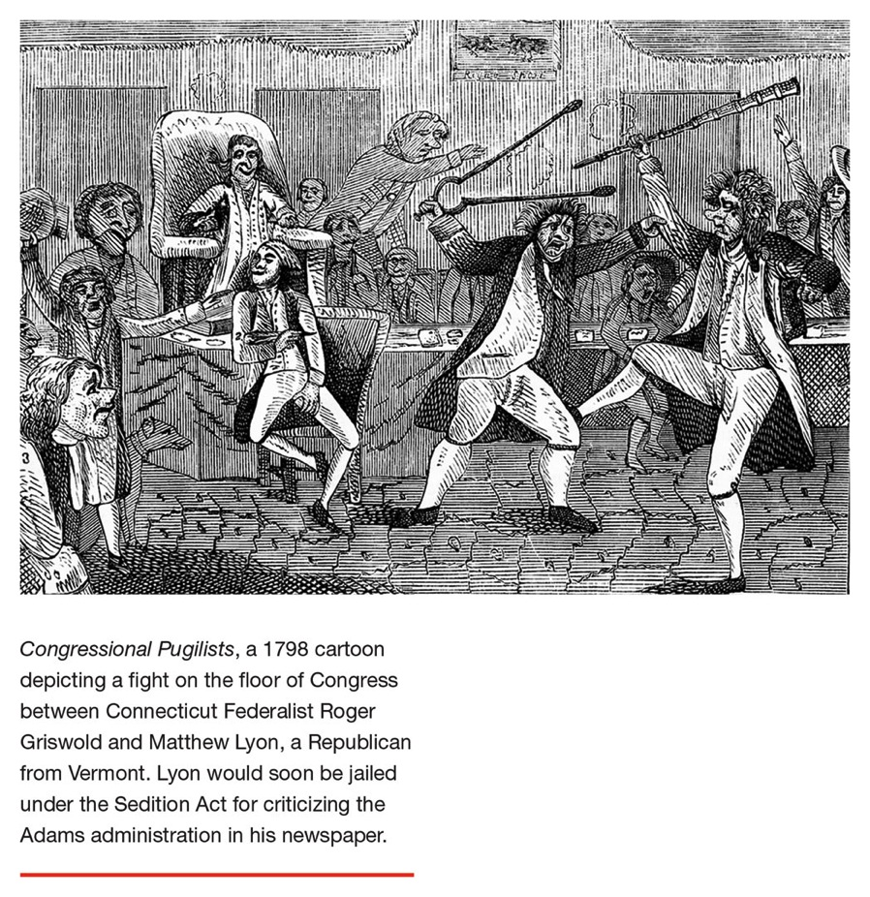
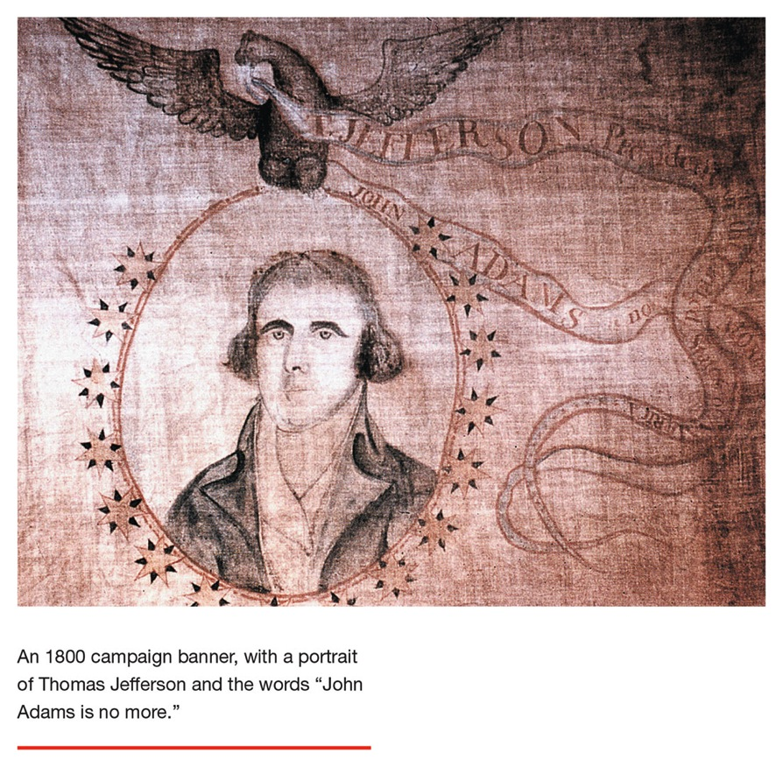
Federalists of Adams vs. Republicans (the later Democrats) of Jefferson
Federalists were anti-French Revolution, Adams administra-tion passed Alien & Sedition Acts during period of naval hostilities with revolutionary France in late 1790s.
Republicans (party that became today’s Democrats) more relaxed about French, Jefferson as president will make 1803 deal with Napoleon for Louisiana territory, doubling U.S. area.

Slide 25
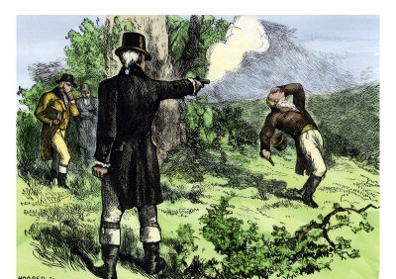
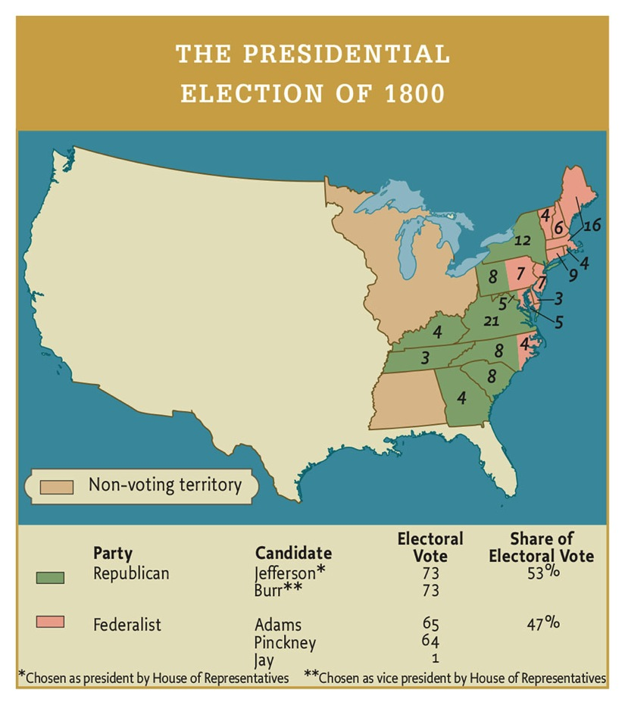
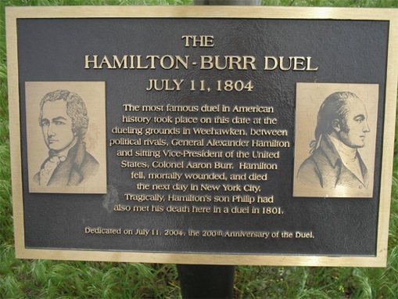
1800 – Close election thrown to House for decision in Jefferson’s favor, with Aaron Burr as Vice President.
1804 – Sitting vice-president Burr shoots former treasury secretary Alexander Hamilton in a duel over Hamilton’s alleged insult to Burr’s honor. (Just in case you thought politics has never been as dirty as it is today!)
Memory culture: You can visit this exciting plaque in Weehawken, New Jersey! Make a day of it!

Slide 26
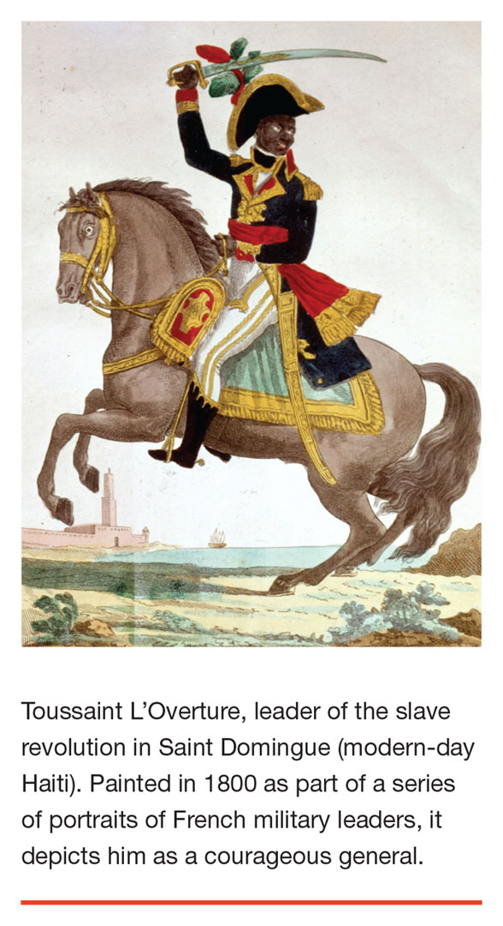
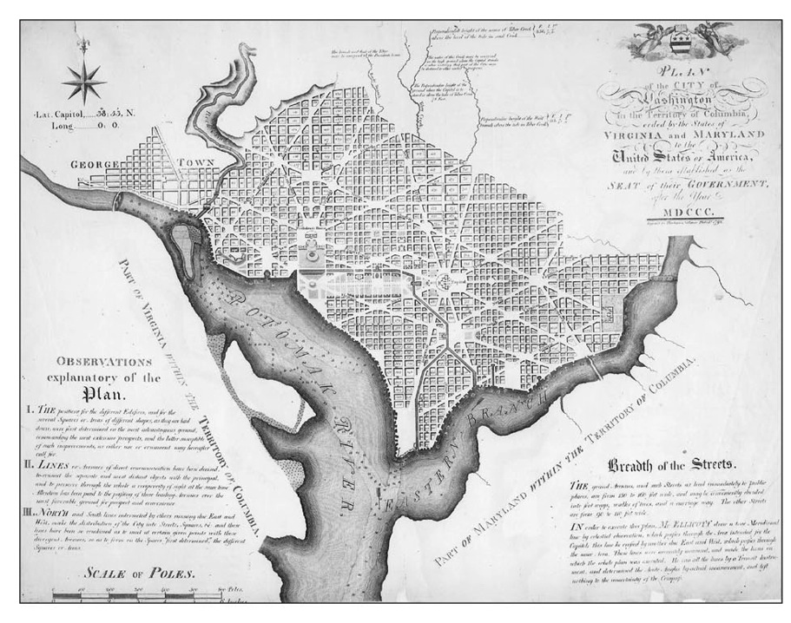
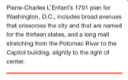

Slide 27
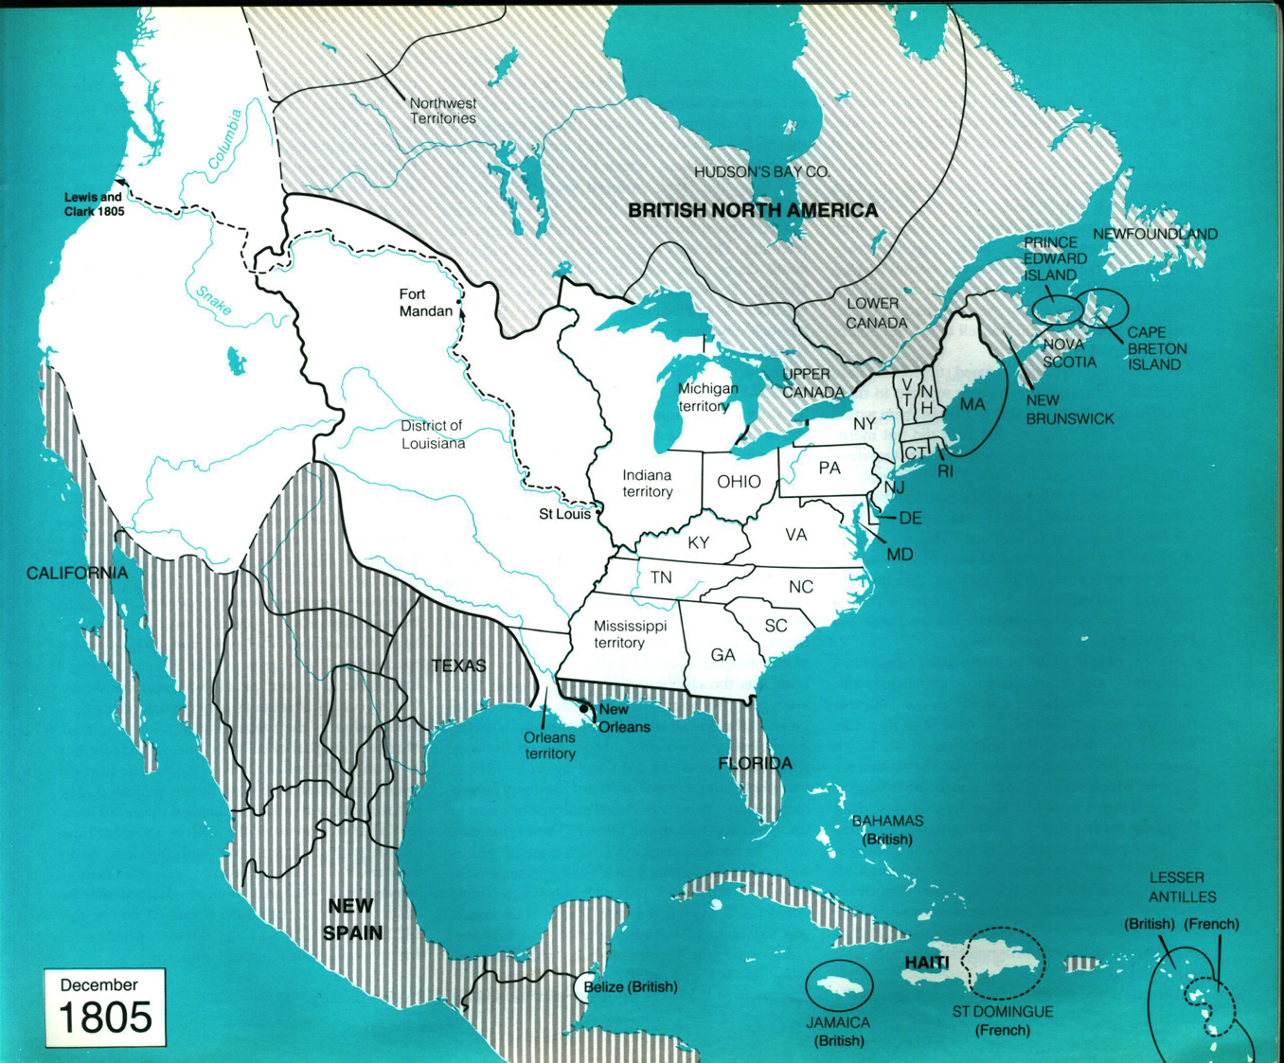
Jefferson negotiates Louisiana Purchase
from France/Spain
More states chartered: Ohio…
Spanish empire re- incorporates Florida
(barely).

Slide 28
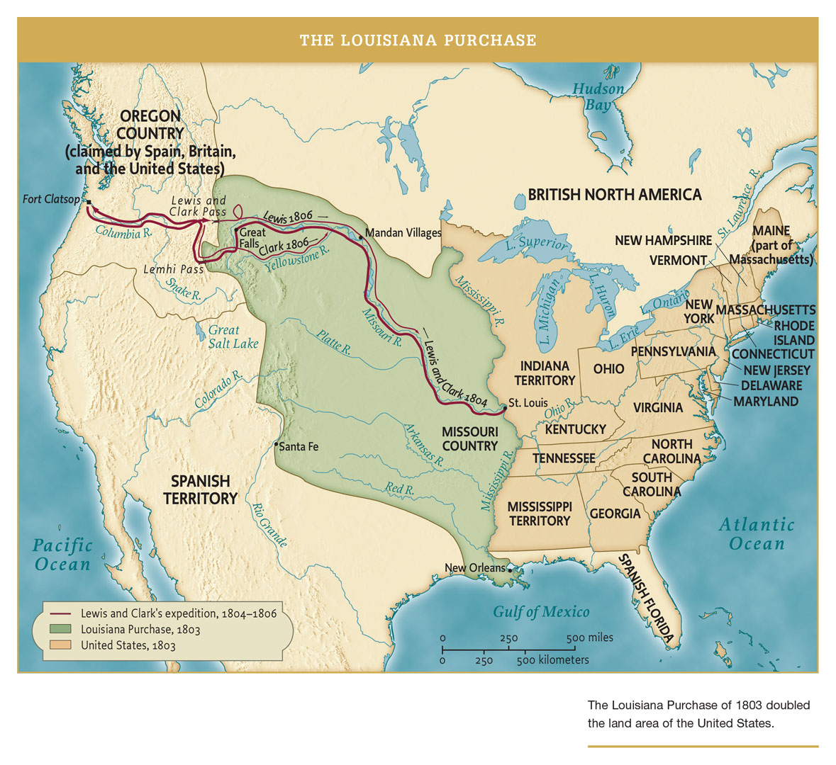

Slide 29
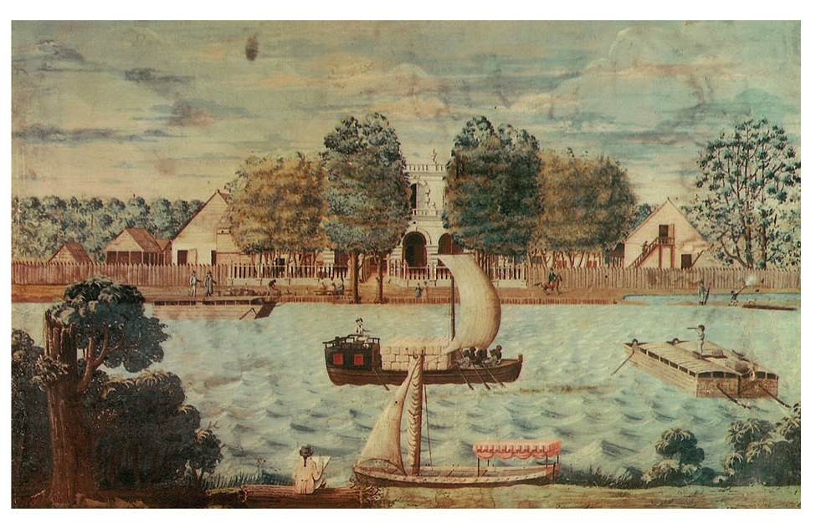
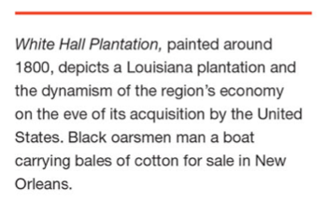

Slide 30
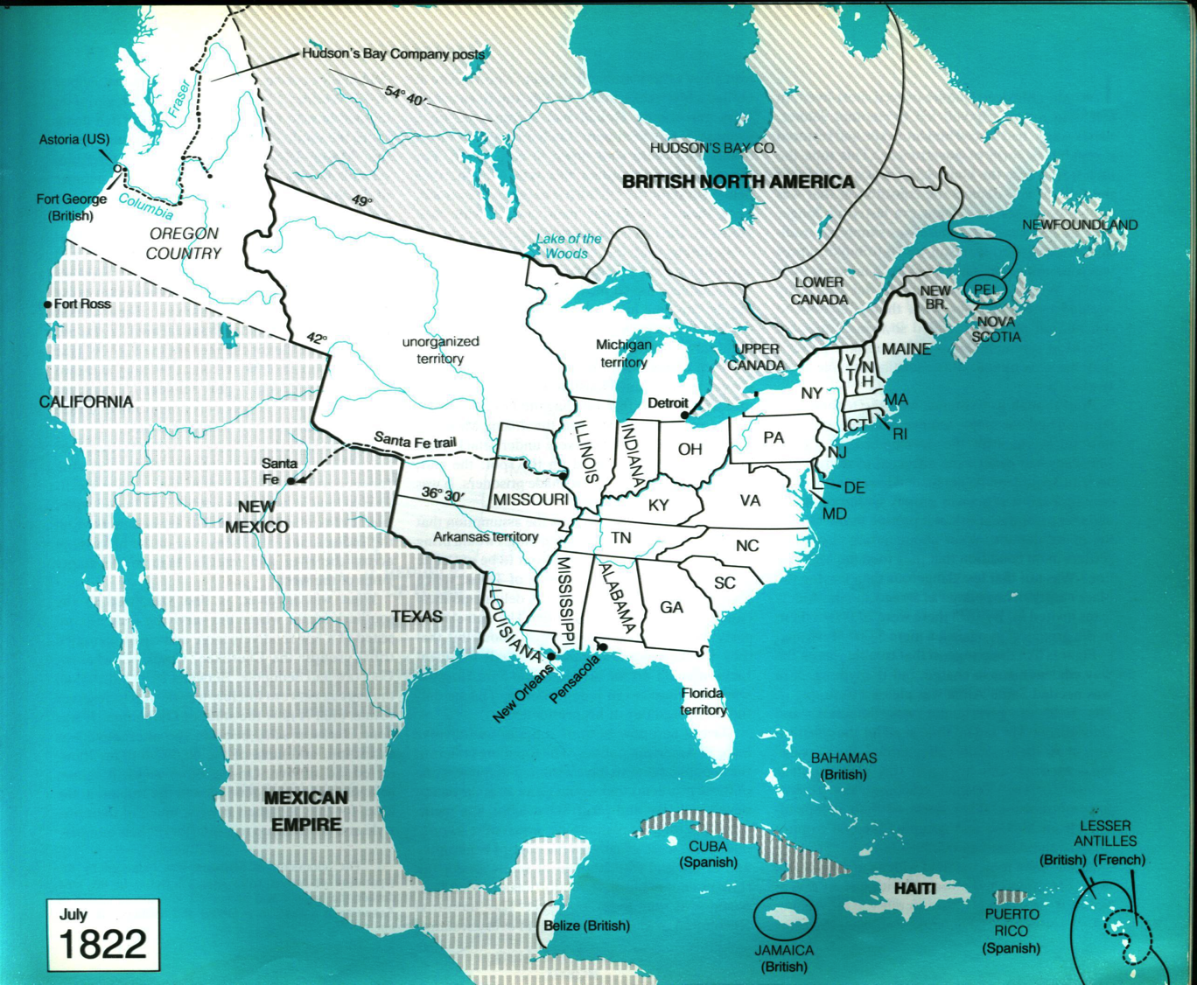
More states chartered: Mississippi, Alabama, Louisiana…
“War of 1812” sparked by English embargo during Napoleonic wars. British/Canada
burn down DC, U.S. holds together. Large Indian uprising in northwest/west led by “the Prophet”(1815).
War hero Gen. Andrew Jackson leads capture of Florida, 1819-20 (a.k.a. First Seminole War).
Missouri Compromise
of 1820 sets line for future determination of slave or free state.

Slide 31
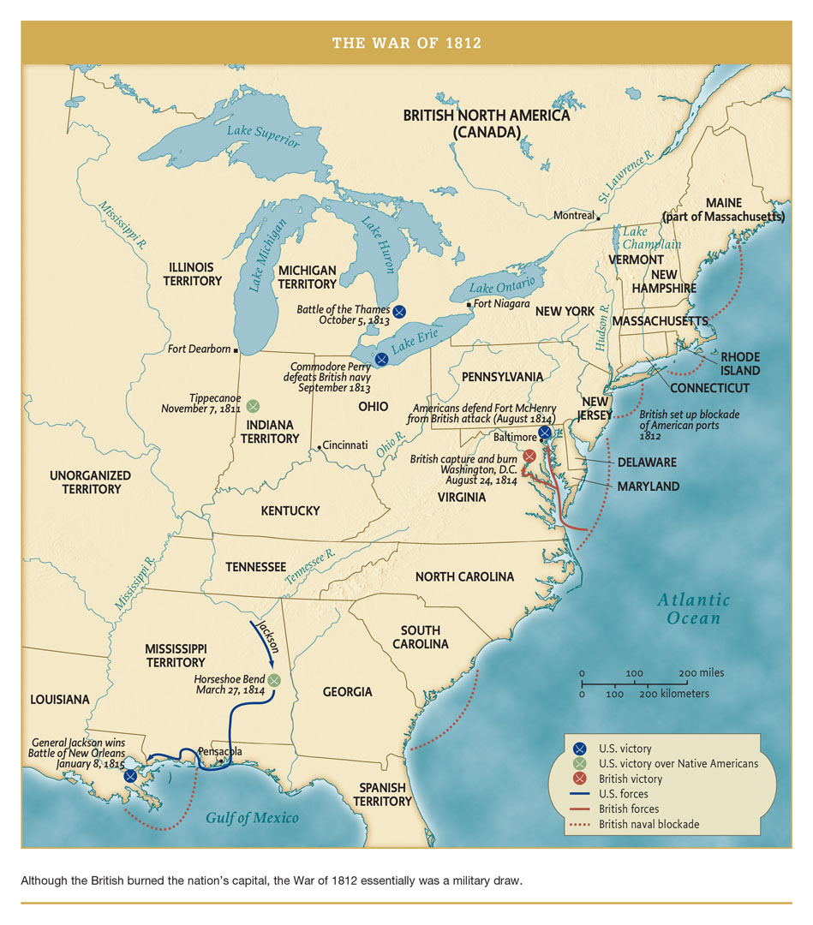

Slide 32
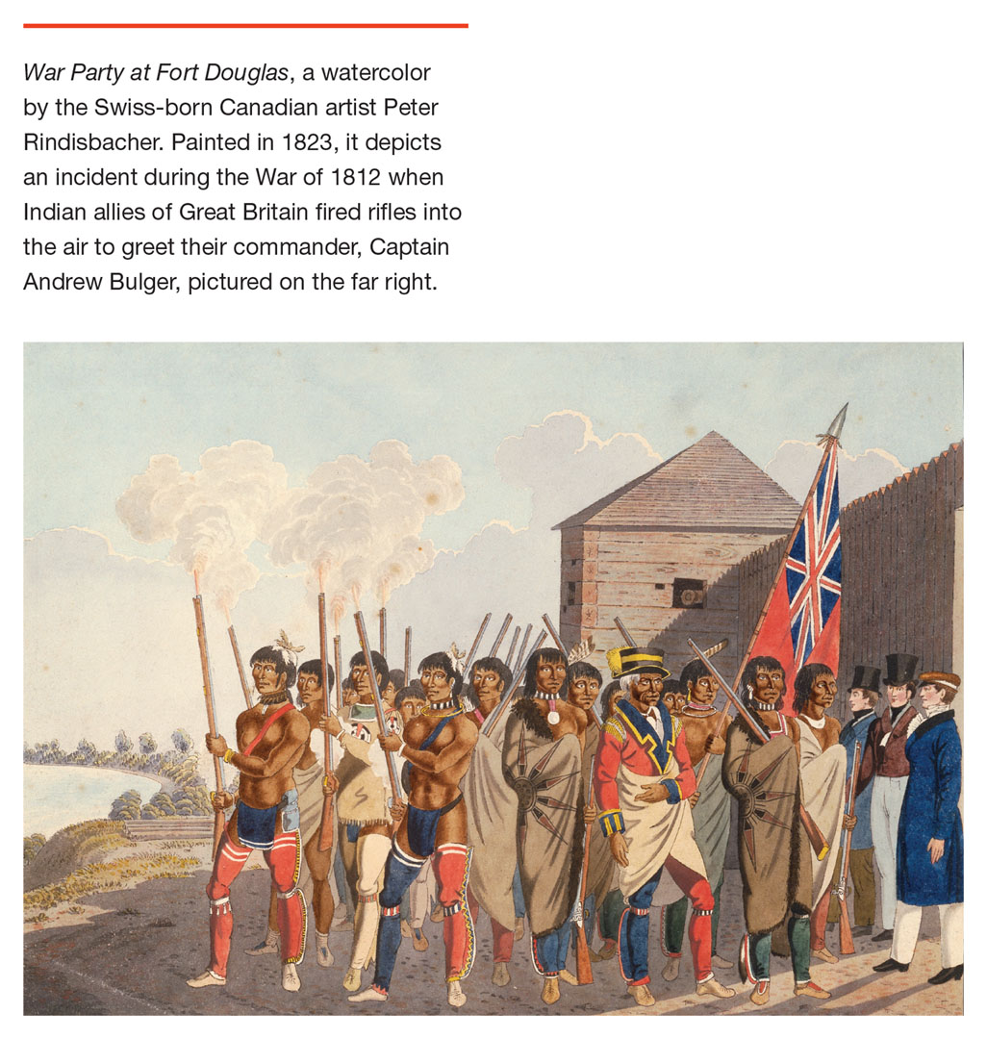
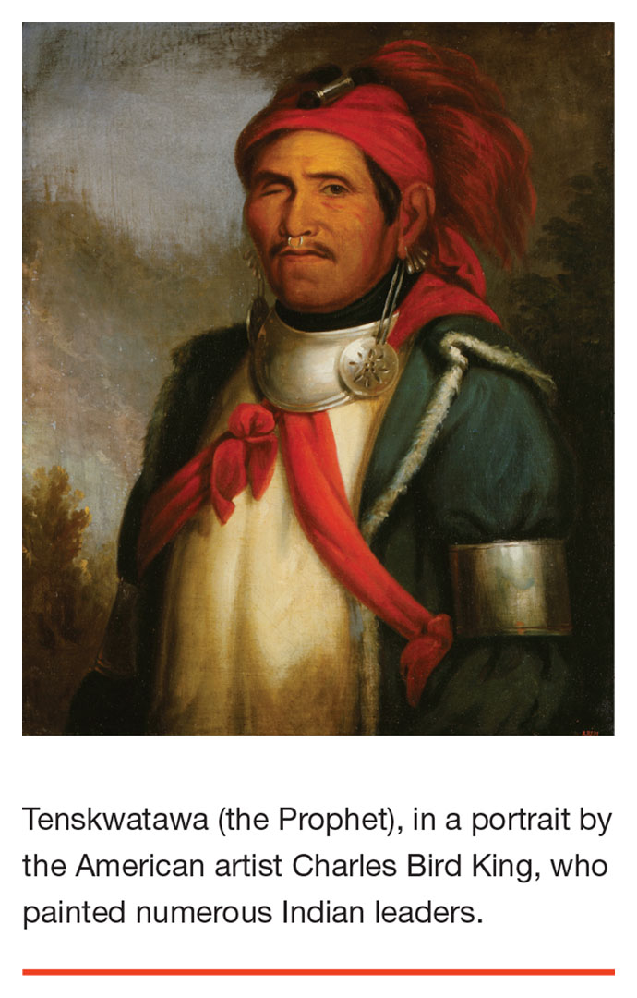

Slide 33
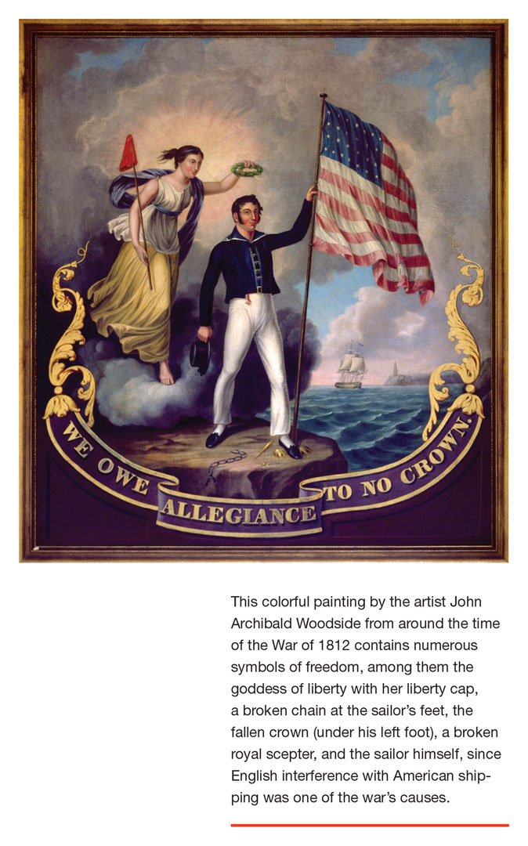


Slide 34


Slide 35


Latin American Independence
& Monroe Doctrine
President James Monroe (on an 1880 $100 bill)

Slide 36

One U.S. market, (relatively) strong government, infrastructure –> economic revolution.

Slide 37


Erie Canal (1824) links New York to Great Lakes, allows large part of developing nation
access to sea and markets abroad, turns NYC into huge port and commercial center…
Cincinnati
(1835 painting)
New York
(1849 litho)

Slide 38


Slide 39



Slide 40


First industrial revolution is powered by cotton from the South supplied to textile mills in the North.

Slide 41



First phase of industrial revolution in U.S. (from around 1820s)

Slide 42



Slide 43



First industrial workers in the U.S. are women.

Slide 44

Meanwhile, on the frontier…

Slide 45

…or is the Prairie more like this?

Slide 46


Or like this?

Slide 47



Population growth & new wave of immigration

Slide 48

Jackson presidency (1828-36) is associated with democratic revolution – massive political participation among white men – also expansion of slavery and harsh times for Indians.

Slide 49


Jackson lost the 1824 election to J.Q. Adams through the Electoral College.
Four years later, voter participation rose by almost 400% and a new party system followed in 1830s. Jefferson’s “Republicans” became the Democrats vs. the more business-oriented Whigs.

Slide 50

Under Jackson presidency (1828-1836), Indian Removal acts (1830-31) forced relocation of Cherokee and other tribes to Oklahoma (“Trail of Tears”)
Many more states chartered…
White settlers in Texas (some with slaves) declare independent Republic, win battles with Mexico, agitate for union with U.S.

