Slide 1
Visual aids for
1500s-1750s
(does not replace lecture)
USSO 10100

Slide 2
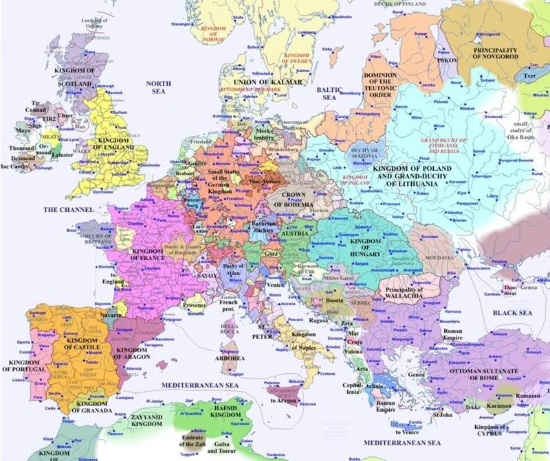

Slide 3
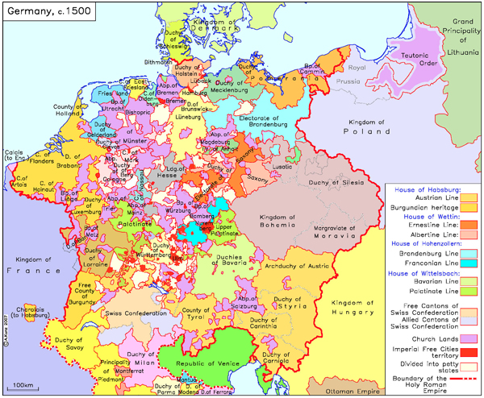

Slide 4
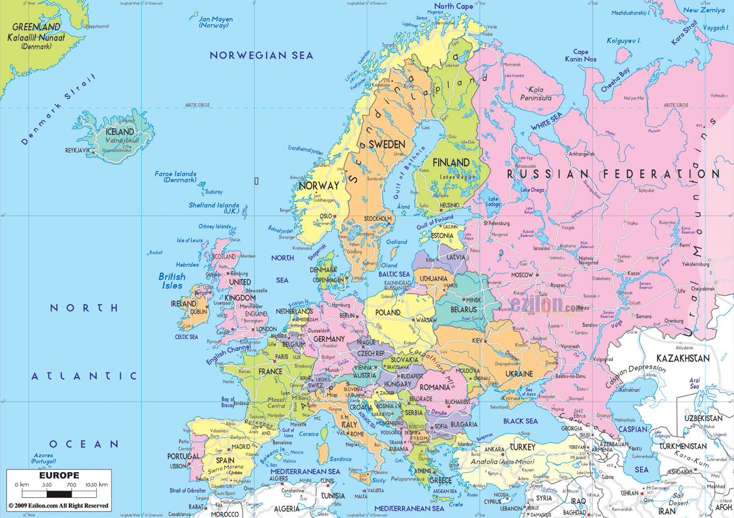
(2016)

Slide 6
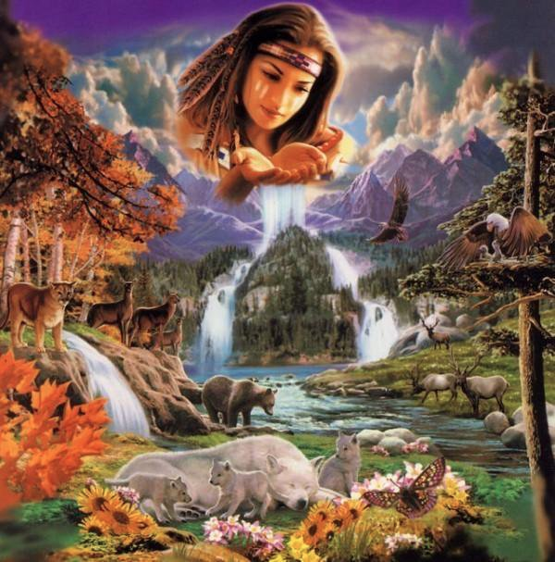
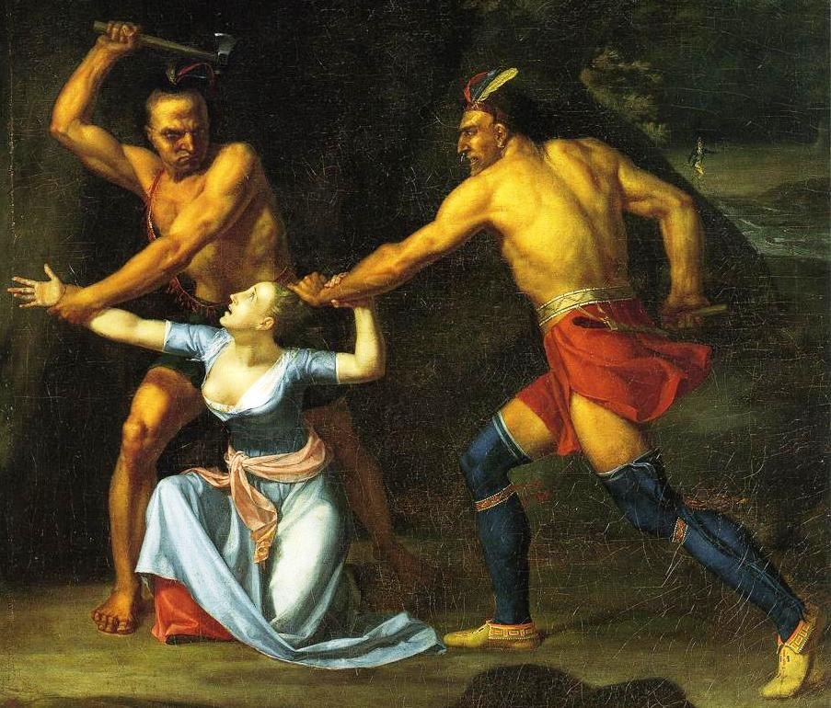

Slide 7
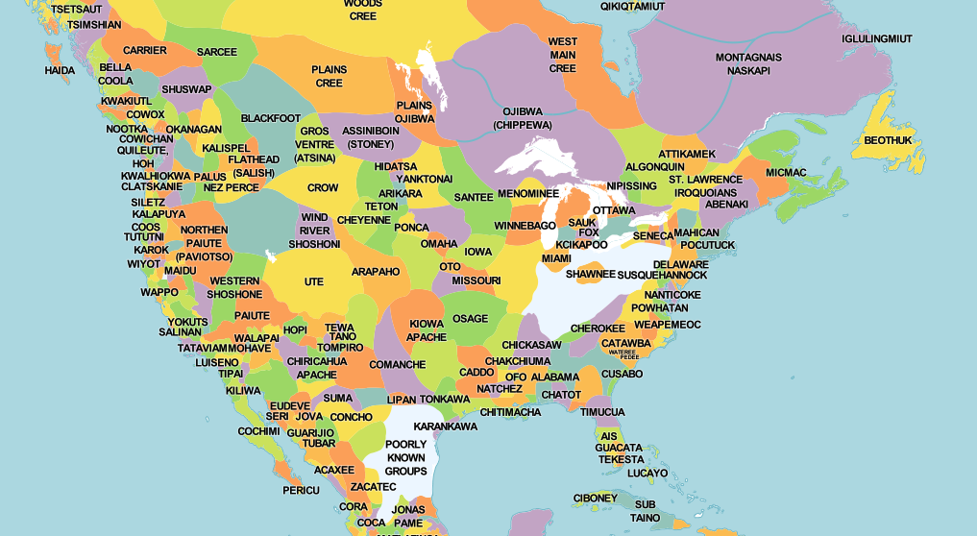

Slide 8
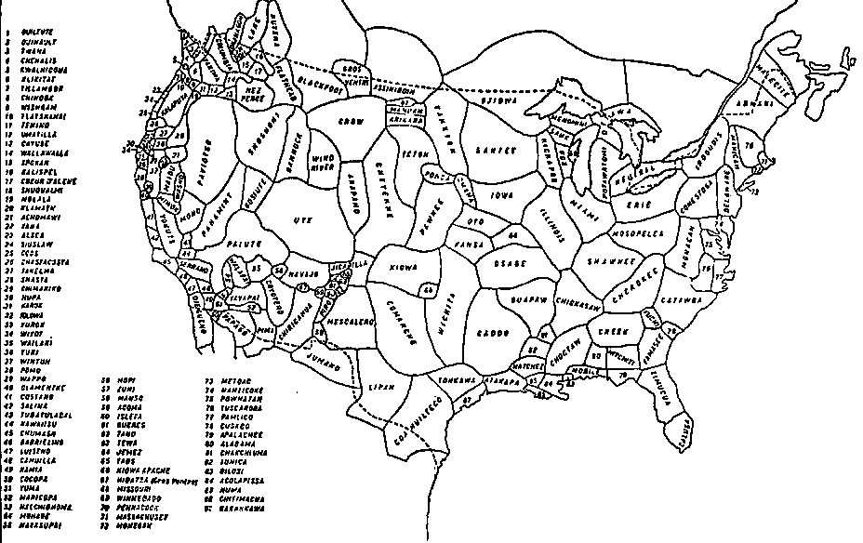

Slide 9
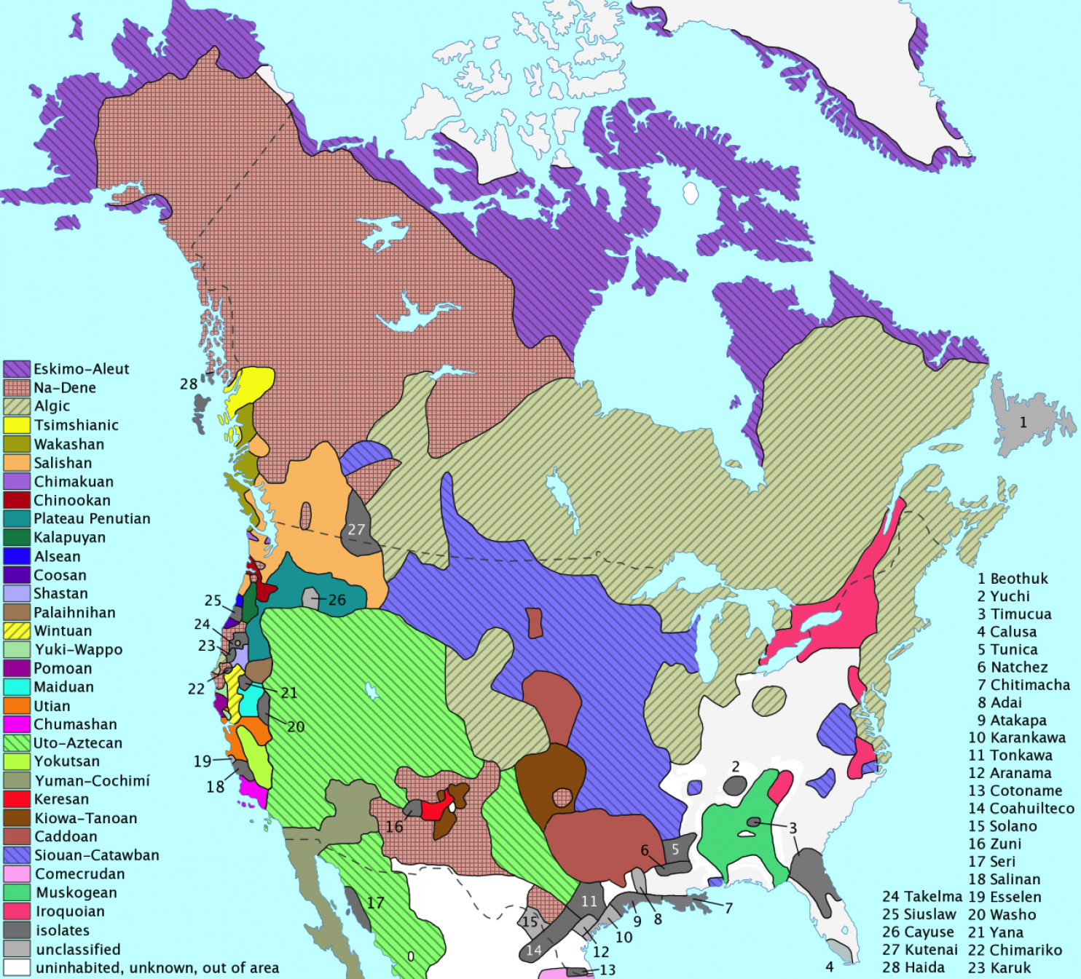
Attempt to map out possible
distribution of indigenous
American languages prior
to contact

Slide 10
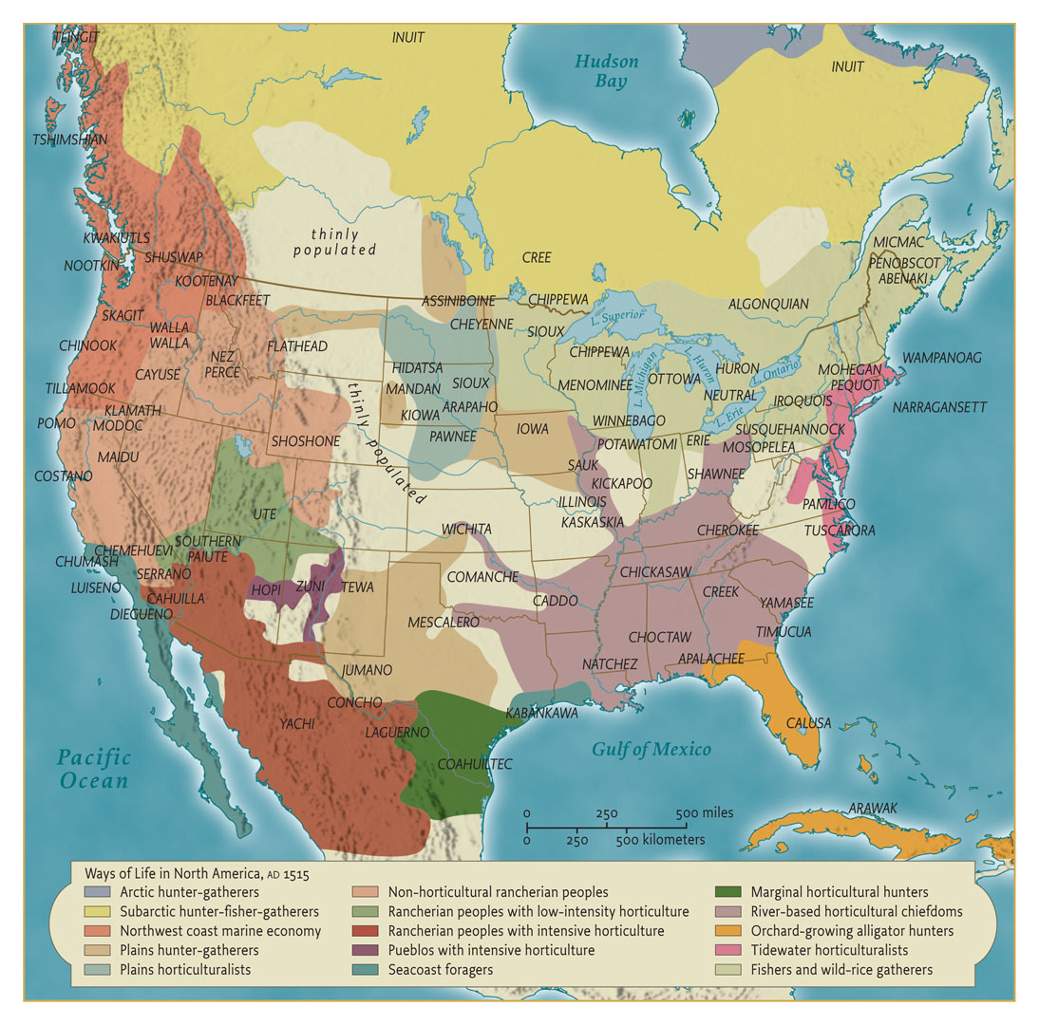

Slide 11
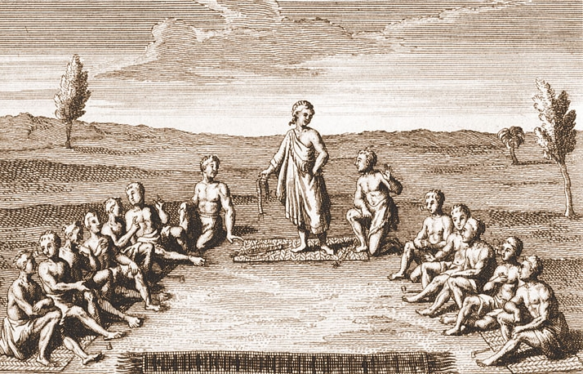
The Grand Council of the Iroquois Nations
An engraving representing the Grand Council
of the Iroquois nations
Give Me Liberty!: An American History, 4th Edition
Copyright © 2013 W.W. Norton & Company

Slide 13
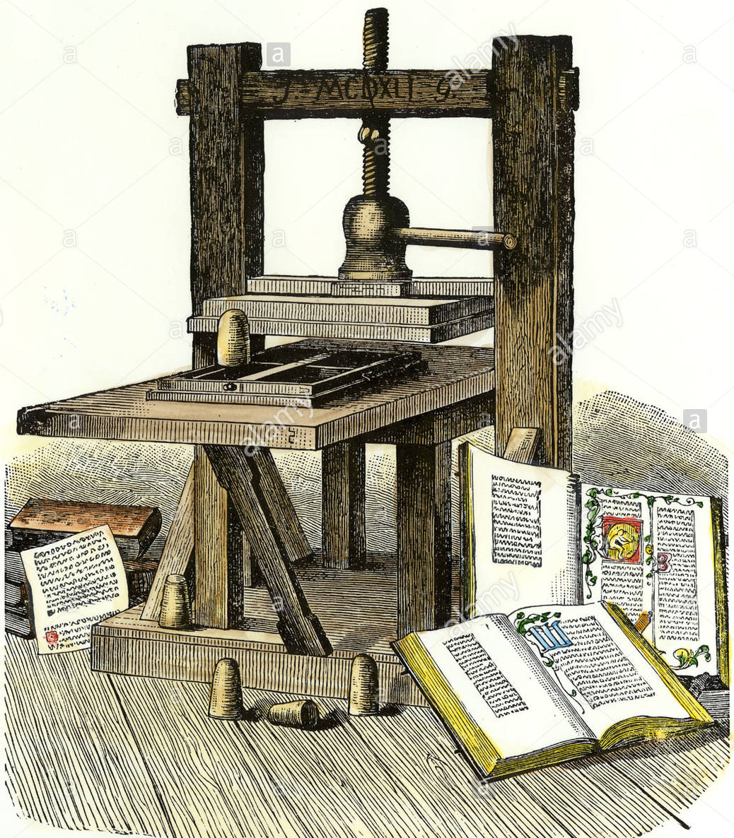

Slide 14
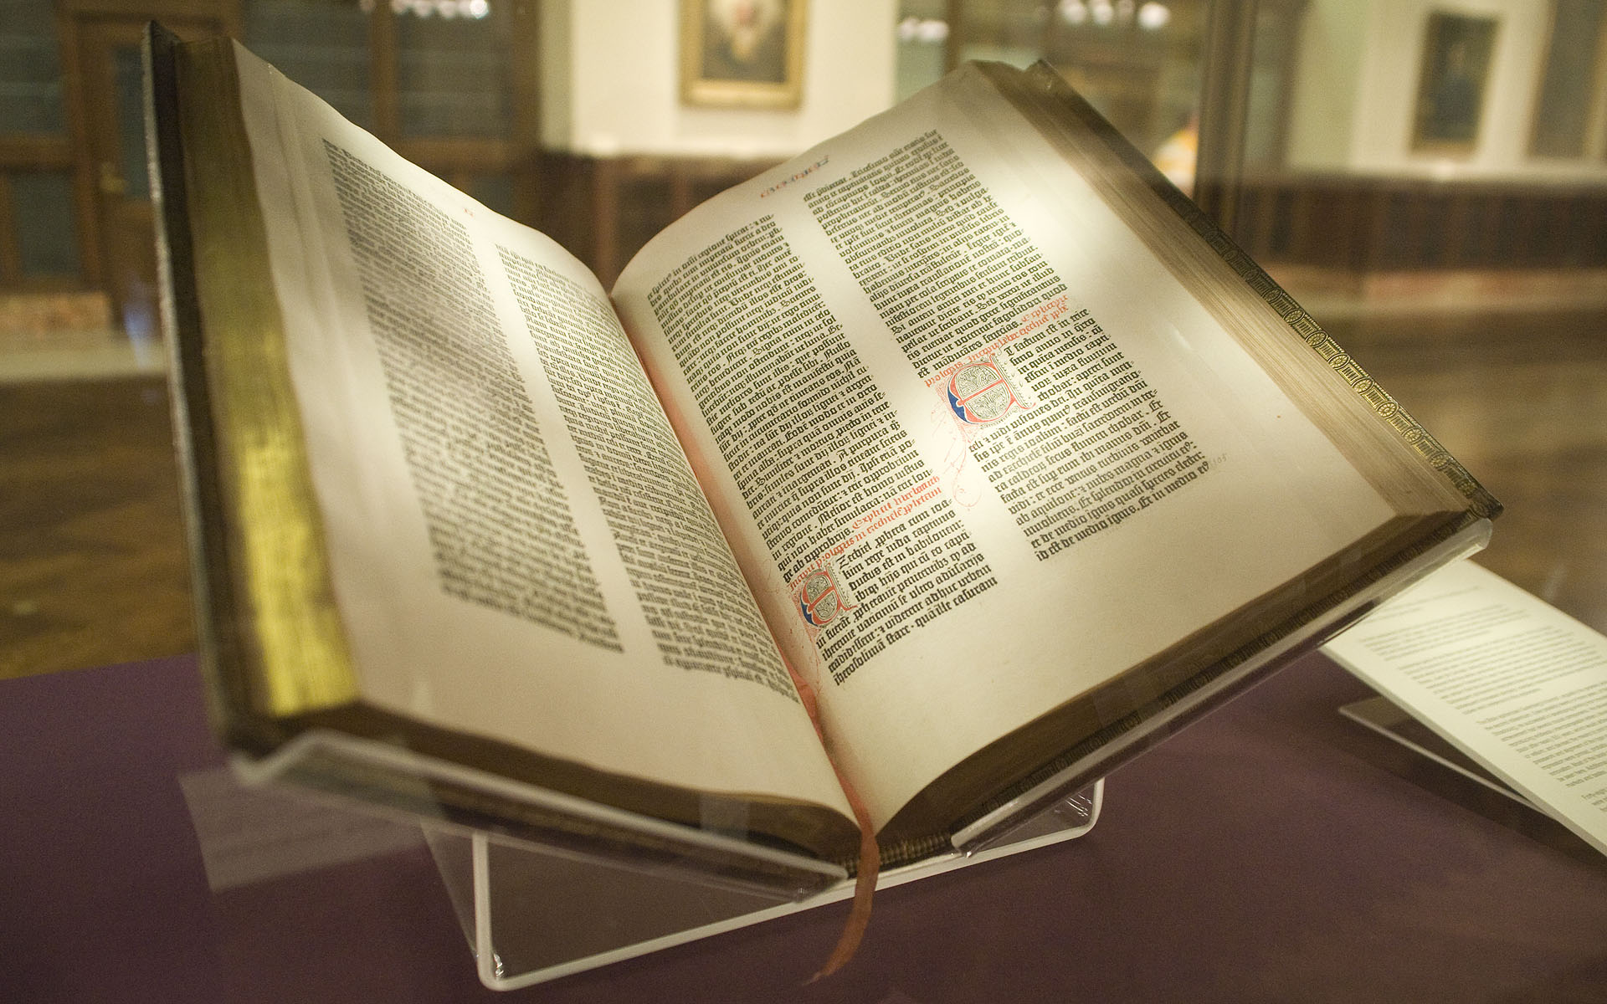

Slide 15
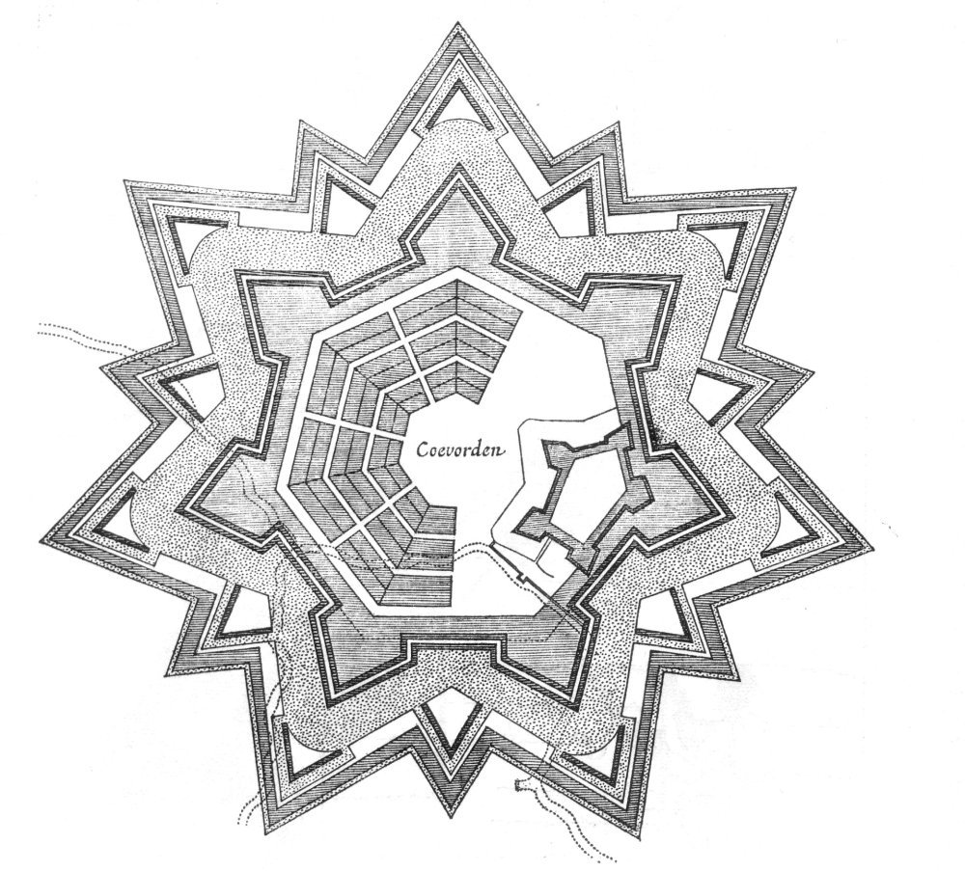

Slide 16
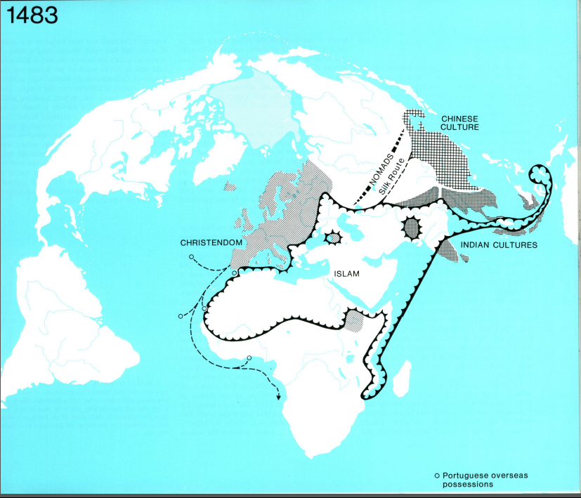

Slide 17
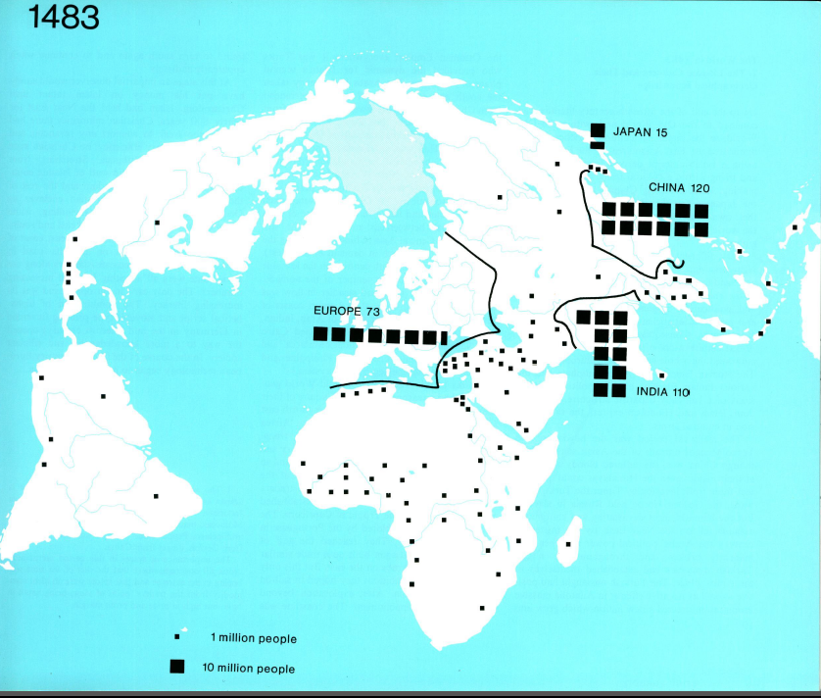
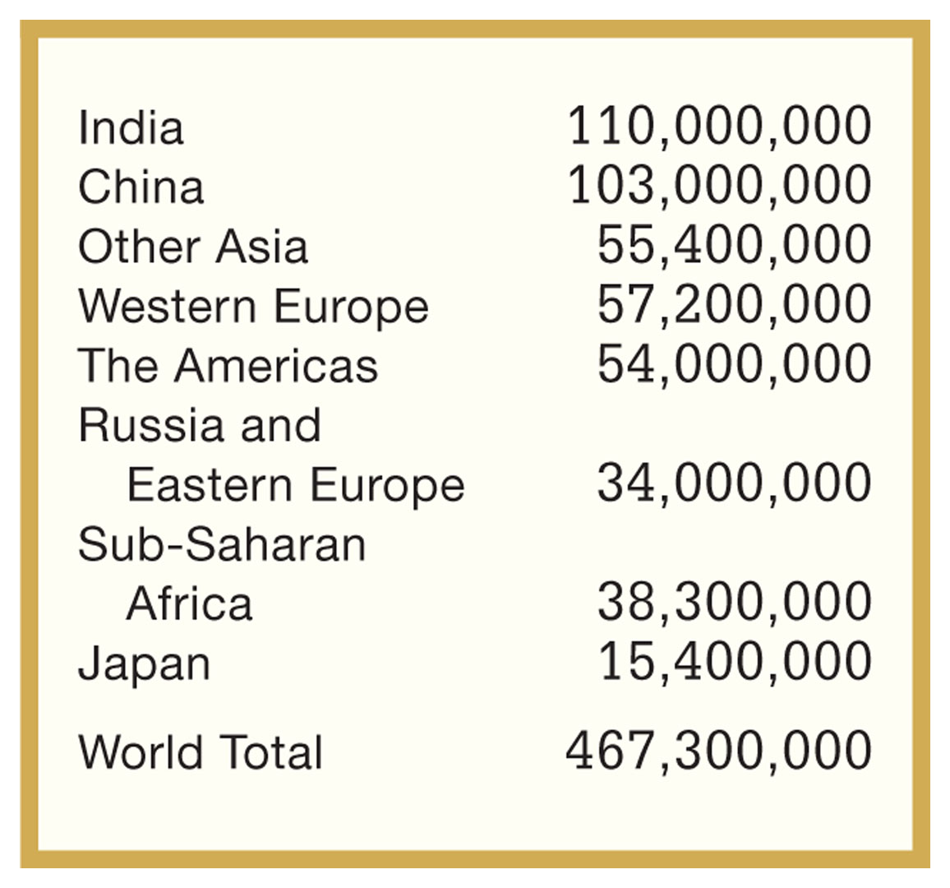
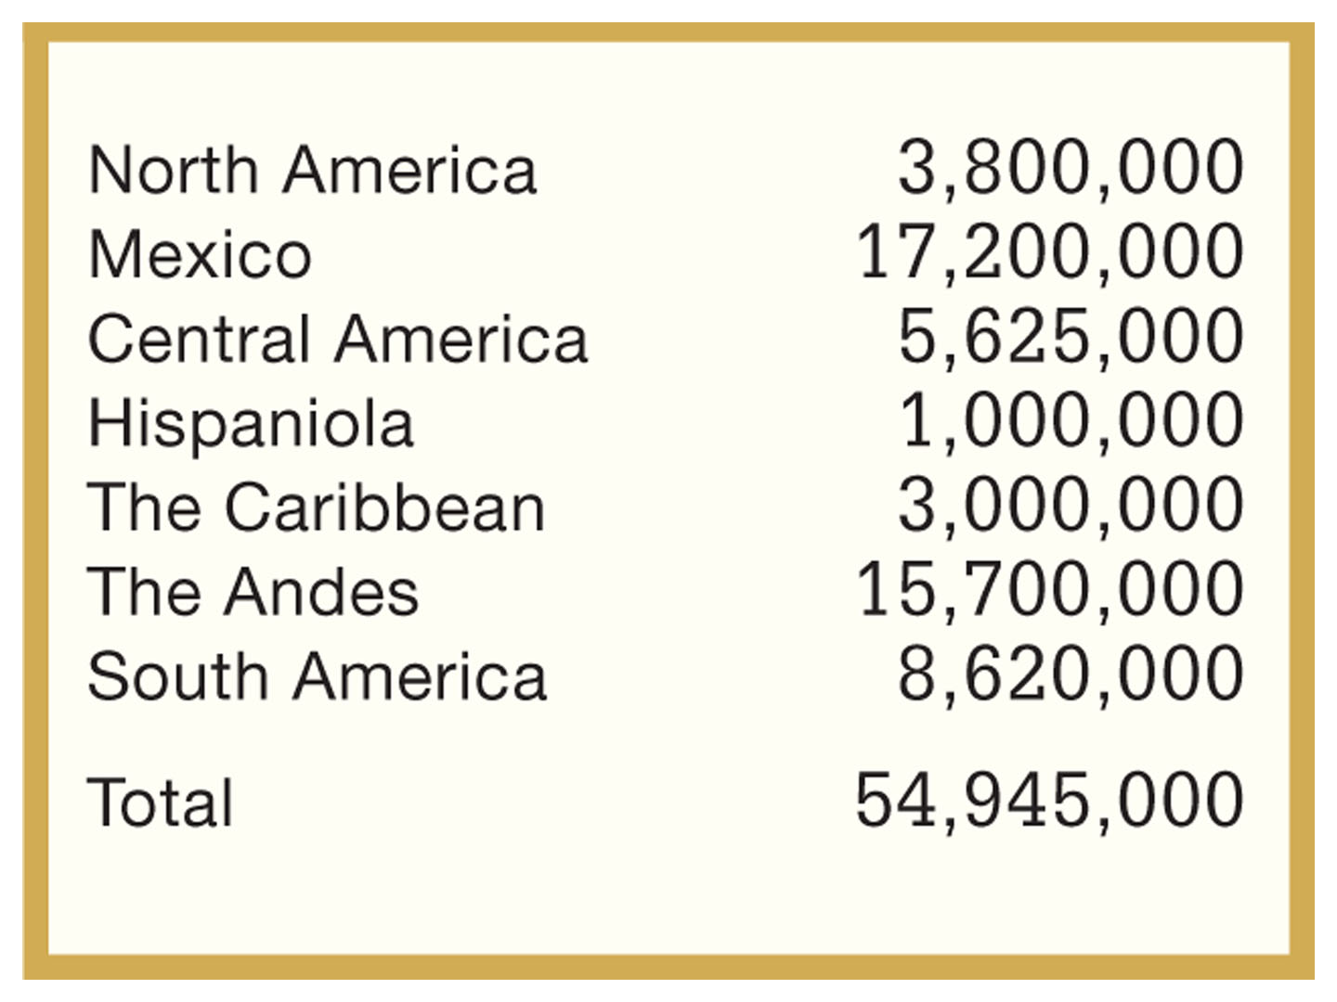
Estimated Populations
by Regions, ca. 1500
Estimated Populations:
The Americas, ca. 1500
McEvedy vs. more modern estimates in Foner

Slide 18
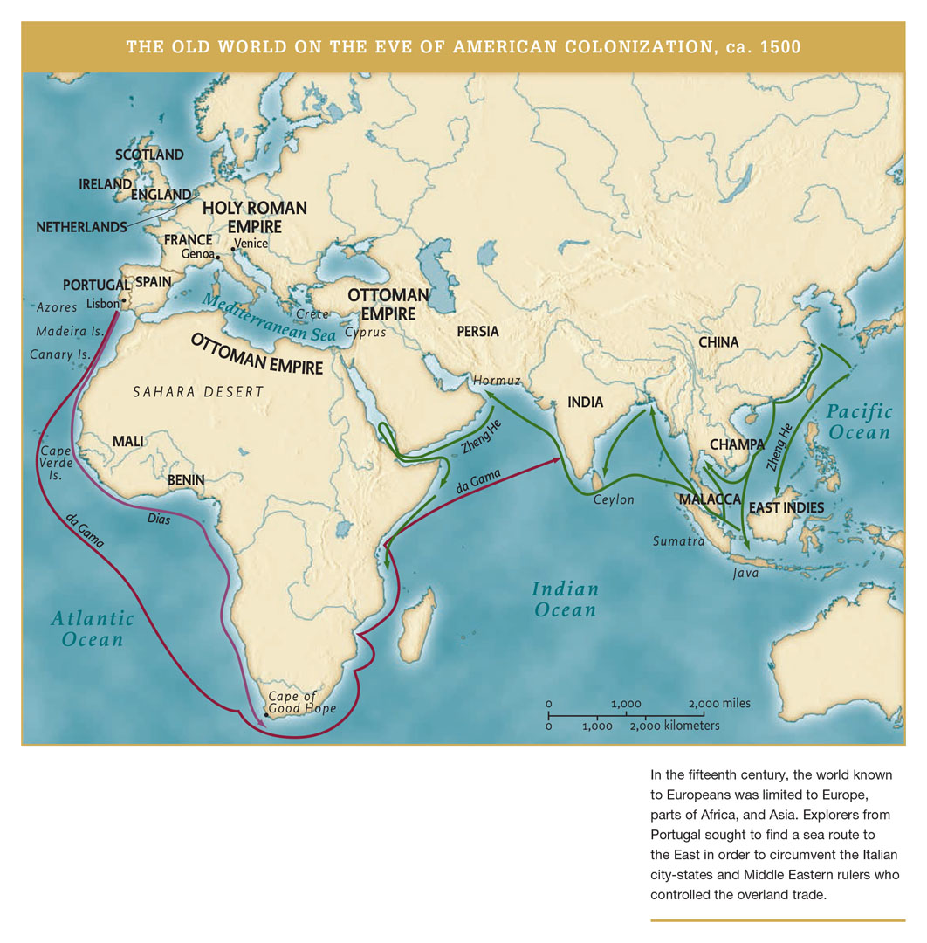

Slide 19
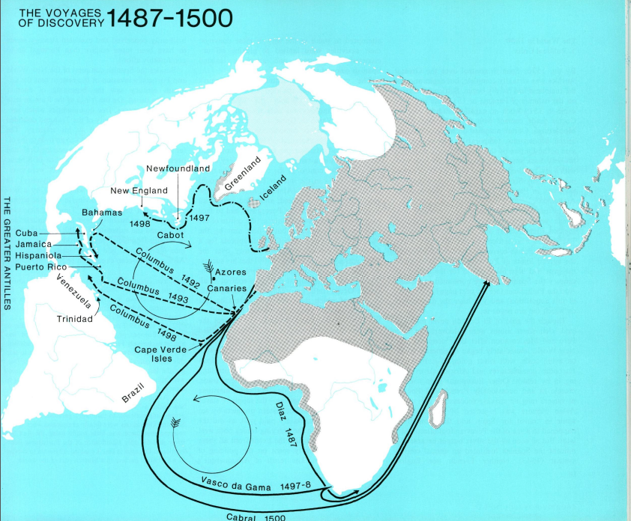

Slide 20
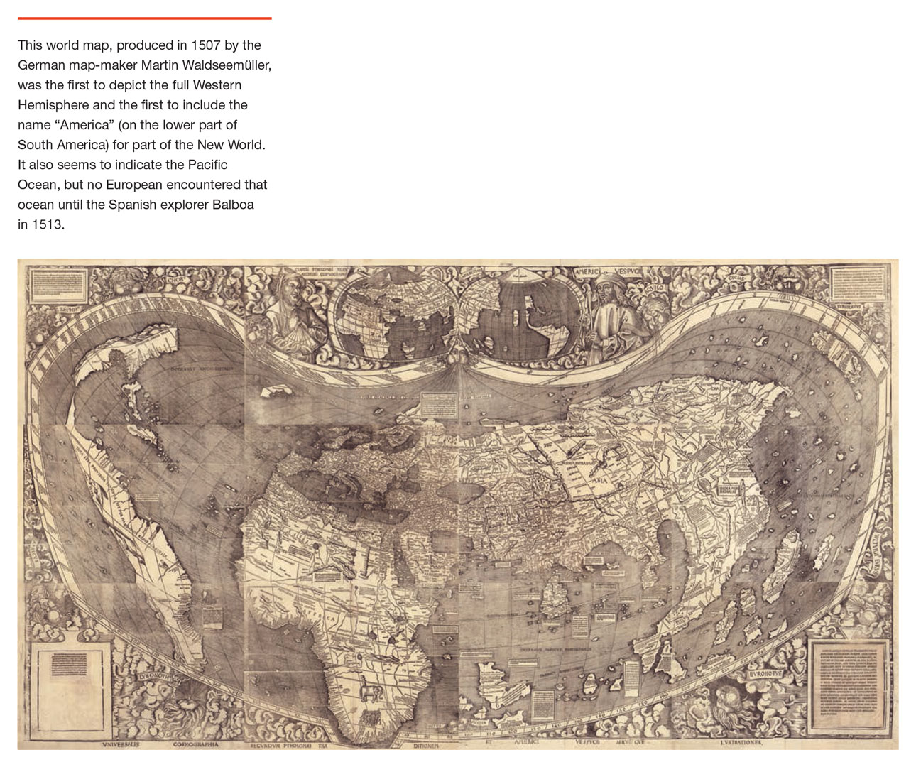

Slide 21
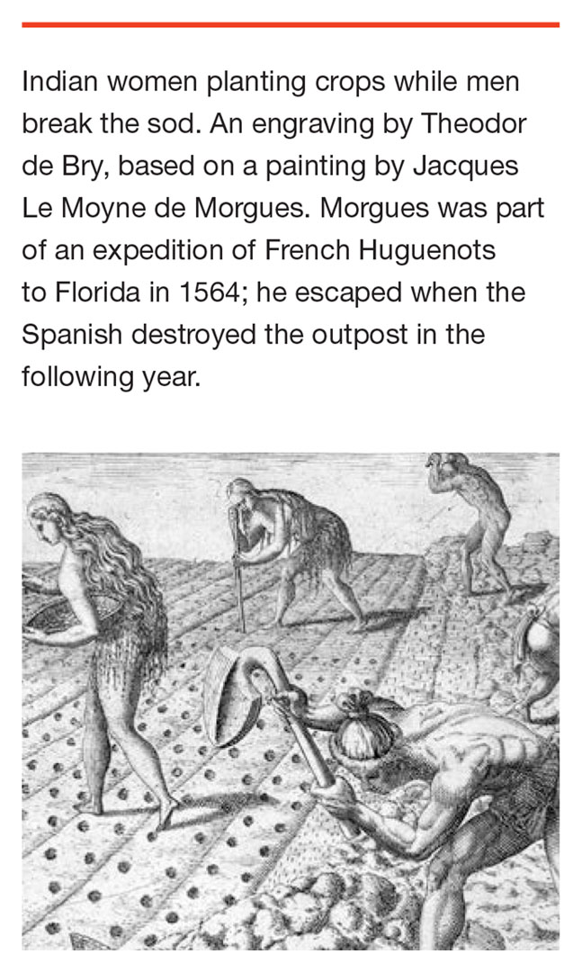
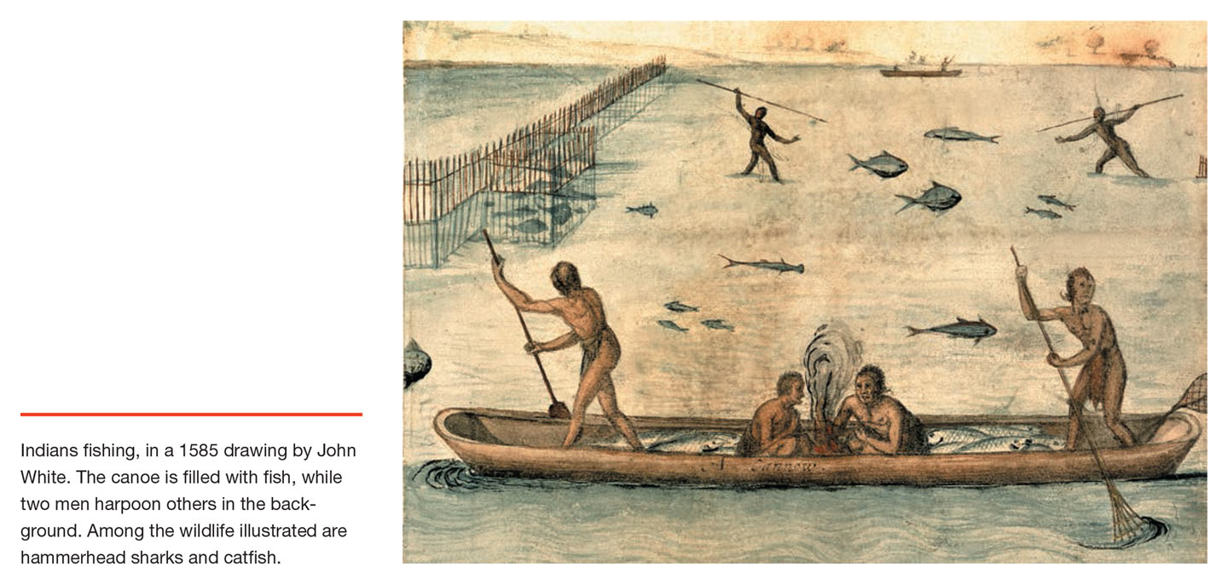

Slide 22
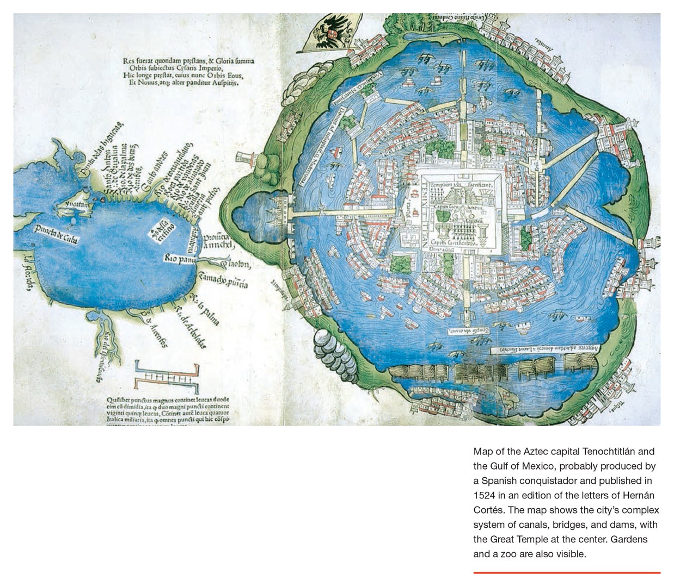

Slide 23
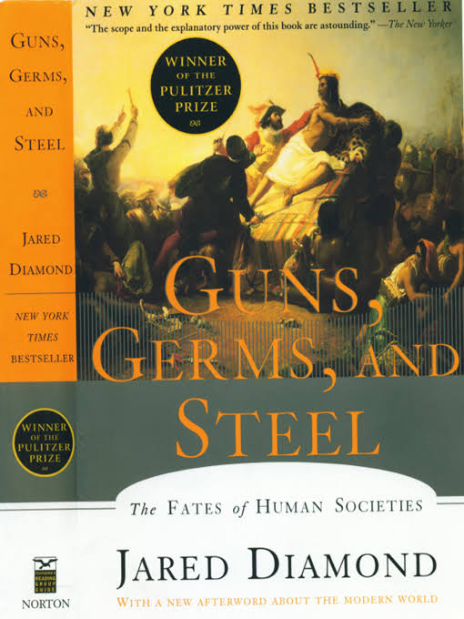

Slide 24
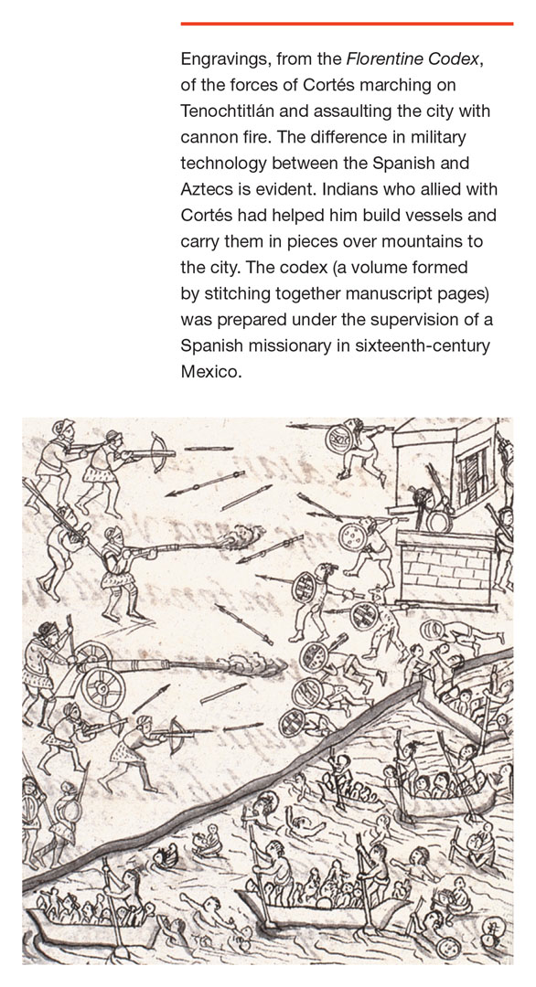
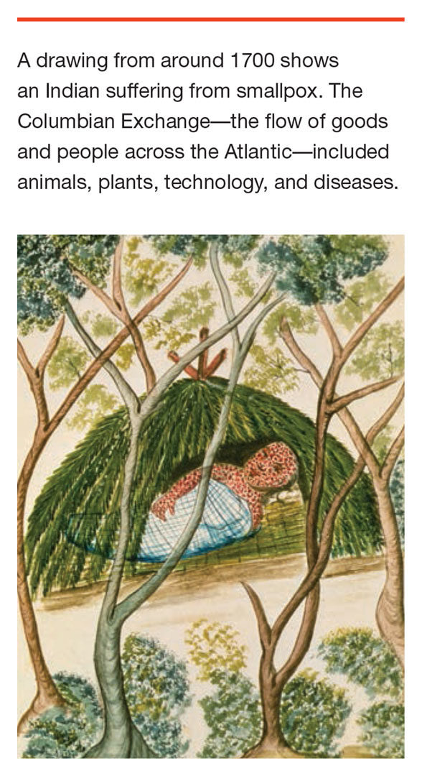

Slide 25
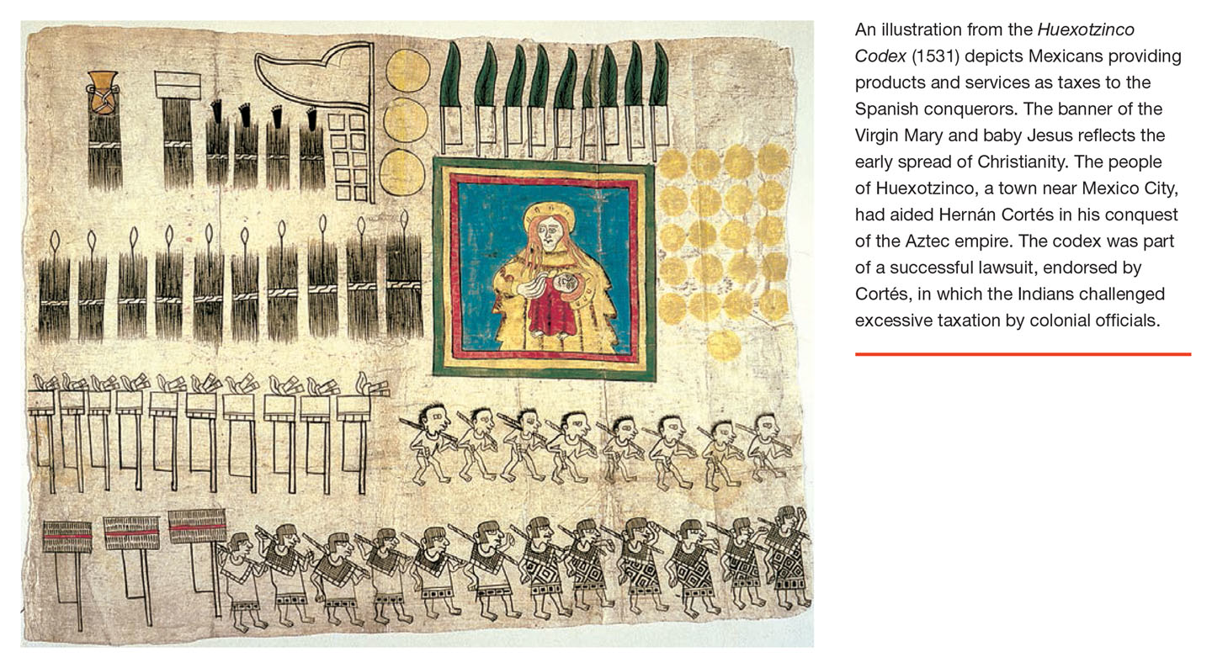

Slide 26
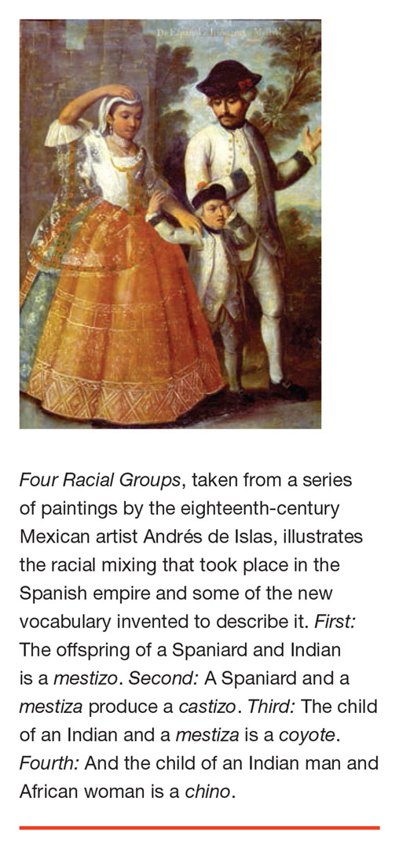
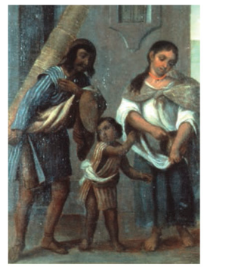
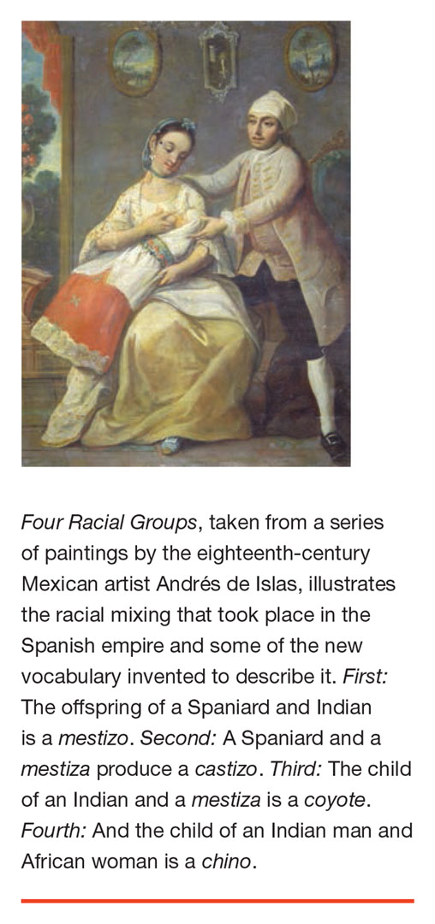
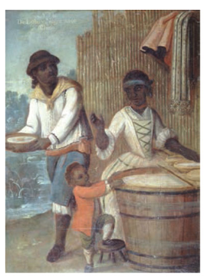

Slide 27
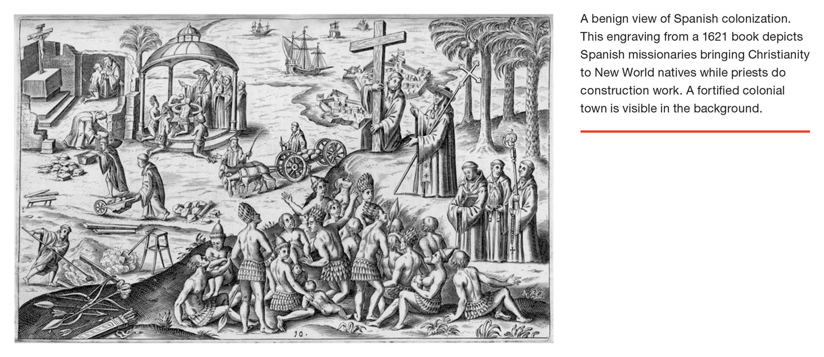
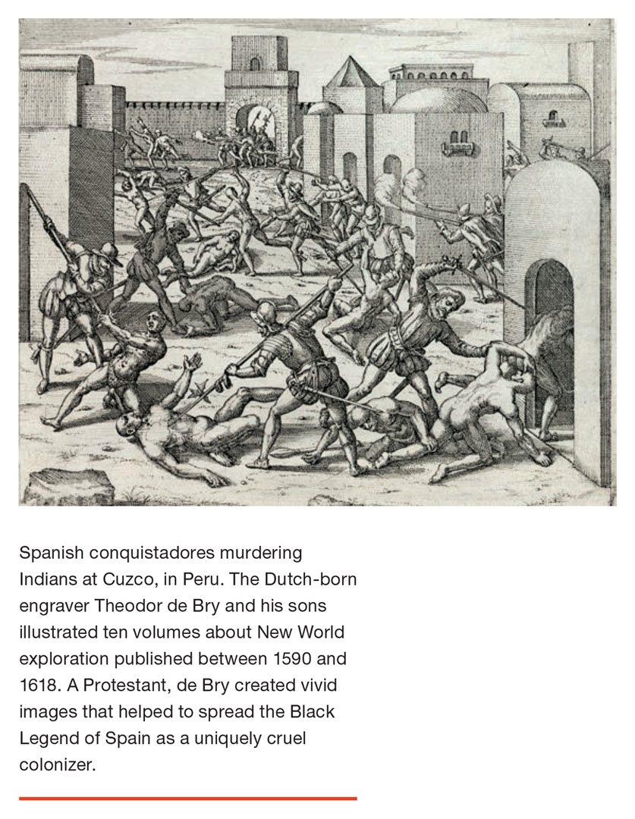

Slide 28
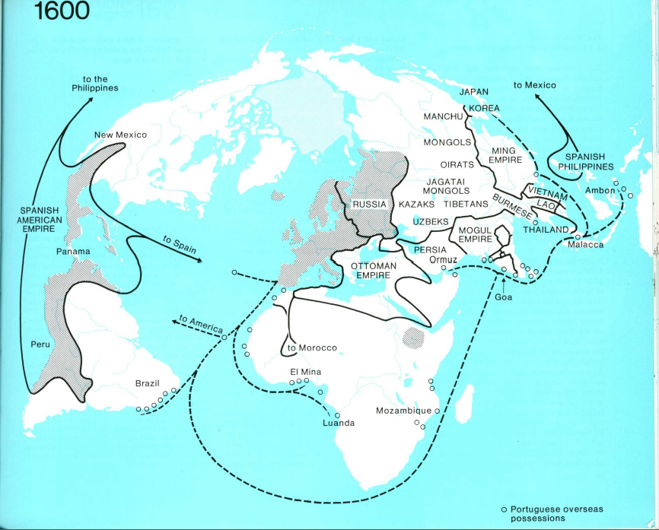

Slide 29
1500 – Population estimates for territories of later U.S. and Canada range from 2 to 5 million.
1500s – Establishment of Spanish Empire over most of present-day Latin America.
Late 1500s – Elizabethan England in hostility with Spain; context of wars of religion in Europe. Decision to establish colonies in Americas. First attempt, Roanoke colony (1587), disappears. Spanish Armada fails, 1588.
1607 – Establishment of Jamestown (Virginia colony).
1608 – Establishment of French colony at Quebec. Dutch expedition under Hudson.
1619 – First ship with slaves from Africa arrives in Virginia.
1620 – Mayflower voyage (beginning of New England).
1622-24 – Powhattan attack on Jamestown. Virginia company fails, English crown takes over.
1624-1664 – Dutch New Amsterdam/New Holland, seized in 1664 by British and re-chartered as New York, New Jersey and Delaware.
1636 – Expelled Puritan dissidents establish Connecticut (belief in government by consent of people) and Rhode Island (Roger Williams, peaceful approach to Naragansett).
1637-38 – “First Pequot War” in New England.
1655 – English force seizes Spanish colony on Jamaica.

Slide 30
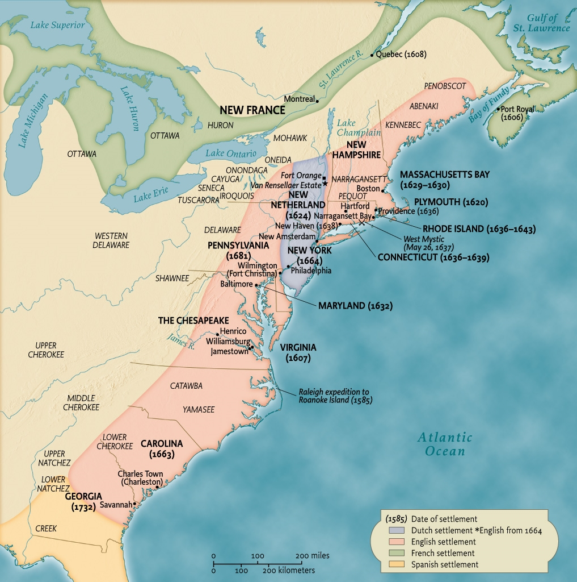
Eastern north america in the 17th and 18th centuries
Map 3.1 Eastern North America in the seventeenth
and early-eighteenth centuries
Give Me Liberty!: An American History, 4th Edition
Copyright © 2013 W.W. Norton & Company

Slide 31
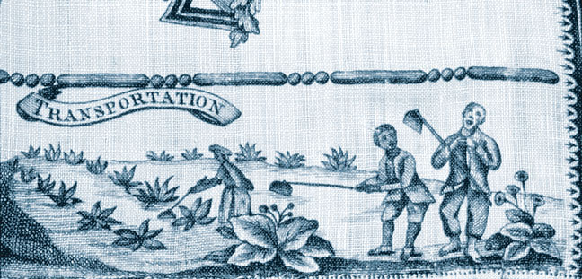
English Handkerchief
In this scene depicted on an English handkerchief,
male and female slaves work in the tobacco fields.
Give Me Liberty!: An American history, 4th Edition
Copyright © 2013 W.W. Norton & Company

Slide 32
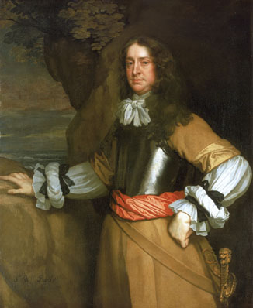
Sir William Berkeley
Give Me Liberty!: An American History, 4th Edition
Copyright © 2013 W.W. Norton & Company
Sir William Berkeley, governor of colonial Virginia

Slide 33
1663 – Carolinas established.
1676 – Bacon’s Rebellion in Virginia (associated with decisive in turn to chattel slavery over indentured servitude as labor system and codification of racial hierarchy in law). “Second Pequot War” in New England.
1681 – Establishment of Pennsylvania by Quaker settlers.
1692-93 – Salem witch trials.

Slide 34
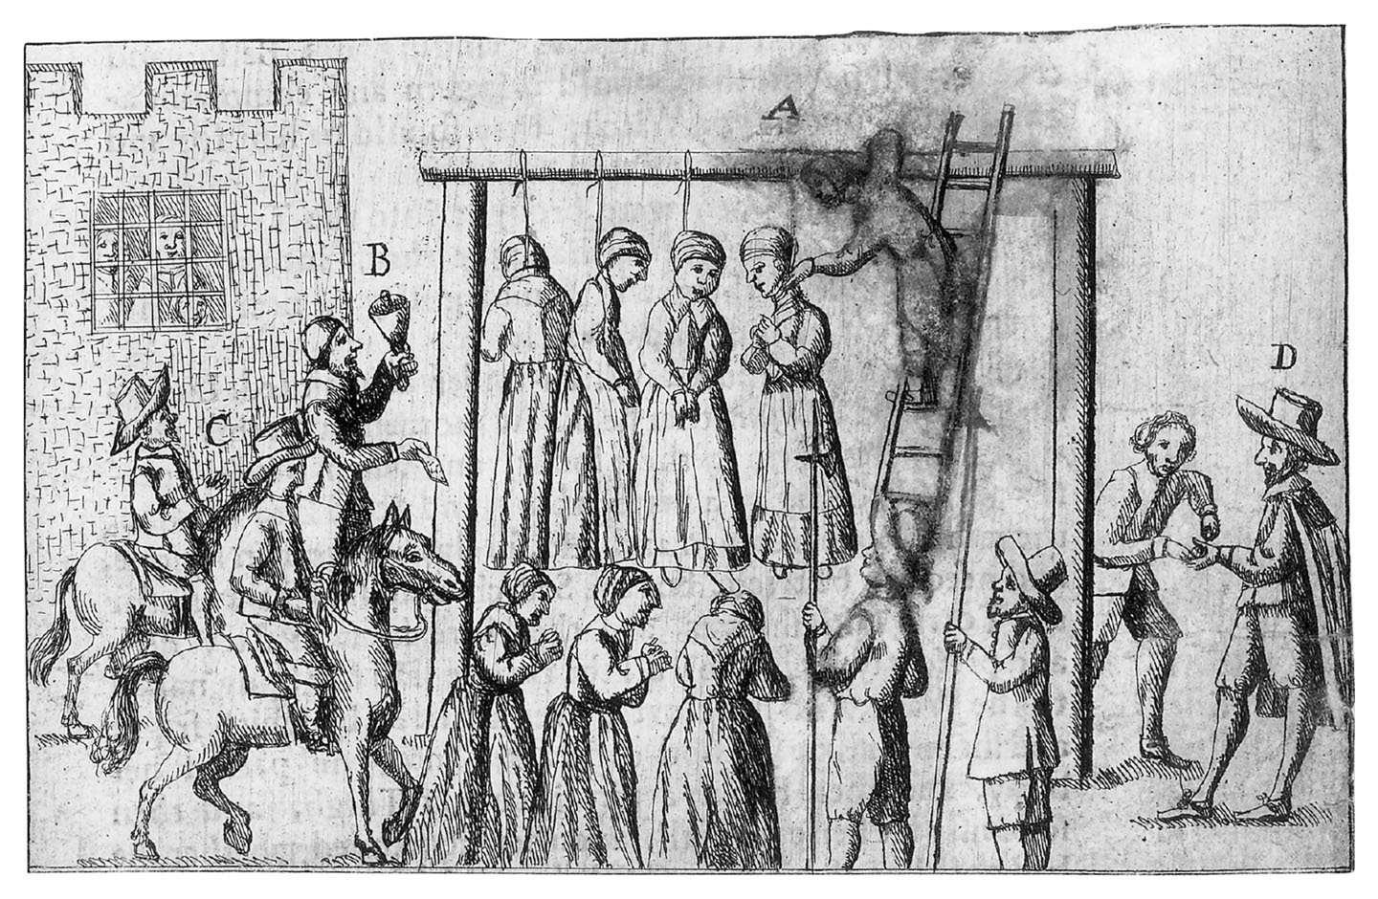
England’s Grievance Discovered
England’s Grievance Discovered
Give Me Liberty!: An American History, 4th Edition
Copyright © 2013 W.W. Norton & Company

Slide 35
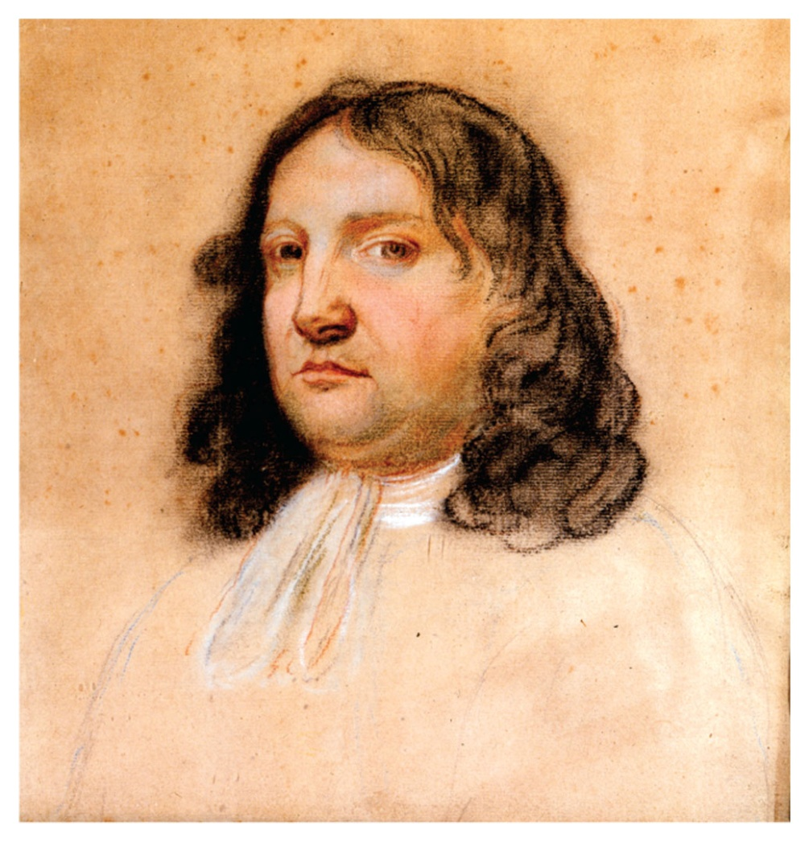
William Penn
William Penn
Give Me Liberty!: An American History, 4th Edition
Copyright © 2013 W.W. Norton & Company

Slide 36
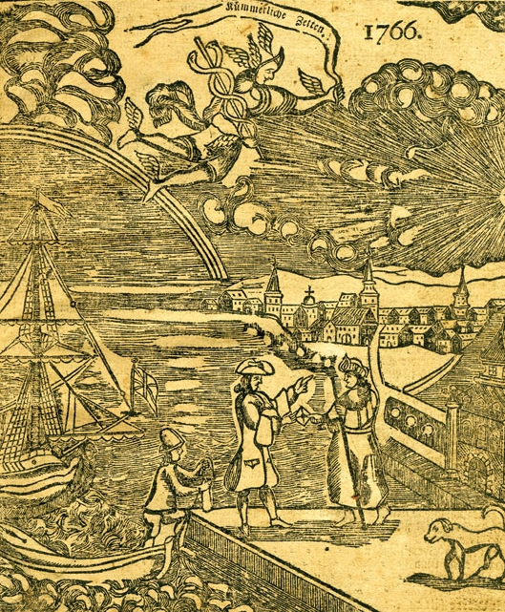
William Penn Welcomes an Immigrant
An early eighteenth-century engraving
depicts William Penn welcoming a German
immigrant on the dock in Philadelphia.
Give Me Liberty!: An American History, 4th Edition
Copyright © 2013 W.W. Norton & Company

Slide 37
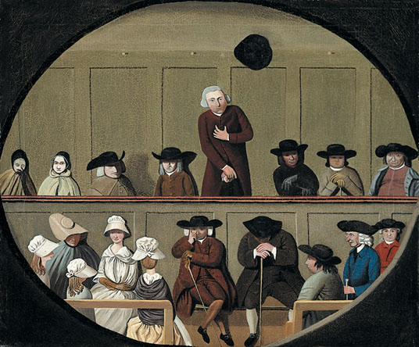
A Quaker Meeting
Give Me Liberty!: An American History, 4th Edition
Copyright © 2013 W.W. Norton & Company
A Quaker Meeting

Slide 38
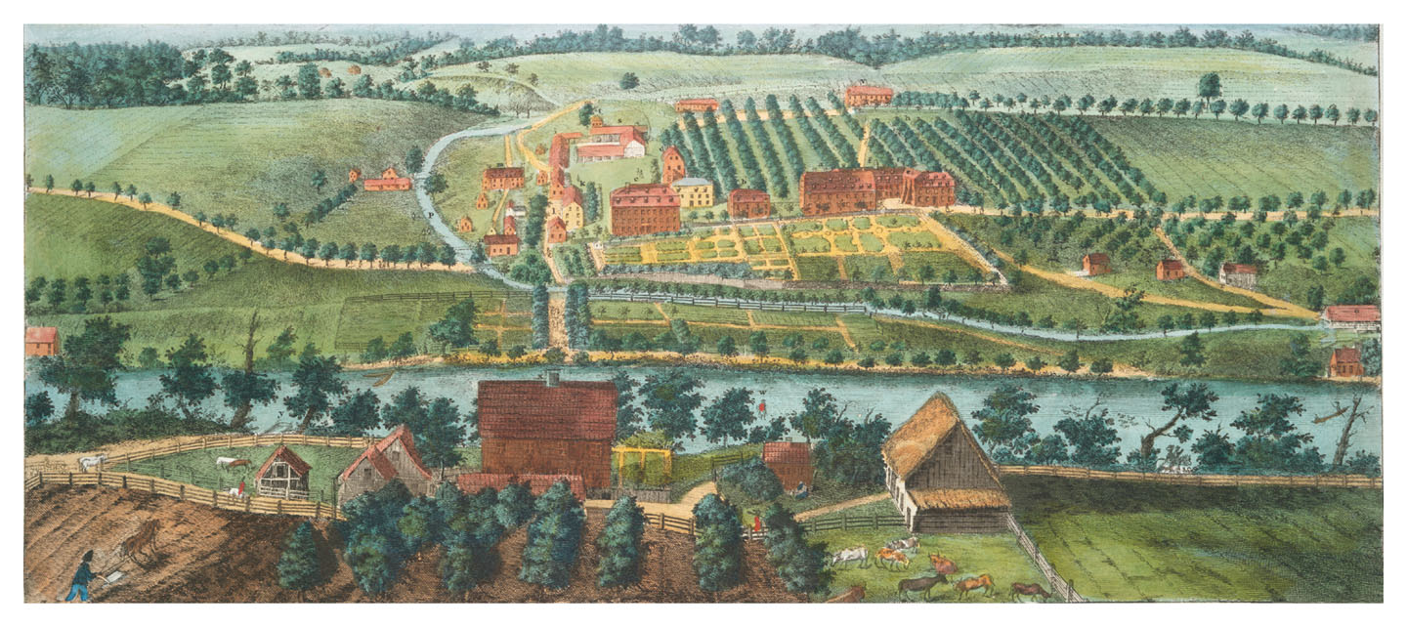
View of Bethlehem
View of Bethlehem, One of the Brethren’s Principal Settlements in Pennsylvania
Give Me Liberty!: An American History, 4th Edition
Copyright © 2013 W.W. Norton & Company

Slide 39
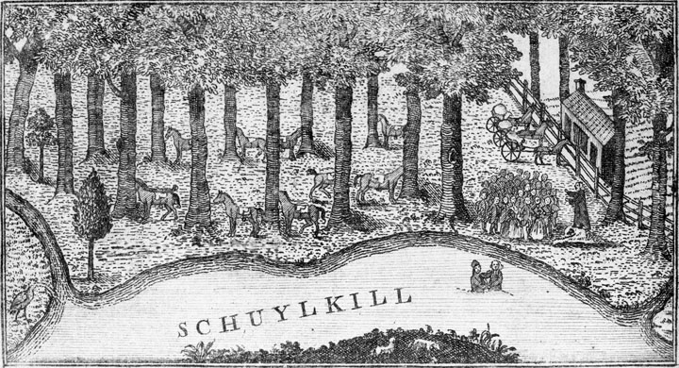
A Baptism in Pennsylvania
Baptists were among the numerous religious
denominations in the eighteenth-century colonies.
Give Me Liberty!: An American History, 4th Edition
Copyright © 2013 W.W. Norton & Company

Slide 40
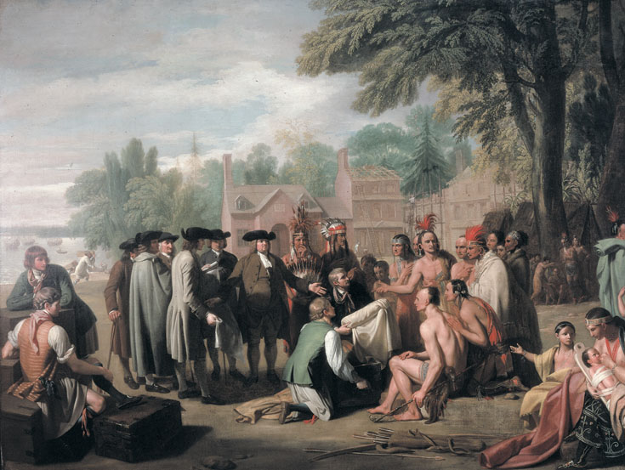
William Penn’s Treaty with the Indians
Give Me Liberty!: An American History, 4th Edition
Copyright © 2013 W.W. Norton & Company
William Penn’s Treaty with the Indians

Slide 41
1700 – Total population of English North American colonies: about 250,000.
1700-1775: Migrations to English colonies estimated at 600,000 arrivals, almost half from Africa (brought as slaves), 110,000 from Ireland, 85,000 from German lands, 100,000 from Britain. In addition to 280,000 slaves, about 100,000 arrive as indenturied servants, 52,000 as convicts, and about 150,000 as free. (Source: Foner, 4th Ed., 2014, Table 3.1, p. 111.)
1770: Philadelphia (pop. ~30,000) is biggest city in English colonies; New York second with pop. 20,000. The other big cities are Boston, Charleston and Newport.

Slide 42
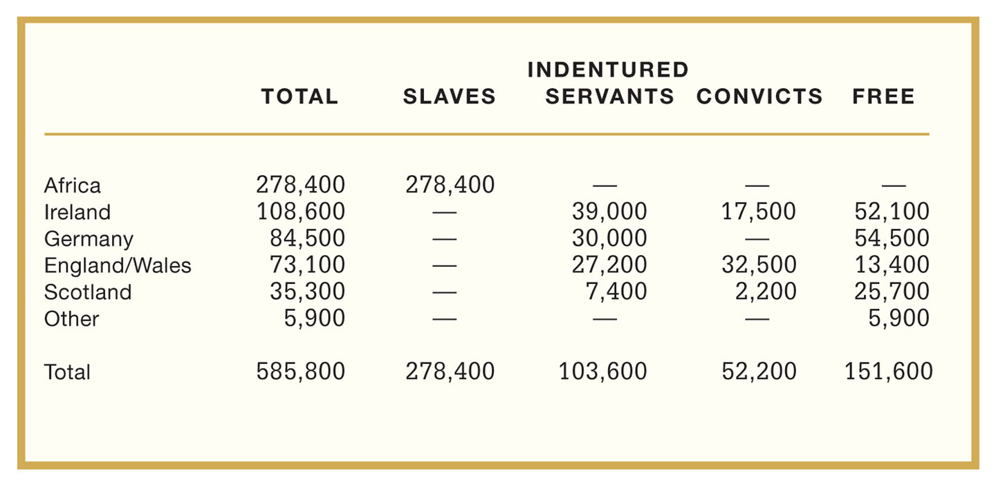
Origins and Status of Migrants to British North American Colonies, 1700–1775
ESTIMATED ARRIVALS TO 13 COLONIES, 1700-1770s
TABLE 3.1 Origins and Status of Migrants to
British North American colonies, 1700–1775
Give Me Liberty!: An American History, 4th Edition
Copyright © 2013 W.W. Norton & Company

Slide 43
1718 – New Orleans founded as capital of French Louisiana.
1730 – Establishment of Georgia (last of 13 colonies). Since 1717, England uses banishment to colonies as punishment for many convicted criminals.
1730s – Great Awakening, religious revivals sweep colonies.
1734-35 – Zenger case in New York sets free speech precedent.
1739 – Slave rebellion in Stono, South Carolina; fugitives flee to Spanish Florida. (Spain has policy of accepting fugitive slaves from English colonies; this increases the Seminole nations in Florida.)
1750 – Estimated European and African population of British colonies, from Nova Scotia to Georgia: 1.2 million. New England 350,000, middle colonies 300,000, South 500,000.
1700s-1800s: First industrial revolution in England. (Similar development in U.S. after 1815, in France from 1820s and in German lands from 1840s.)
1754 – Seven Year’s War, a world war of European empires, originates with colonists’ conflict with natives on Ohio River. Around this time Benjamin Franklin presents “Albany Plan” for united defense of colonies. In Pennsylvania, non-Quaker majority supports war with Indians.
1763 – End of Seven Years’ War, line of settlement, beginning of pre-revolutionary period.

Slide 44
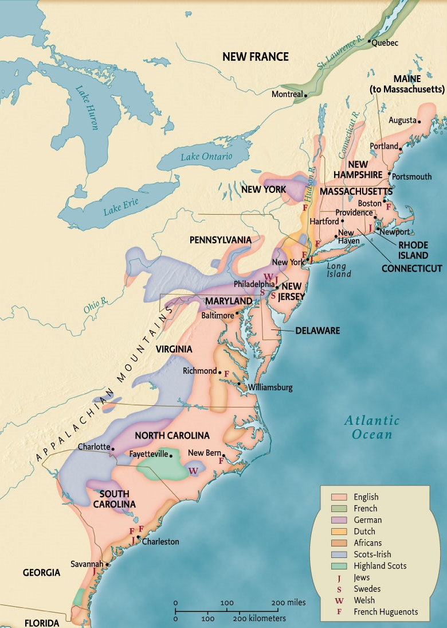
European Settlement on the Atlantic Coast
Map 3.2 European settlement and ethnic diversity on the
Atlantic coast of North America, 1760
Give Me Liberty!: An American History, 4th Edition
Copyright © 2013 W.W. Norton & Company

Slide 45
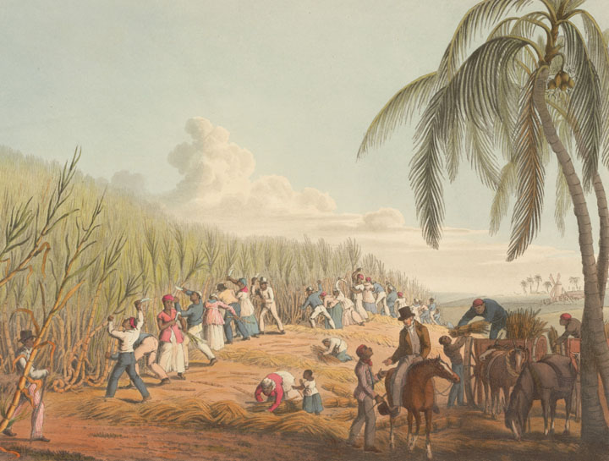
Cutting Sugar Cane
Cutting Sugar Cane, an engraving from Ten
Views in Antigua
Give Me Liberty!: An American History, 4th Edition
Copyright © 2013 W.W. Norton & Company

Slide 46
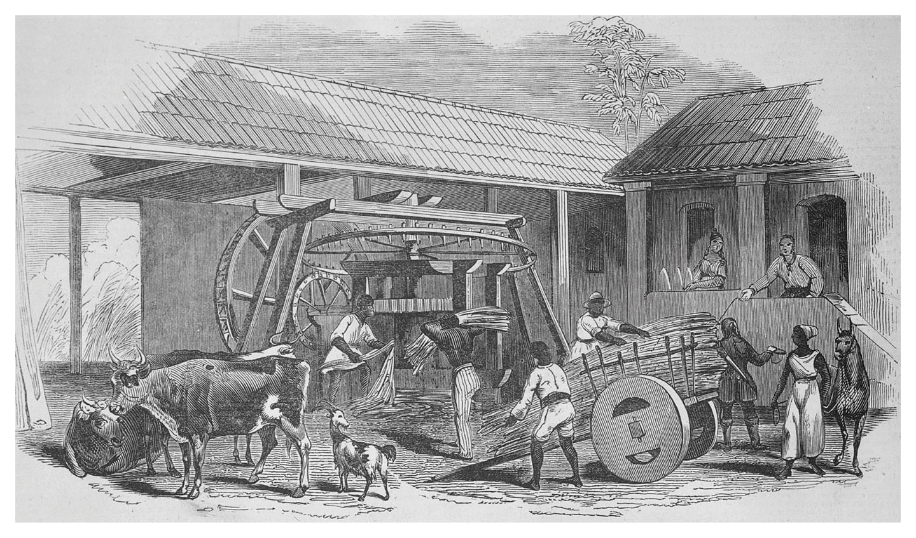
A Sugar Mill
Operation of a Sugar Mill
Give Me Liberty!: An American History, 4th Edition
Copyright © 2013 W.W. Norton & Company

Slide 47
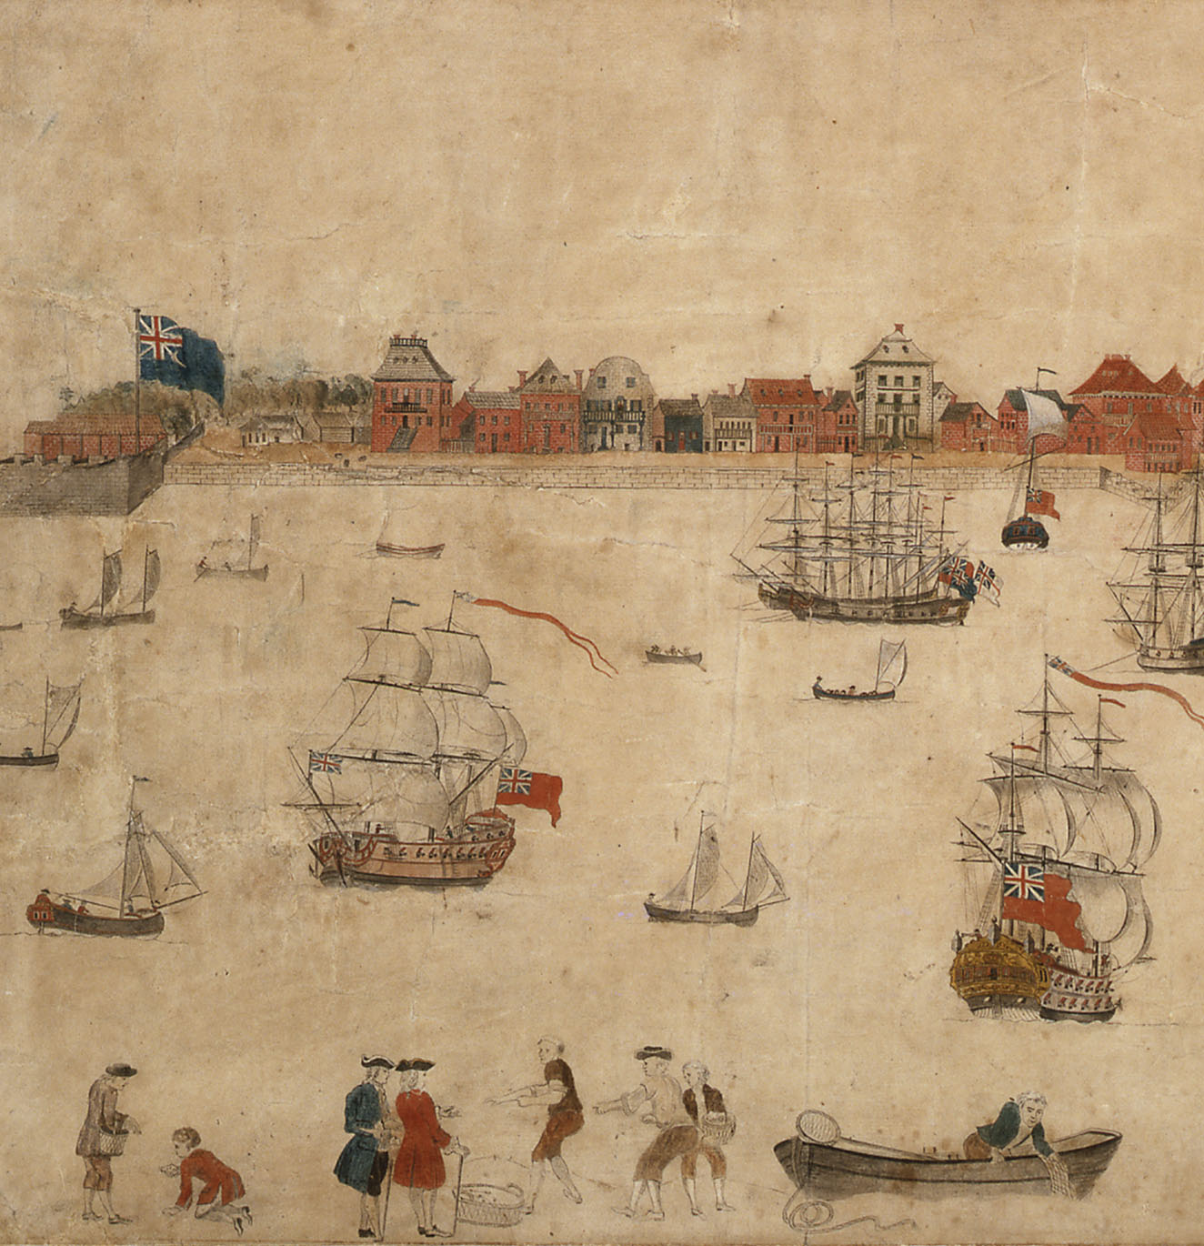
Charles Town Harbor
Charles Town Harbor
Give Me Liberty!: An American History, 4th Edition
Copyright © 2013 W.W. Norton & Company

Slide 48
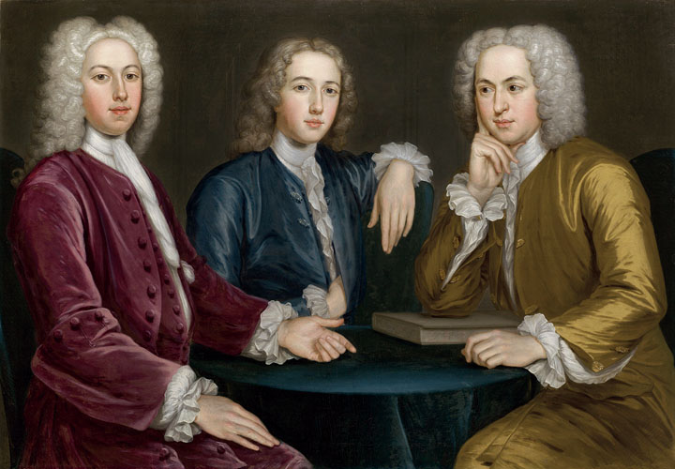
Daniel, Peter, and Andrew Oliver
A 1732 portrait of Daniel, Peter, and Andrew Oliver,
sons of a wealthy Boston merchant
Give Me Liberty!: An American History, 4th Edition
Copyright © 2013 W.W. Norton & Company

Slide 49

The Cheney Family
This portrait of the Cheney family illustrates the
high birthrate in America.
Give Me Liberty!: An American History, 4th Edition
Copyright © 2013 W.W. Norton & Company

Slide 50


Slide 51


Slide 52
The provincial colonies included New Hampshire, New York, Virginia, North Carolina, South Carolina, and Georgia. The proprietary colonies included Pennsylvania, Delaware, New Jersey, and Maryland. The charter colonies included Massachusetts, Rhode Island, and Connecticut. The provincial colonies were the most tightly controlled by the crown. The British king appointed all of the provincial governors. These crown governors could veto any decision made by the legislative assemblies in the provincial colonies. The proprietary colonies had a similar structure, with one important difference: governors were appointed by a lord proprietor, an individual who had purchased or received the rights to the colony from the crown. This generally led to proprietary colonies having more freedoms and liberties than other colonies in colonial America. The charter colonies had the most complex system of government, formed by political corporations or interest groups who drew up a charter that clearly delineated powers between executive, legislative, and judiciary branches of government. As opposed to having governors appointed, the charter colonies elected their own governors from among the property-owning men in the colony. Over the course of the eighteenth century, local control over the selection of governors eroded.

Slide 53

ΝΕΧΤ WEEK
Watch PBS / BBC Documentary “THE AMERICAN REVOLUTION,” Episode 1 online
https://www.youtube.com/watch?v=wsSpvkLfUDA
Review American Yawp, Chapters 5 and 6 but keep up with the assigned reading.

