Slide 1
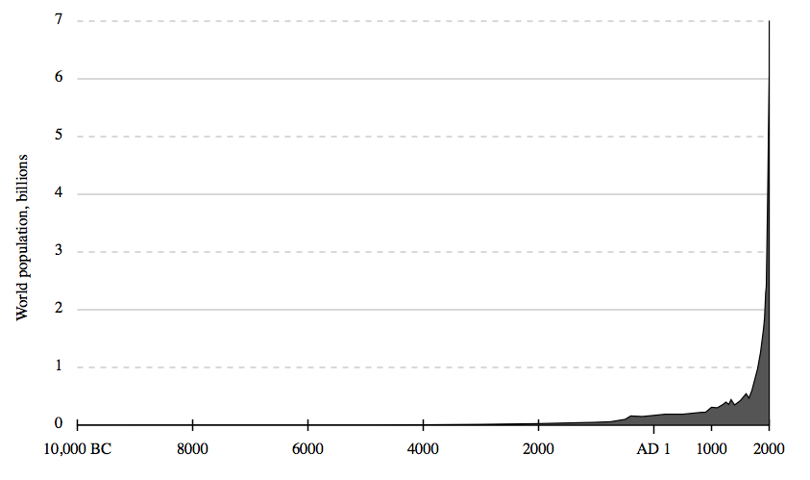
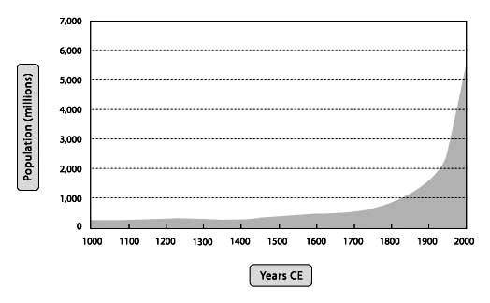
Big Picture
World Population Estimates
Last 12,000 Years
Last 1,000 Years
Source: Wikimedia, https://commons.wikimedia.org/wiki/File:Population_curve.svg
produced using lower historical estimates of U.S. Census Bureau at
http://www.census.gov/population/international/data/worldpop/table_history.php
Source: Christian, David. 2004. Maps of Time an Introduction to Big History. Berk`eley: University of California Press.

Slide 2
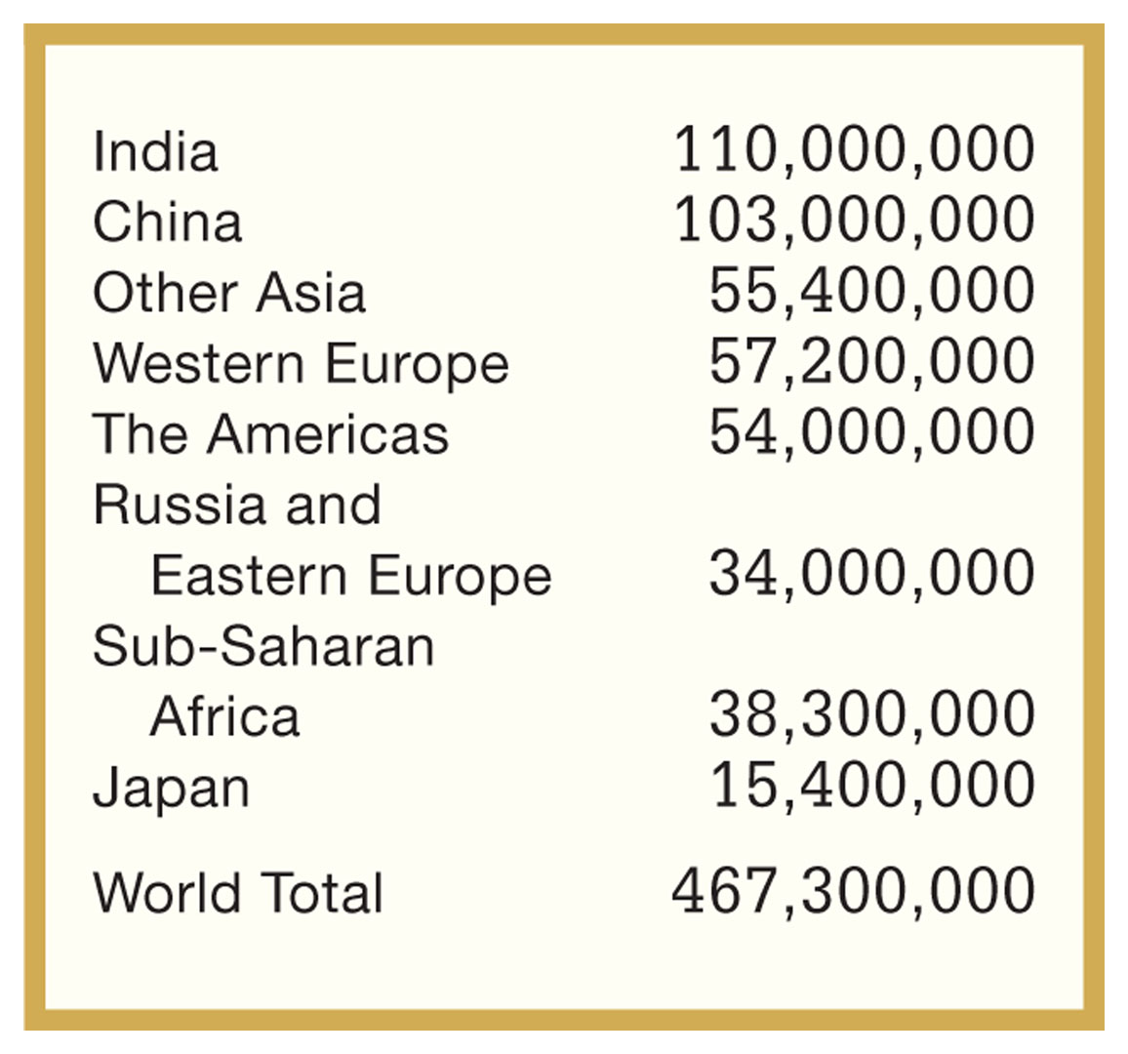
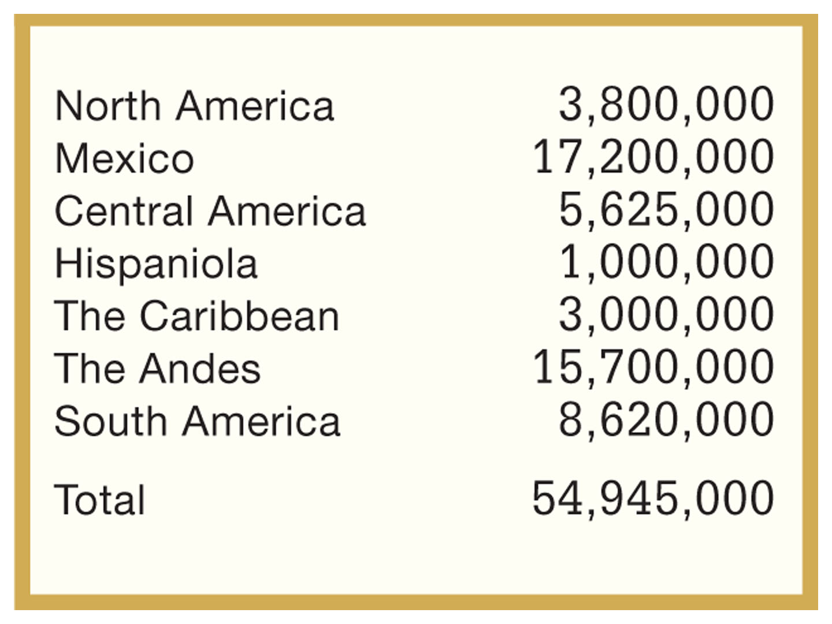
Estimated Regional Populations: The World, ca. 1500
World Populations by Region, 1500
Table 1.2 Estimated Regional
Populations, ca. 1500
Table 1.1 Estimated Regional Populations:
The Americas, ca. 1500
Give Me Liberty!: An American History, 4th Edition
Copyright © 2013 W.W. Norton & Company

Slide 3
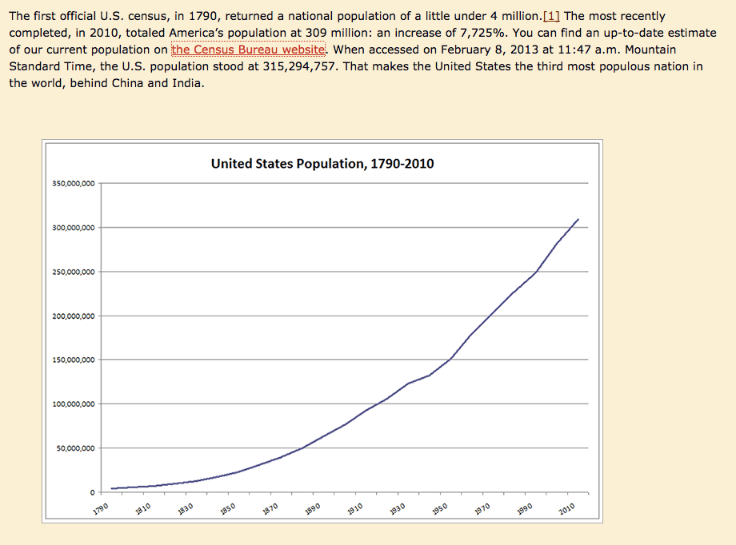
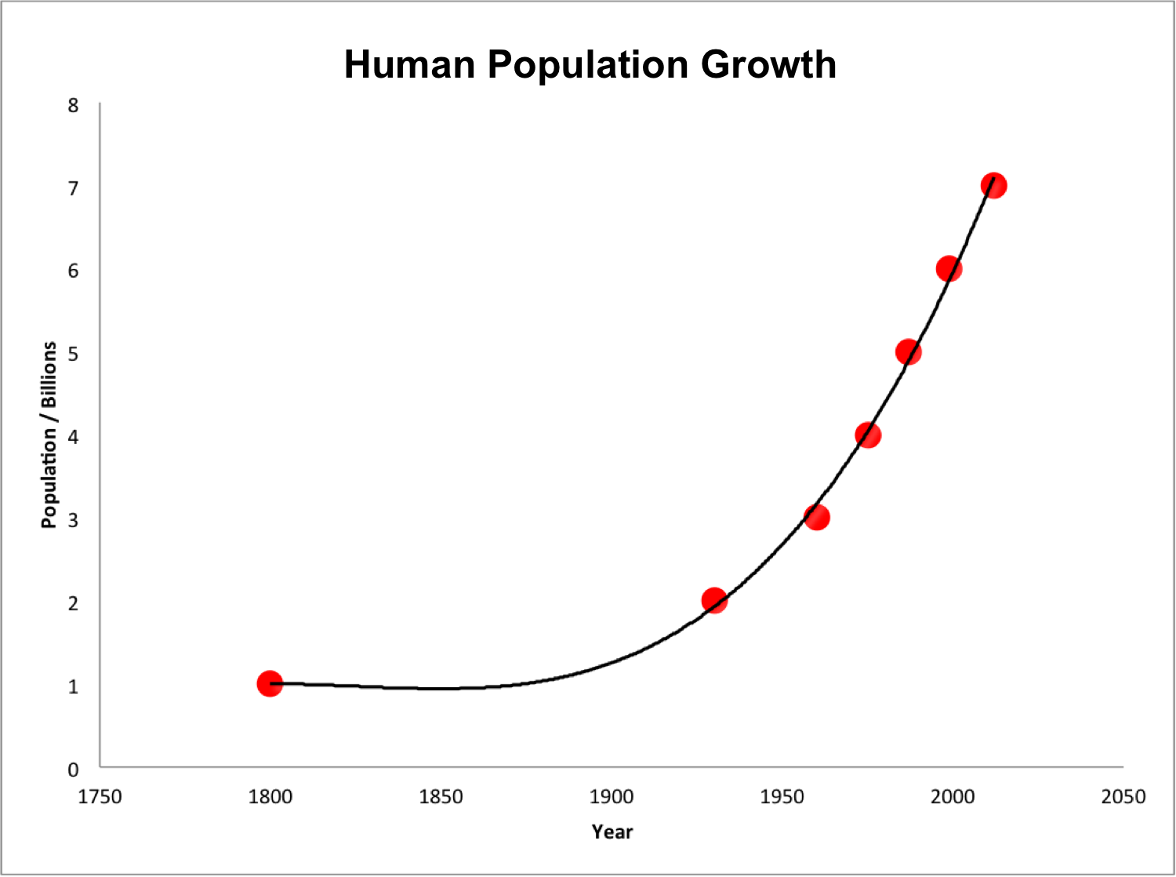
World, 1800-2010

Slide 4
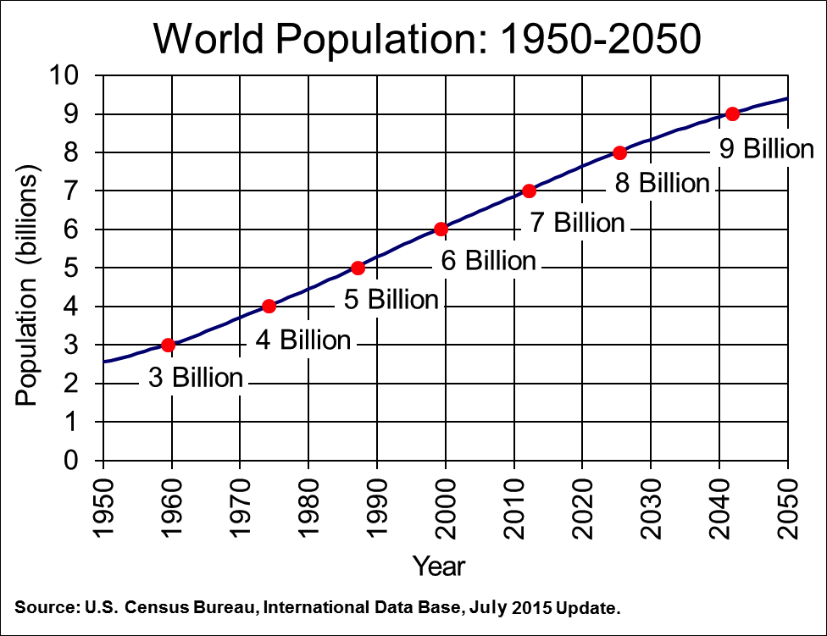
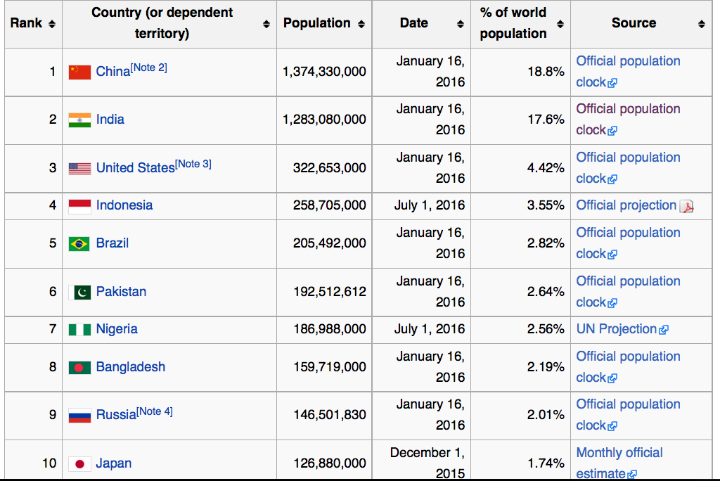
Top 10 Countries by Population, 2016
Links to data sources at
https://en.wikipedia.org/wiki/List_of_countries_and_dependencies_by_population

Slide 5
Quiz #0
How much of this can you fill in?

Slide 6
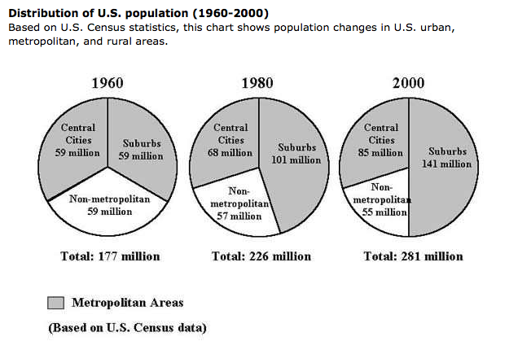
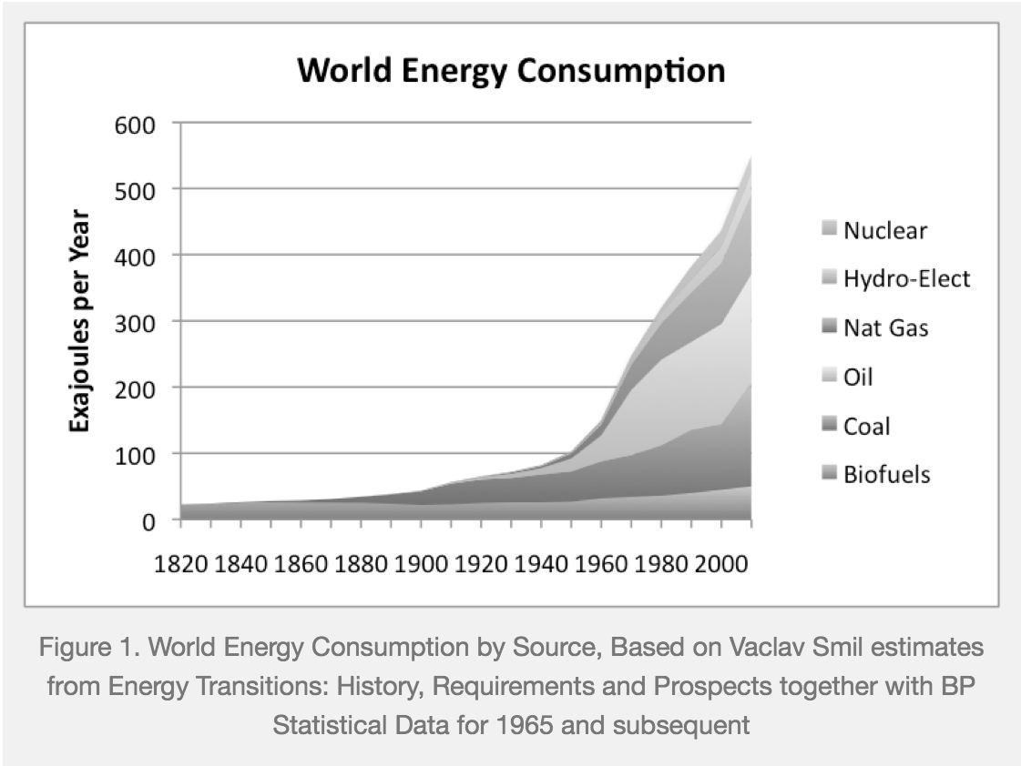

Slide 7
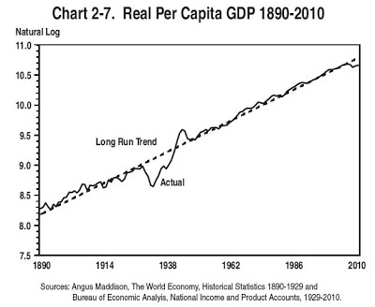

Slide 8
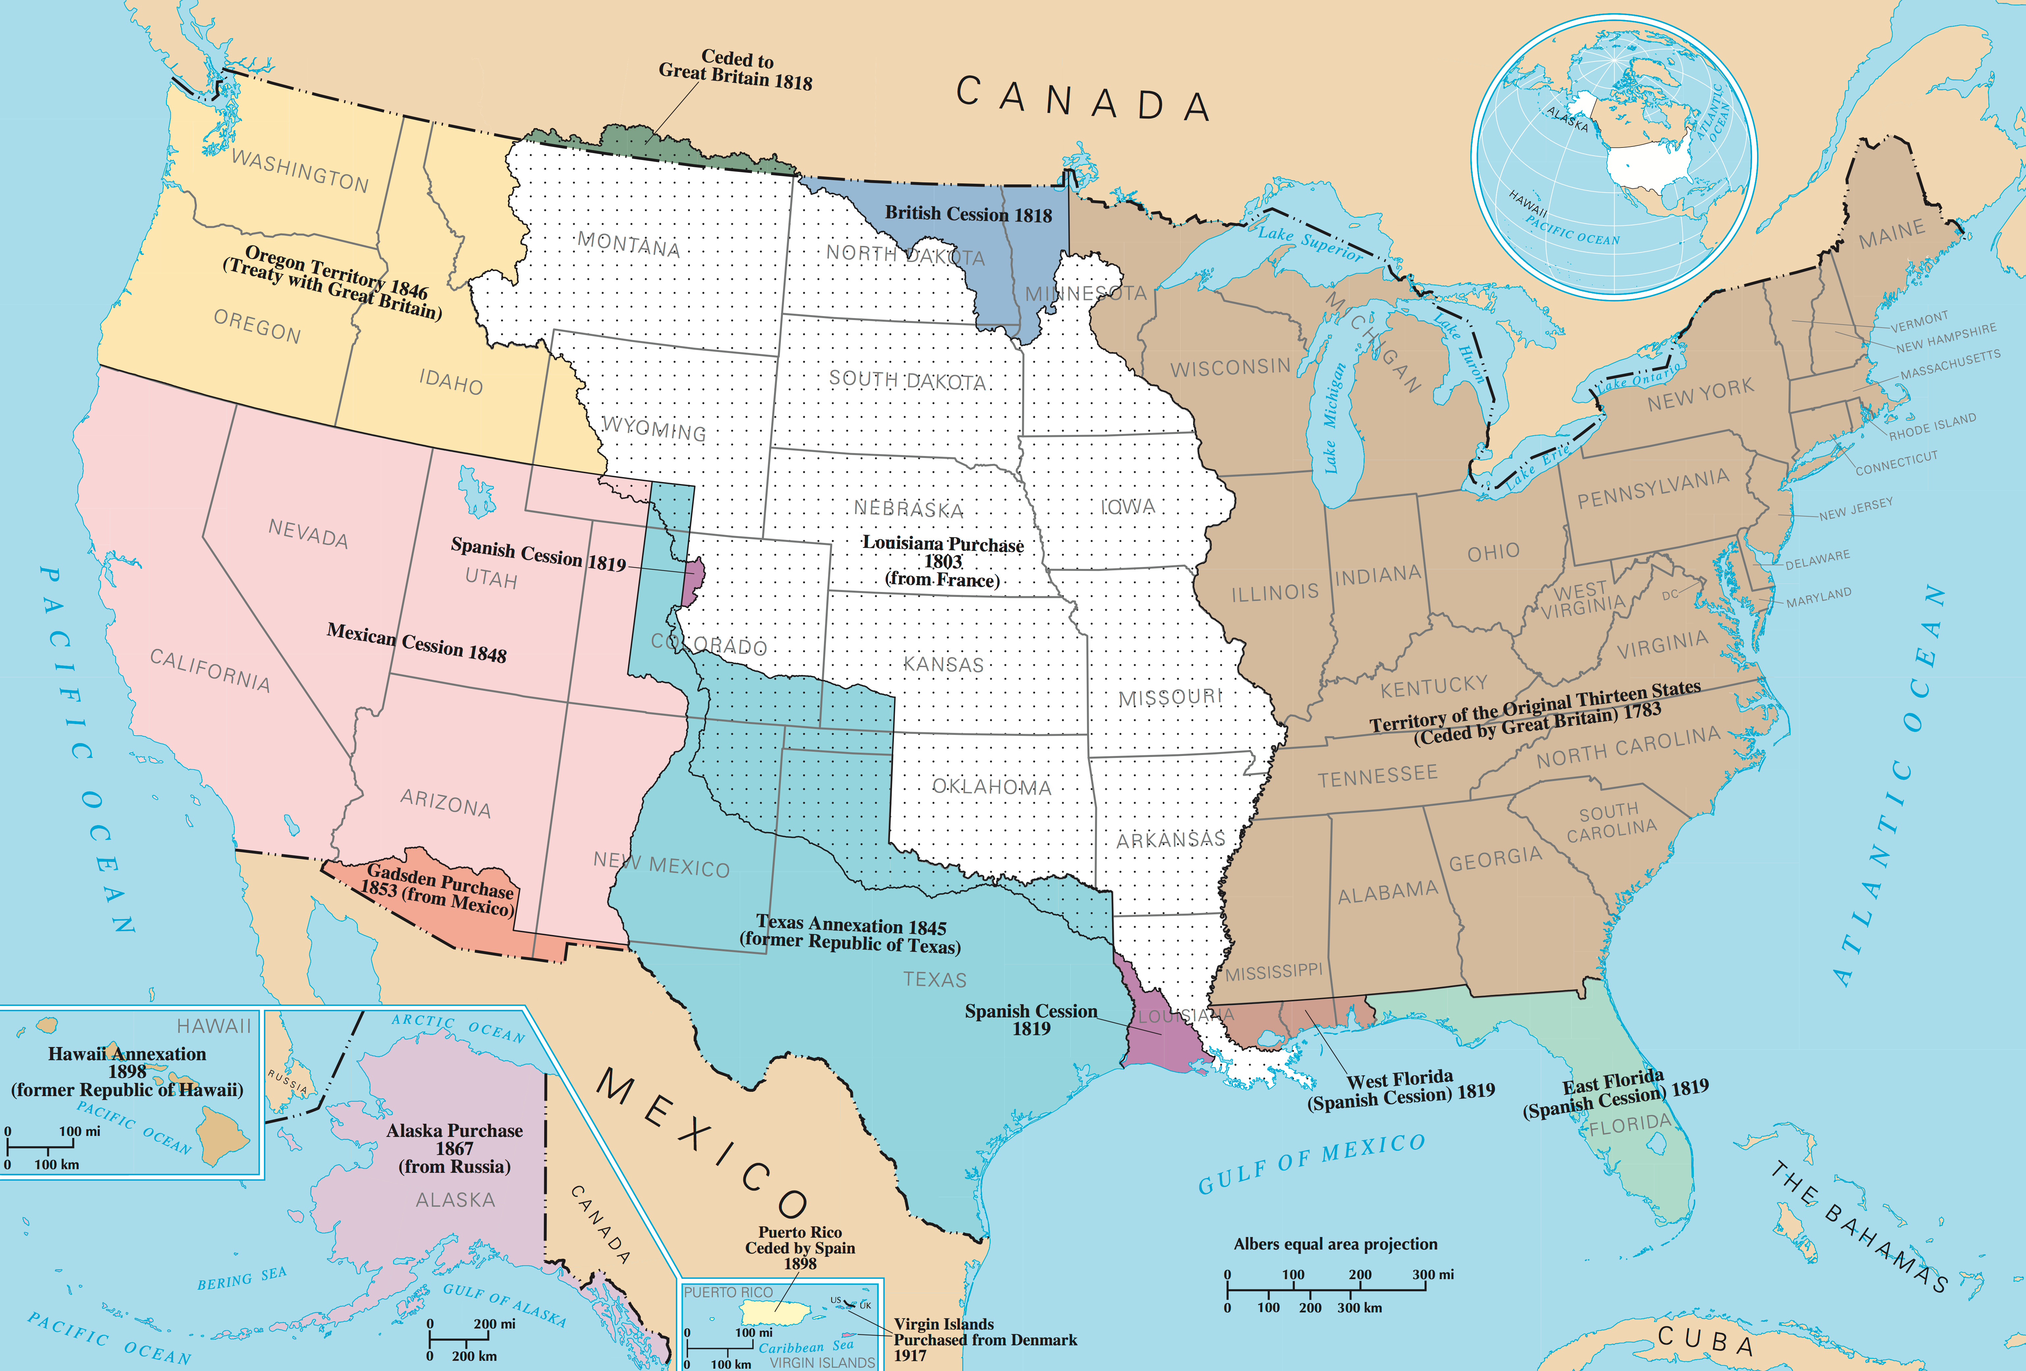

Slide 9
